Slide 1
EPUB Accessibility 101
October 6th 2021
Accessible Publishing and Reading Webinars daisy.org/webinars

Slide 2
Introduction

Slide 3
Your panel
Host: Richard Orme (He/Him/His)
Rachel Comerford (She/Her/Hers)
Macmillan Learning
Tzviya Siegman (She/Her/Hers)
Wiley

Slide 4
Overview
What is an EPUB – the basics
What is an EPUB – HTML
What is an EPUB – DPUB-ARIA and epub:type
Navigation
Metadata – schema and onix

Slide 5
What Is EPUB?

Slide 6
A Quick EPUB Overview
What is the structure of the epub?
Mimetype (file)
META-INF (folder)
container.xml
Folder containing actual content (OEBPS or OPS)
OPF
HTML
CSS
Images

Slide 7
What Does Each Element Mean
Mimetype: All this does is tell the reading system that this is an EPUB.
META-INF: This file points to the package file of the EPUB, so the reading system can find it.
Content Folder: contains everything needed to display the EPUB
Package file (.opf)
HTML, CSS
Images, audio files, videos

Slide 8
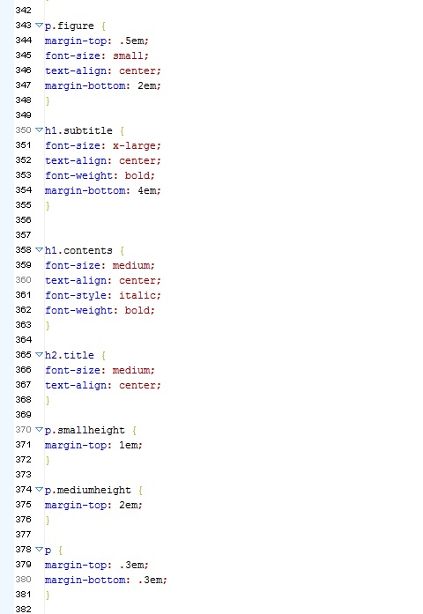
CSS
The Cascading Style Sheet or .css file is the file that describe how the book looks. How big are the headings? How much space between lines? What fonts are used?

Slide 9
What Is EPUB? Focus on HTML

Slide 10
Content Documents in HTML
The text of a publication is written in HTML
HTML has native semantics that convey meaning.
<ul>
<li>Rachel</li>
<li>Tzviya</li></ul>
This conveys visually and non-visually that the contents are a list.

Slide 11
Why does HTML matter?
Every HTML element has a specific meaning
For example
An <h1> is a heading
A <p> is a paragraph
Using the correct element for your content goes a long way to making it accessible

Slide 12
What Is EPUB? DPUB-ARIA and epub:type

Slide 13
What is ARIA? DPUB-ARIA
ARIA - Accessible Rich Internet Applications
Sometimes, content is more complex than the HTML elements available, or the HTML is not as accessible as you want it to be.
ARIA is another way of telling users what a component means.
DPUB-ARIA is a specialized vocabulary for publishing that maps to the epub:type vocabulary
DPUB = Digital Publishing
<nav role="doc-toc" epub:type="toc">
<section epub:type="chapter" role="doc-chapter">

Slide 14
Navigating EPUBs

Slide 15
Understanding the Nav Document
The REQUIRED navigation document is a specialized HTML file that the reading system uses to generate the device’s table of contents. It can also be viewed directly.
The body of the navigation document has one required nav element, the toc, and several optional nav elements.
The most commonly used optional nav elements are the landmarks and the page list. All are structured as ordered lists.

Slide 16
Finding Your Way Around an EPUB
How do you know and find a HTML file that you’re looking for? Think like a reading system.
Open the OPF document
Find the Navigation Document (nav) in the manifest (has properties="nav")
Open the nav
Find the link: <a href="filename.xhtml">Chapter Title</a>
Open the XHTML file for editing

Slide 17
Navigation Table of Contents and Headings
The most common form of navigation in an ebook is the table of contents or headings
These digital elements echo the familiar structure of a print book

Slide 18
Navigation - using Links
Link navigation may be present in the nav but it not exposed in all reading systems
Internal Links
<a href="page_1.xhtml#learning_objectives>Go to Learning Objectives</a>
External links
<a href="https://www.example.com">Example.com</a>

Slide 19
Navigation – Page Numbers
People like page numbers even if there aren't traditional "pages". They help with way-finding.
Include a page-list in the TOC to navigate from anywhere:
<nav epub:type="page-list" hidden="hidden">
<ol>
<li><a href="georgia.xhtml#page752">752</a></li>
Label pagebreaks in the content
<span role="doc-pagebreak" id="pg24" aria-label="24"/>

Slide 20
The Value of EPUB Metadata

Slide 21
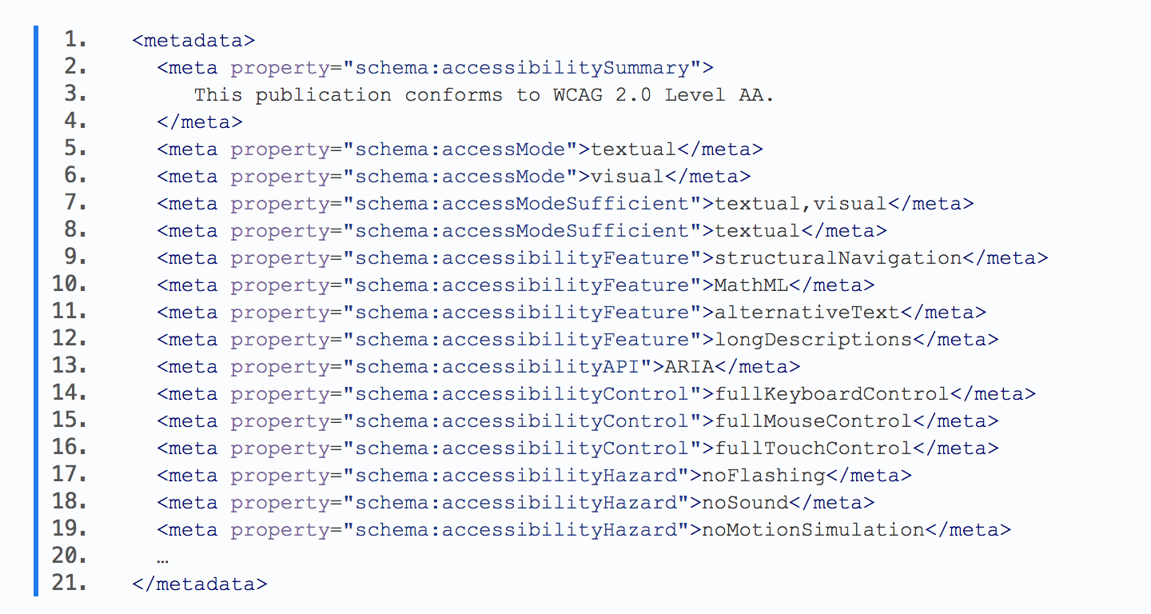
Accessibility Metadata
Where do you find it?
OPF
What is it?
Information about the accessibility features - and limitations - of the EPUB
More info: http://kb.daisy.org/publishing/docs/metadata/schema-org.html

Slide 22
Accessibility Summary
This is the nontechnical, human readable summary of the accessibility of the book.
This publication meets the EPUB Accessibility requirements and it also meets the Web Content Accessibility Guidelines (WCAG) at the double "AA" level. It is screen-reader friendly and is accessible to persons with disabilities. The publication was designed to be as accessible as possible to all persons with disabilities. It is compatible with the wide range of Assistive Technology on the market today. Extensive navigation is provided to make it easy to use via a table of contents and page numbers. All non-decorative images have alt text or captions, or are described in the surrounding text.

Slide 23
Additional Summary Elements
Is there Math? Consider including:
Math was created with and is represented by MathML.
Chemistry?
Math and chemistry was created with and is represented by MathML.
Long/Extended Image Description?
Long descriptions are present for complex images and graphs that are necessary for understanding content.

Slide 24
Resources
DAISY Accessible Publishing Knowledge Base
EPUB Accessibility Using InDesign
EPUB 3.3 and EPUB Accessibility 1.1
BISG Guide to Accessibility
DPUB-ARIA
Aria Authoring Practices

Slide 25
Discussion and Q&A

Slide 26
Wrap up
Webinar video, slide deck and links to resources will be posted at:
daisy.org/webinars
Coming up:
October 14 - DAISY Information Sharing Day
October 20 - Creating and Reading Accessible Math
November 3 - Validating and Conformance Checking of EPUB

