Slide 1
December 9, 2020
Do more with
WordToEPUB
Accessible Publishing and Reading Webinars daisy.org/webinars

Slide 2
House Keeping
Live captioning available:
recommended: daisy.org/webinarCC
or click on CC in the Zoom controls
This webinar is recorded. The video, slide deck and any resources will be posted afterwards at daisy.org/webinars
Use the Q&A feature to submit a question any time.

Slide 3
Your panel
Host: Kirsi Ylänne
Richard Orme
Chief Executive DAISY Consortium
Joseph Polizzotto
Alternate Media Supervisor
UC Berkeley

Slide 4
Overview
Quick refresh
Summary of supported EPUB features
What’s new
Coming soon
Q & A

Slide 5
Quick refresh
WordToEPUB is free to download and use
Currently Windows only
Start with an accessible, structured Word document
End with a beautiful EPUB for any platform, any reading app
Simple mode and Advanced mode
Localized into multiple languages
Download from: daisy.org/wordtoepub
Notes:
Richard will cover the basics

Slide 6
WordToEPUB button on the Word ribbon

Slide 7
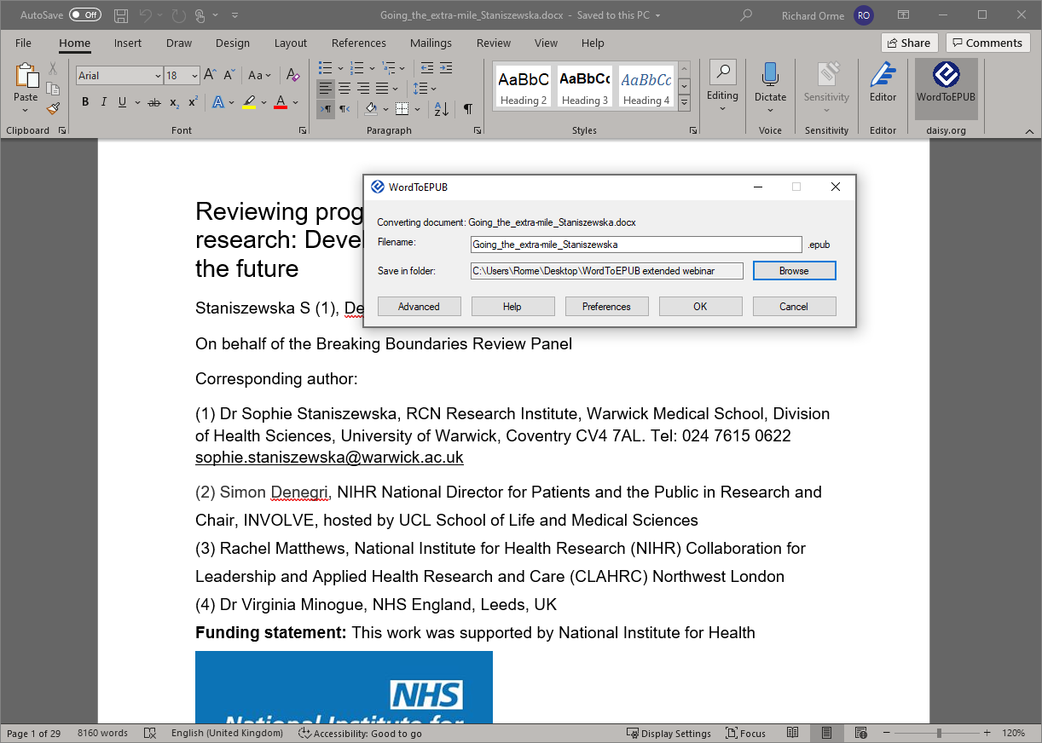
WordToEPUB simple dialog

Slide 8
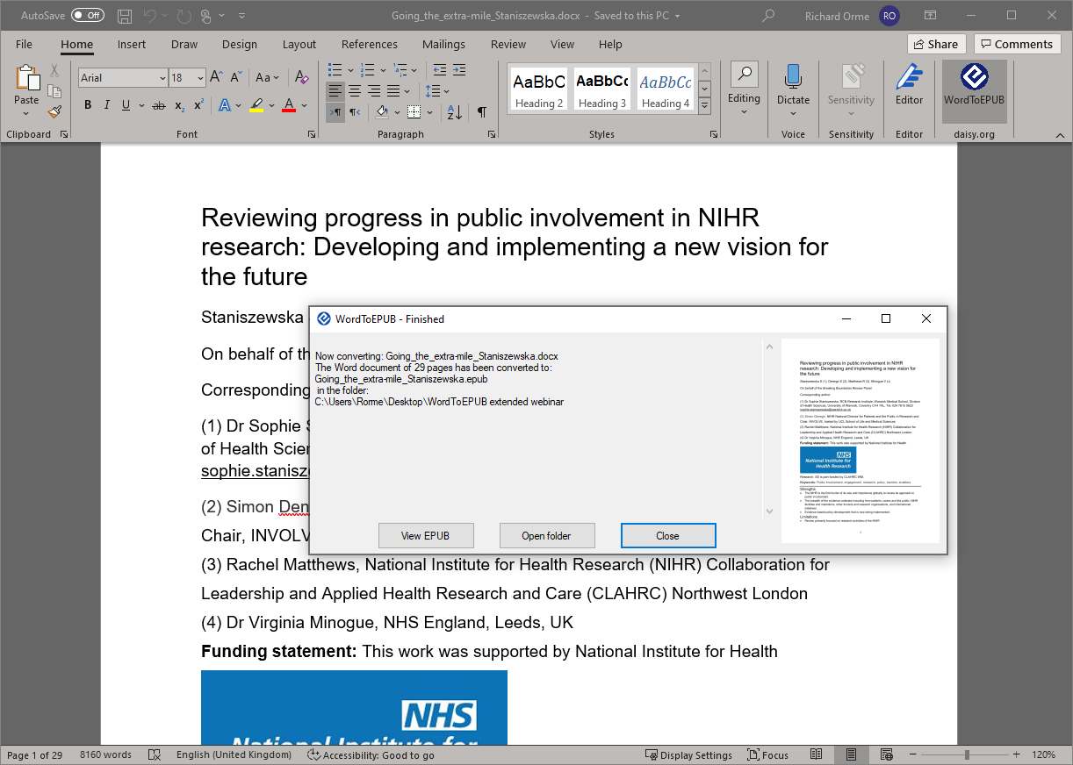
WordToEPUB finished

Slide 9
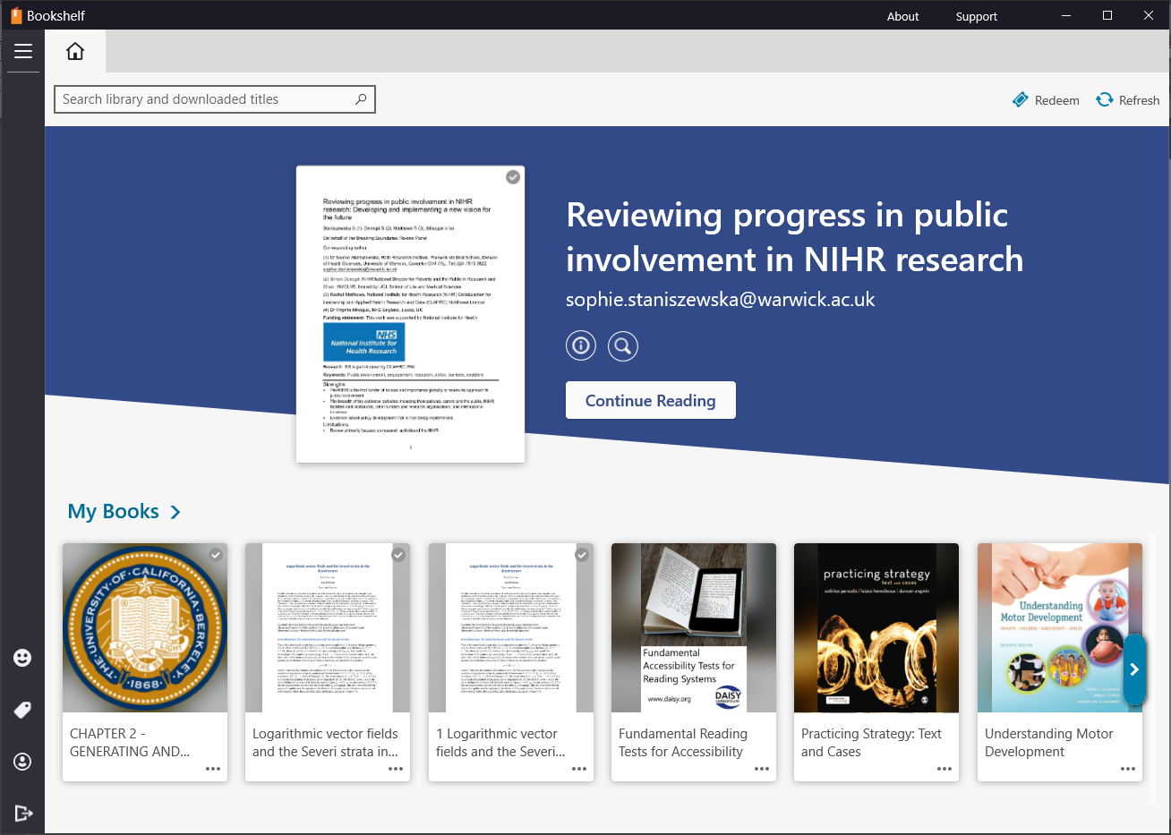
Newly created EPUB added to Bookshelf reading app

Slide 10
Features of EPUBs from WordToEPUB
Accessibility:
Images with alt text or marked as decorative
Navigable tables
Inline language mark up
Math expressions as MathML
Low vision friendly font option
Also:
Add a helpful cover image
CSS stylesheets for visual styling
Rich metadata
HTML output option
Navigation:
Table of contents and marked up headings
Print page navigation
Navigable endnotes
Navigable internal and external links
Semantics:
Bulleted and numbered lists
Block quotes
Asides
Context transitions <hr>
<strong>, <em>, <mark> and <cite>
Notes:
WordToEPUB is used by:
University alt format departments
Specialist services creating accessible school textbooks across Canada
Non profit organisations creating accessible books in Latin America, Africa and South East Asia
Government and other public bodies making accessible versions of reports and other publications
Self publishing authors to create their own eBooks

Slide 11
What’s new?
New default stylesheet
Faster, more reliable language detection
New options for page numbers
Optional metadata summary page
Tweak with Sigil
New Quality Assurance wizard
Generate clean HTML

Slide 12
What’s new?
New default stylesheet
Faster, more reliable language detection
New options for page numbers
Optional metadata summary page
Tweak with Sigil
New Quality Assurance wizard
Generate clean HTML

Slide 14
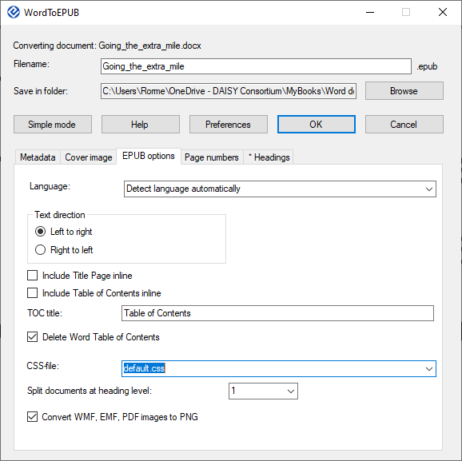

Slide 15
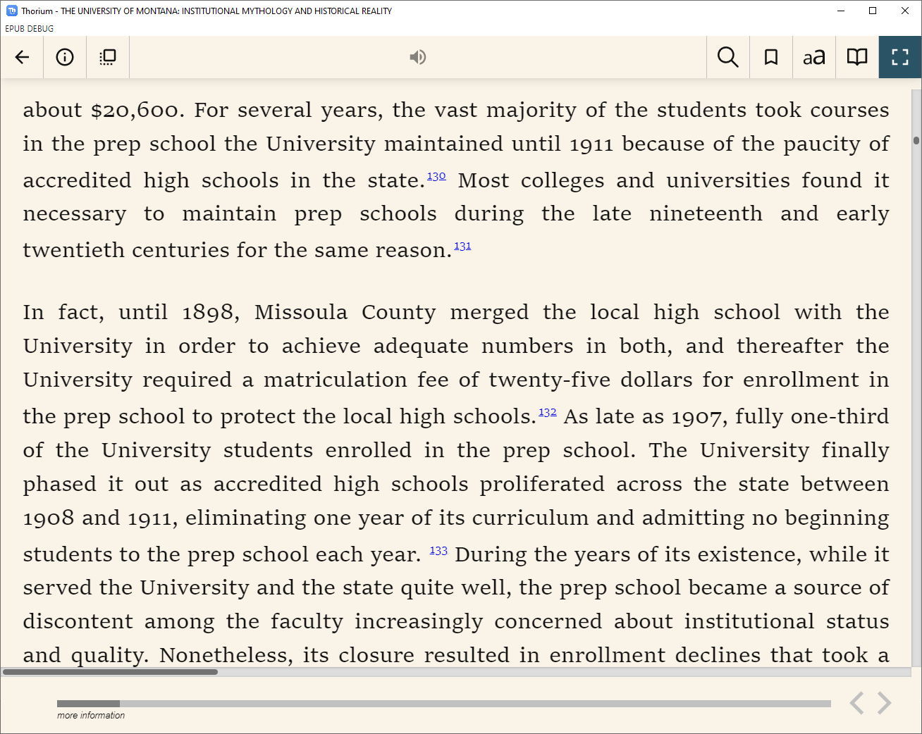
Justification
Superscript reference numbers
Improved paragraph spacing
Better heading formatting

Slide 16
What’s new?
New default stylesheet
Faster, more reliable language detection
New options for page numbers
Optional metadata summary page
Tweak with Sigil
New Quality Assurance wizard
Generate clean HTML

Slide 17
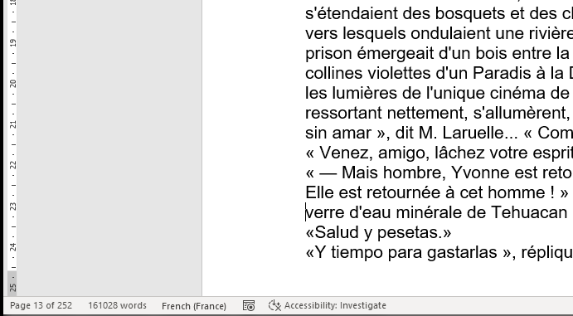

Slide 18
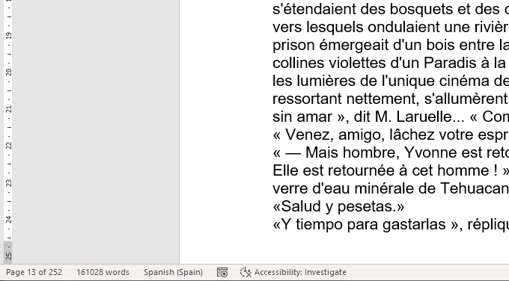

Slide 19
Voice switching (read aloud & screen reader)

Slide 20
What’s new?
New default stylesheet
Faster, more reliable language detection
New options for page numbers
Optional metadata summary page
Tweak with Sigil
New Quality Assurance wizard
Generate clean HTML

Slide 21
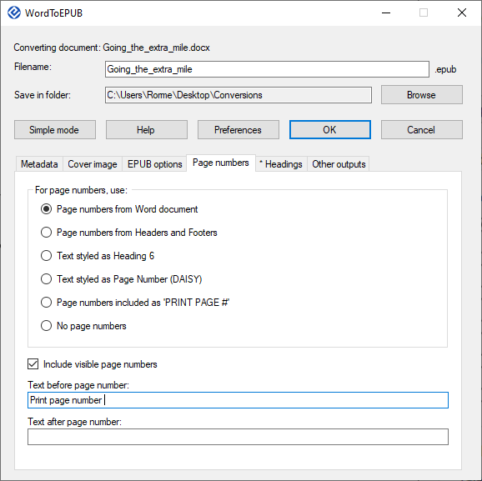
Detect pages with text string
Show page numbers in EPUB
Customize text before and after

Slide 22
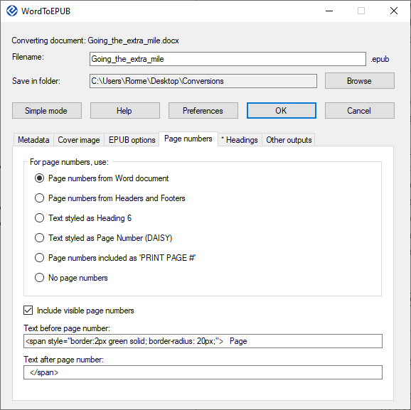
Detect pages with text string
Show page numbers in EPUB
Customize text before and after
Experiment with styling

Slide 23
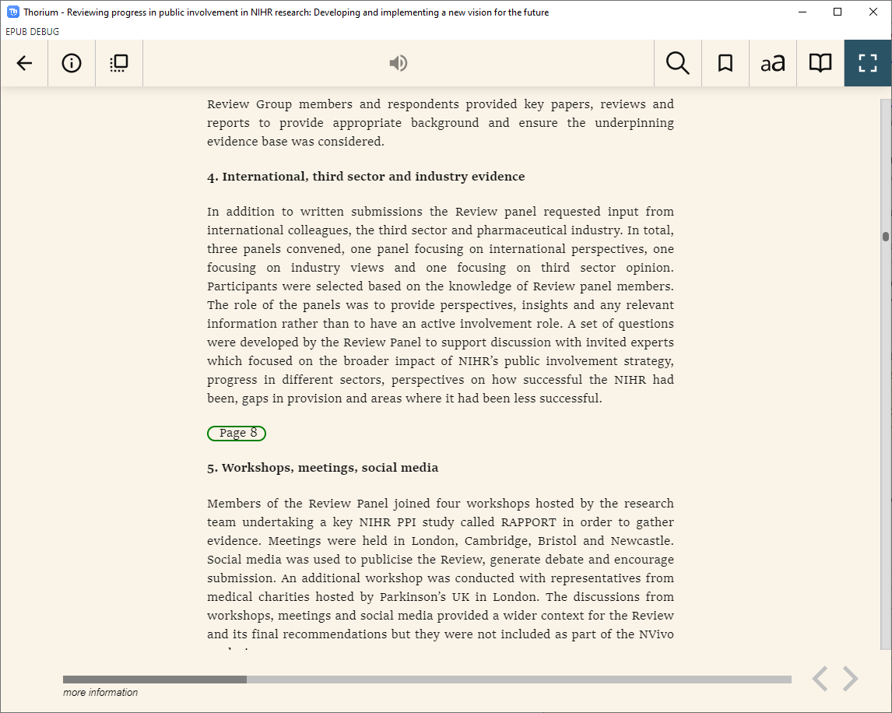
Here the page numbers are included with a border

Slide 24
What’s new?
New default stylesheet
Faster, more reliable language detection
New options for page numbers
Optional metadata summary page
Tweak with Sigil
New Quality Assurance wizard
Generate clean HTML

Slide 25
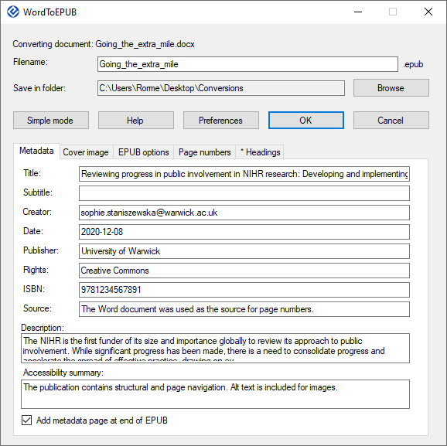

Slide 26
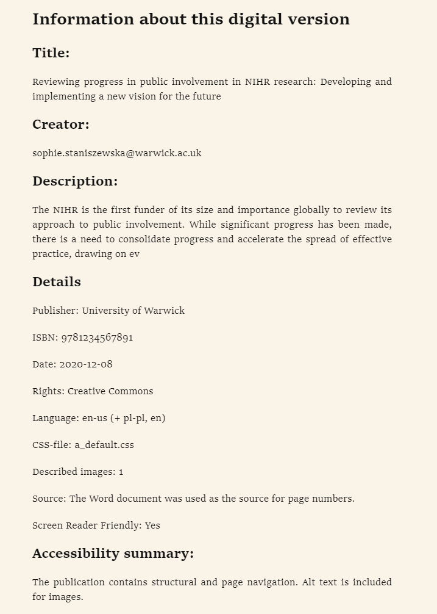
Generates a summary at the end of the EPUB

Slide 27
What’s new?
New default stylesheet
Faster, more reliable language detection
New options for page numbers
Optional metadata summary page
Tweak with Sigil
New Quality Assurance wizard
Generate clean HTML

Slide 28
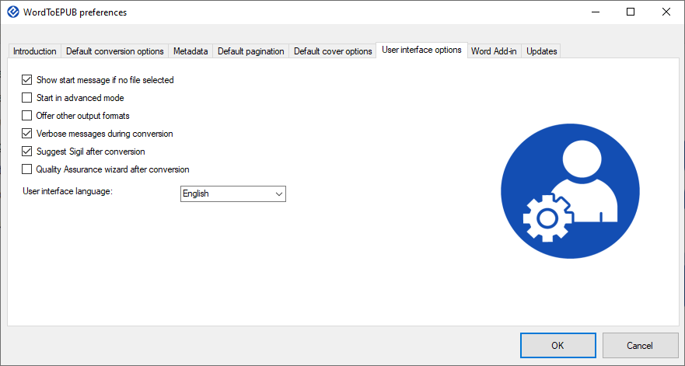

Slide 29
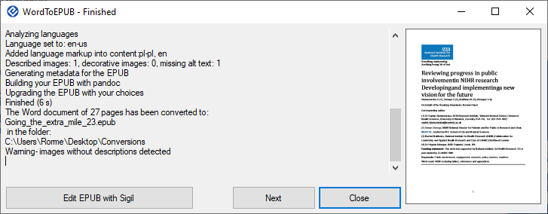

Slide 30
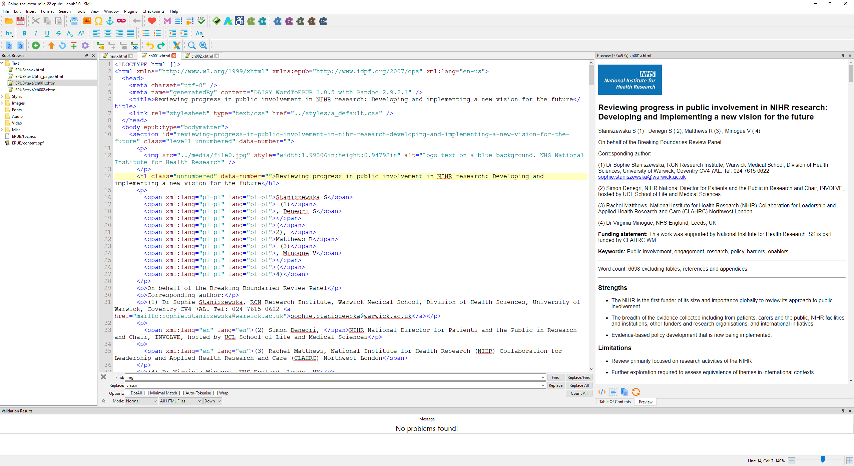

Slide 31
What’s new?
New default stylesheet
Faster, more reliable language detection
New options for page numbers
Optional metadata summary page
Tweak with Sigil
New Quality Assurance wizard
Generate clean HTML

Slide 33
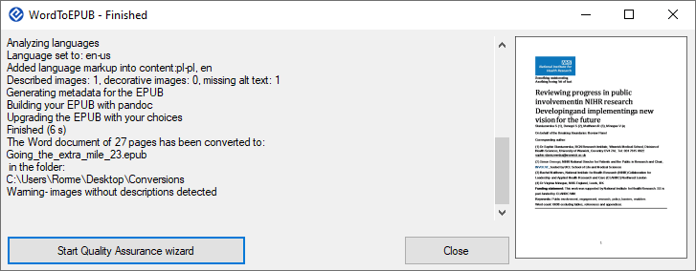

Slide 34
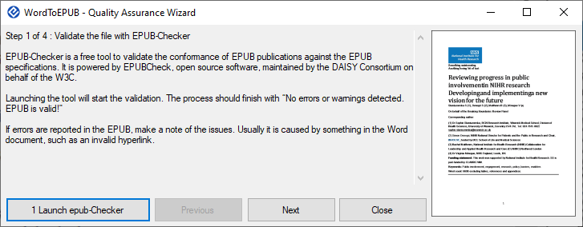

Slide 35
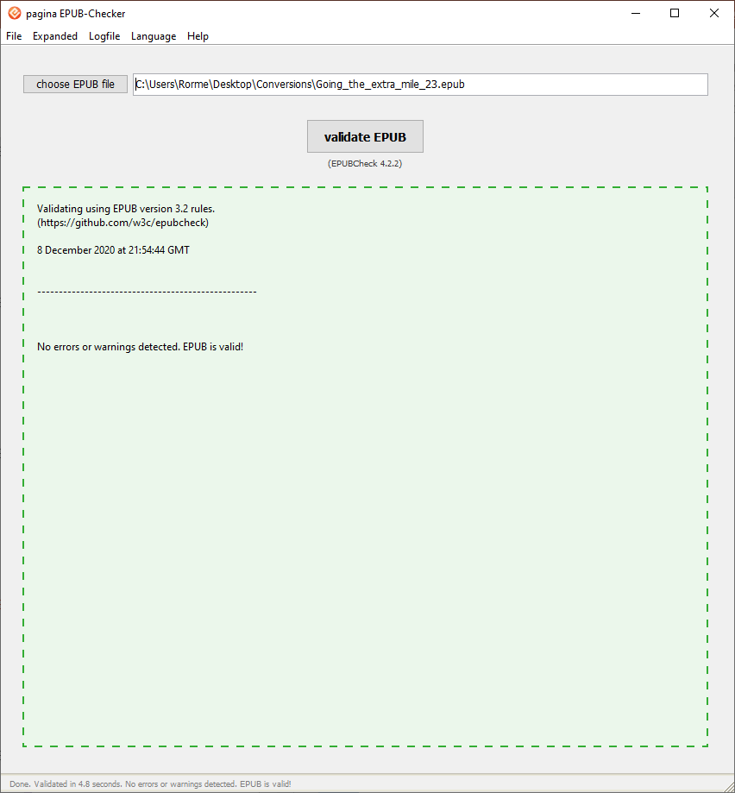
EPUB-Checker will be downloaded if you don’t have it
Selecting this step will launch the program and run a check on the EPUB just generated

Slide 36
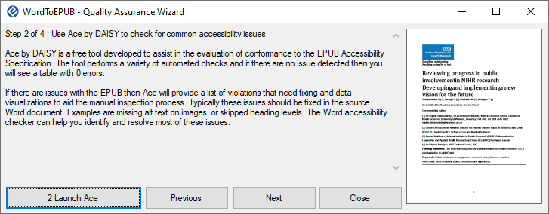

Slide 37
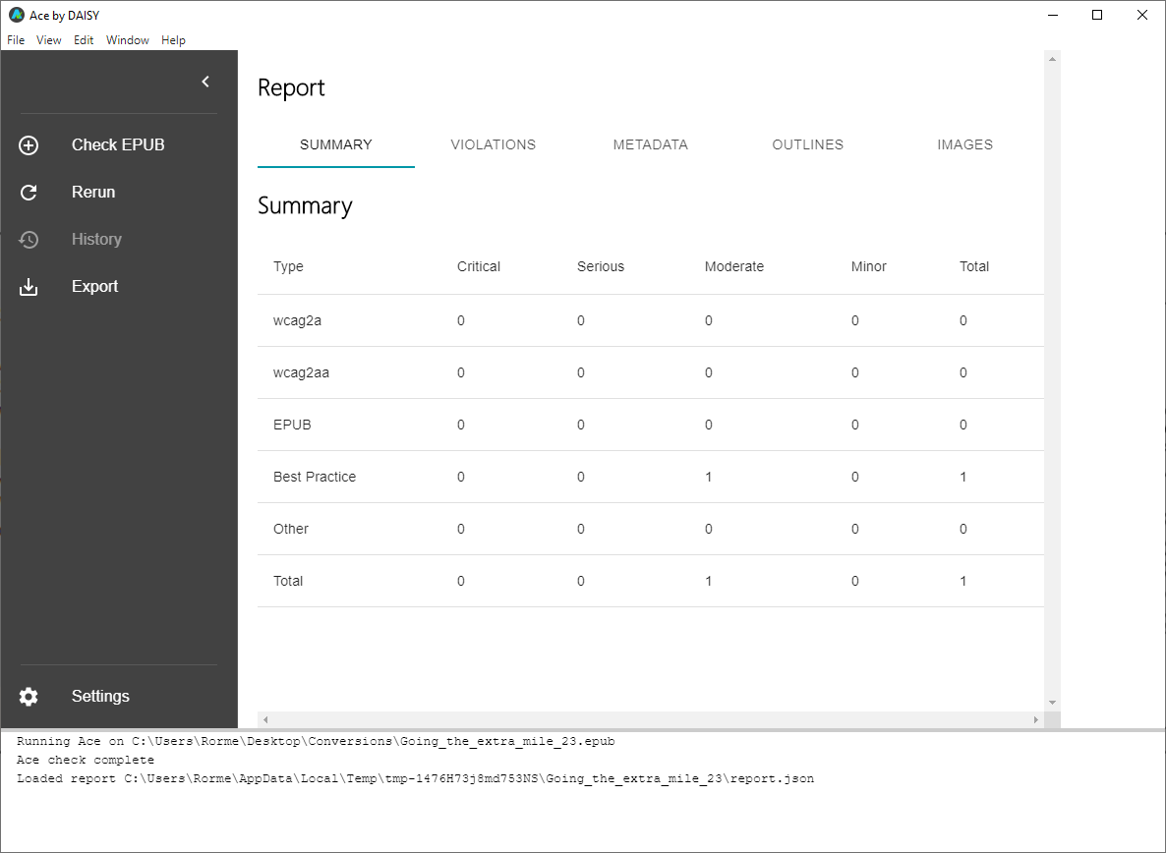
Ace will be downloaded if you don’t have it
Selecting this step will launch the program and run a check on the EPUB just generated

Slide 38
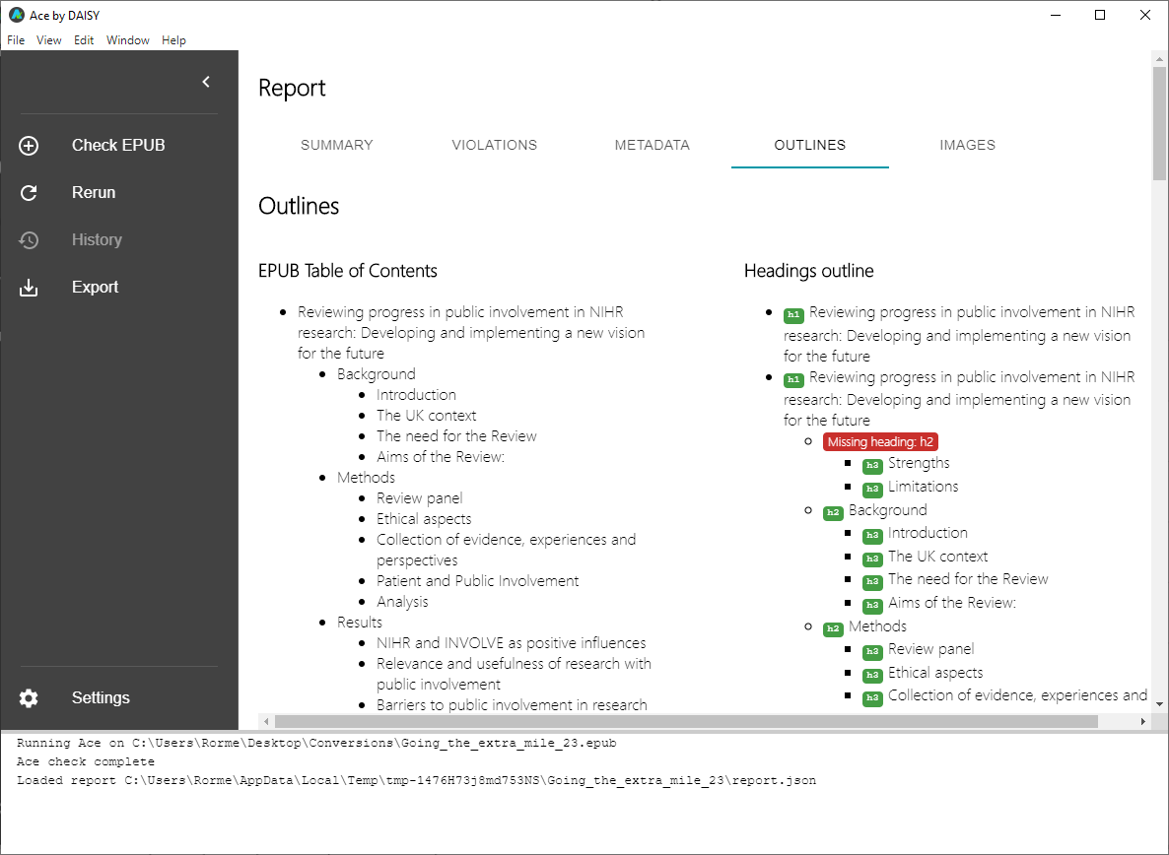

Slide 39
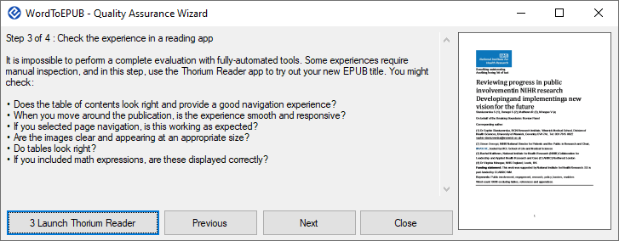

Slide 40
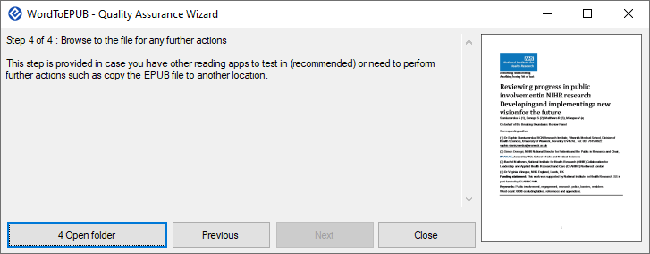

Slide 41
What’s new?
New default stylesheet
Faster, more reliable language detection
New options for page numbers
Optional metadata summary page
Tweak with Sigil
New Quality Assurance wizard
Generate clean HTML

Slide 43
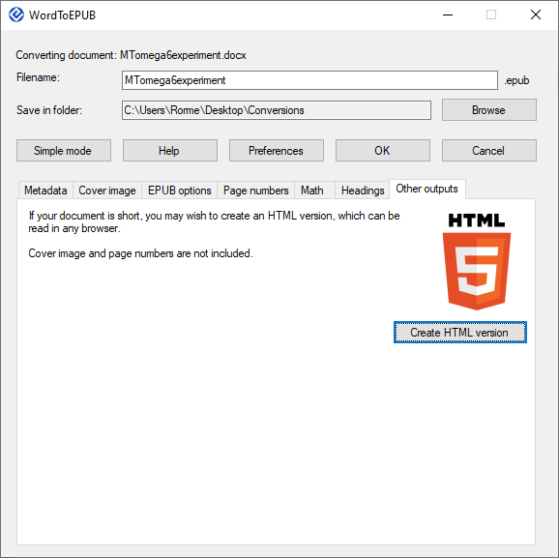
HTML from WordToEPUB
read in any browser
clean HTML
lots more semantic support
math support
Notes:
Semantic support includes: language markup, citations, blockquote, endnotes, image conversion

Slide 44
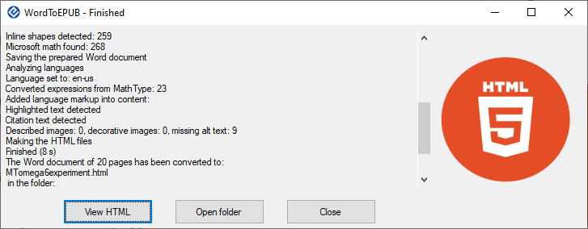

Slide 45
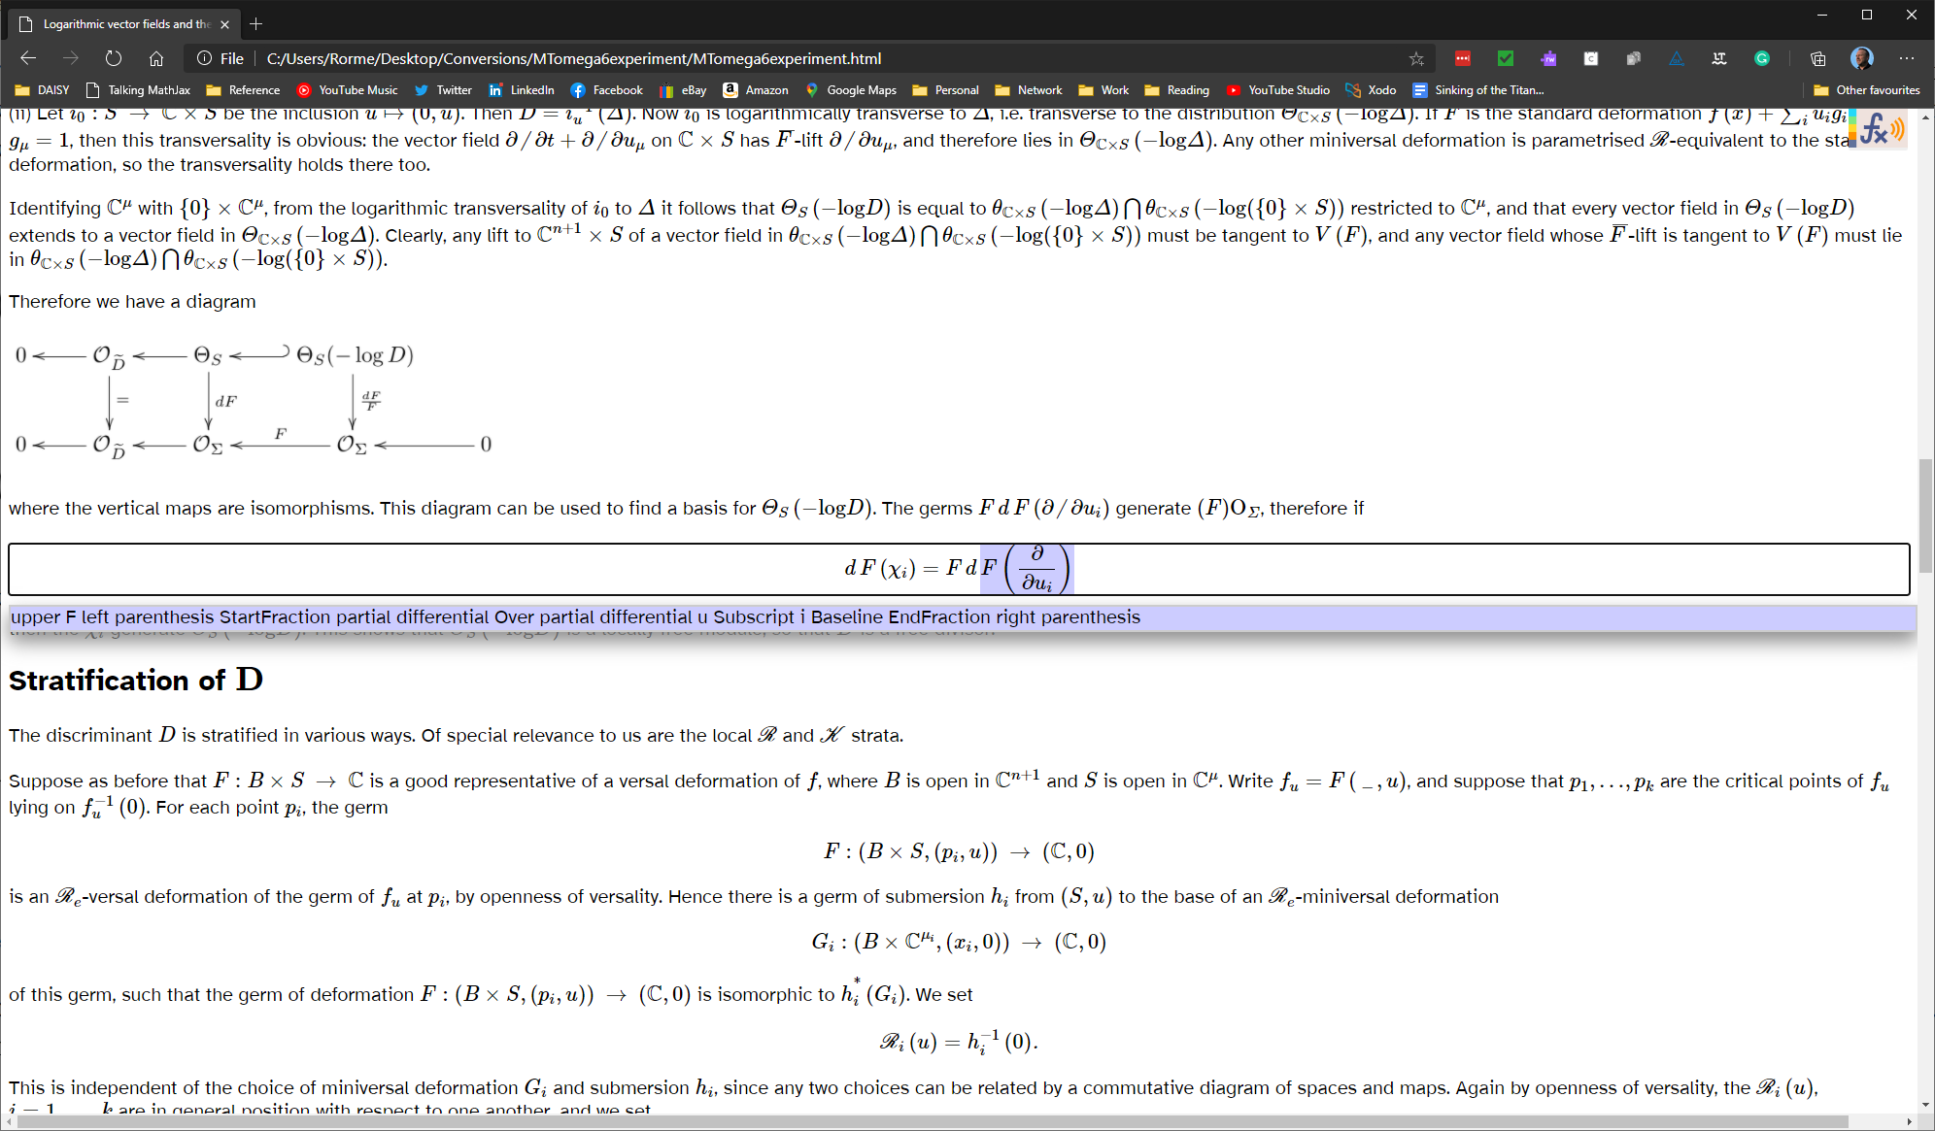

Slide 46
Coming soon
Improved stylesheet / embedded font options
Expandable content in <details>
Support for MathType expressions

Slide 47
Contact information
daisy.org/wordtoepub
wordtoepub@daisy.org

Slide 48
Discussion and Q&A

Slide 49
Wrap up
Webinar video, slide deck and links to resources will be posted at:
daisy.org/webinars

Slide 50
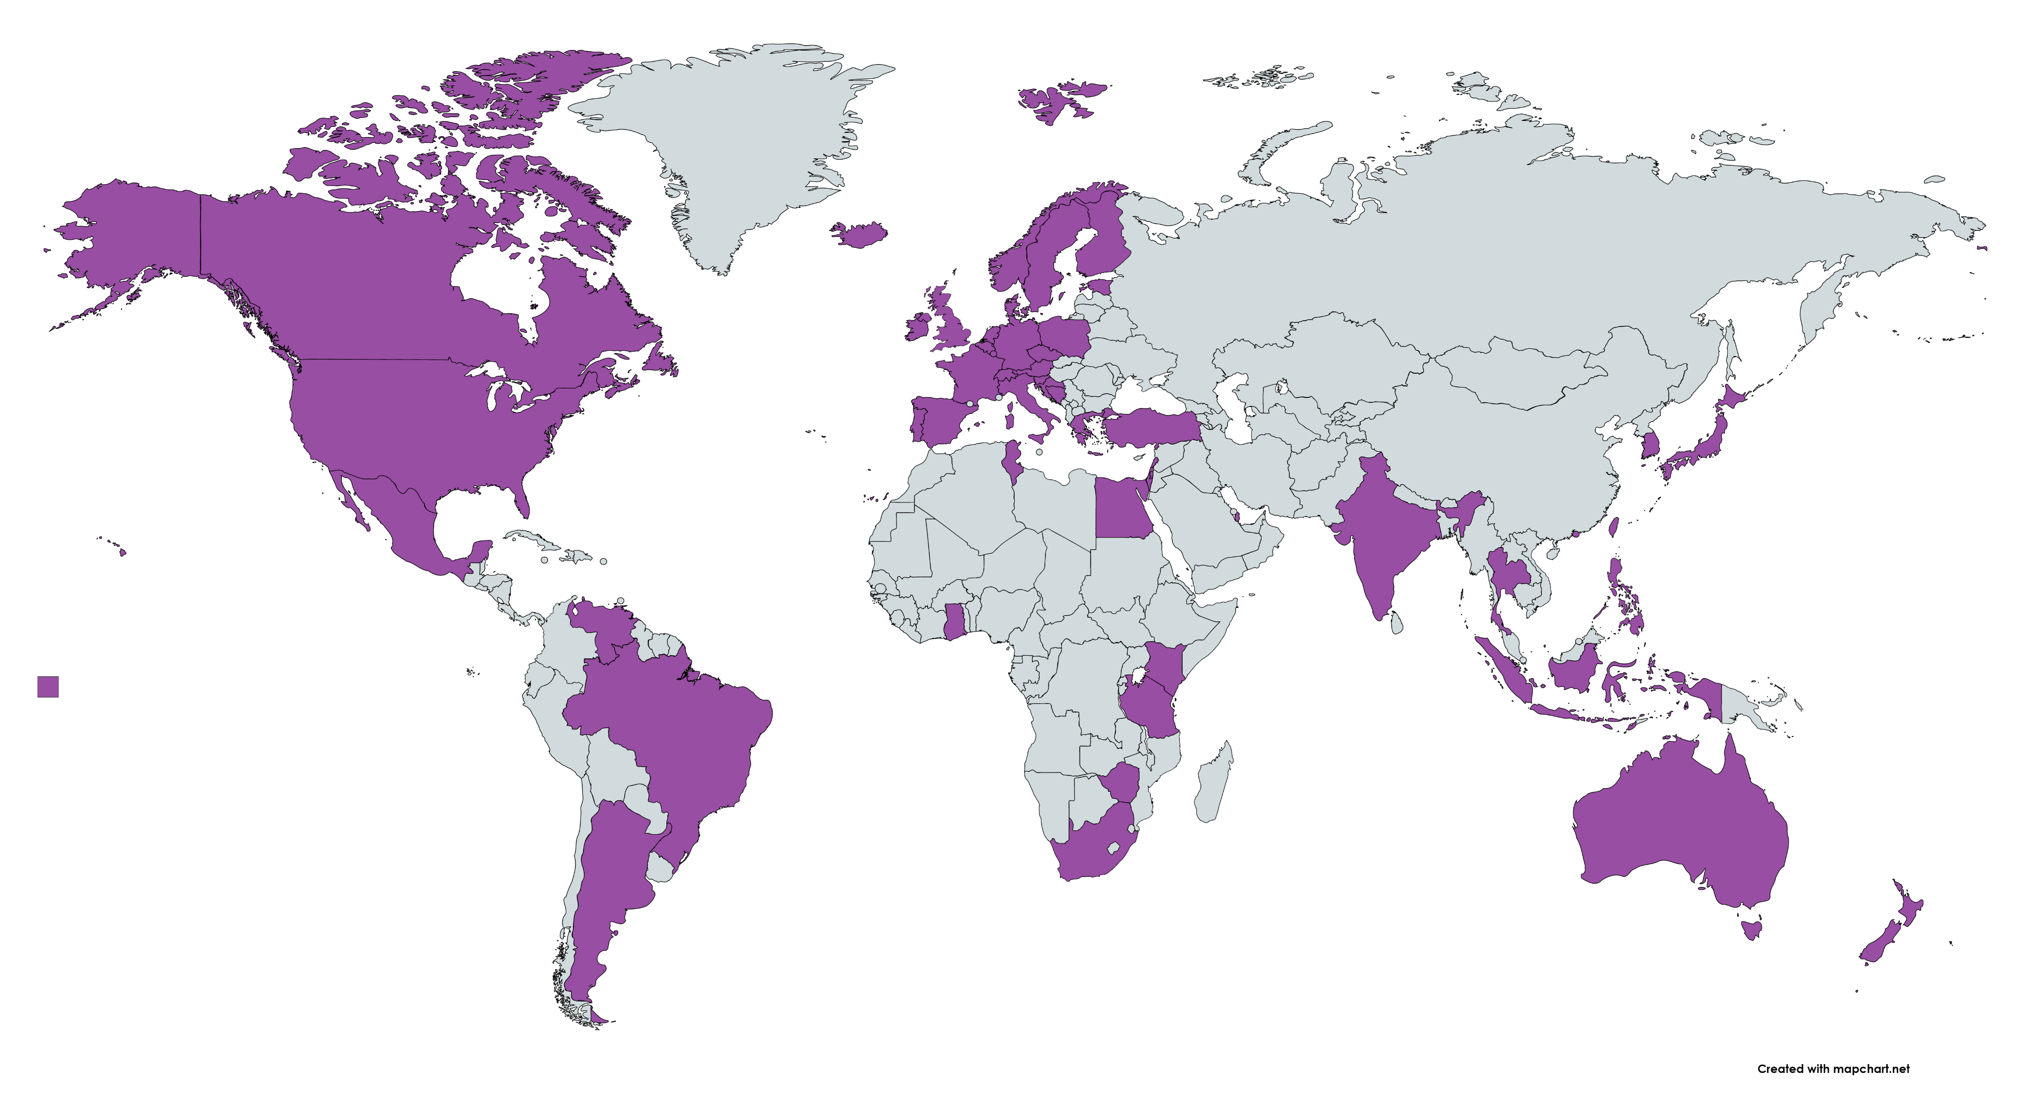
Webinar Participation from 56 Countries
Argentina, Australia, Austria, Belgium, Bermuda, Bosnia and Herzegovina, Brazil, Canada, Croatia, Czechia, Denmark, Egypt, Estonia, Finland, France, Germany, Ghana, Greece, Hong Kong, Iceland, India, Indonesia, Ireland, Israel, Italy, Japan, Kenya, Republic of Korea, Lebanon, Lithuania, Luxembourg, Mexico, Nepal, Netherlands, New Zealand, Nigeria, Norway, Palestine, Philippines, Poland, Portugal, Qatar, Slovenia, South Africa, Spain, Sweden, Switzerland, Taiwan, United Republic of Tanzania, Thailand, Tunisia, Turkey, United Kingdom, United States of America, Venezuela, Zimbabwe.

