Slide 1
AI converting from scanned/PDF content

Slide 2
DAISY PDF Conversion Quality Framework
Richard Orme

Slide 3
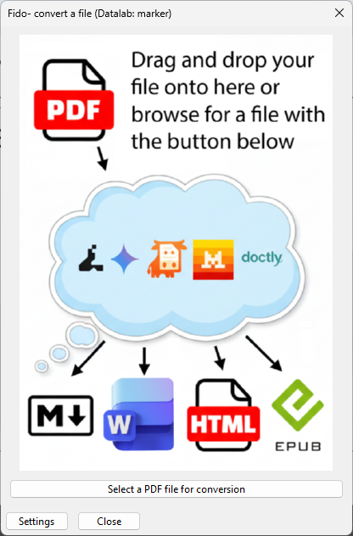
Experimenting with Fido AI
DAISY’s tool for prototyping and experimenting with AI models and workflows
Restricted access
PDF conversion, image description, metadata generation, text-to-speech

Slide 4















Many PDF conversion options
Docling
Doctly
Gemini
Marker
Mathpix
Mistral
MuPDF
Abby FineReader
Adobe Acrobat
Google Drive
Microsoft Word
LlamaParse
DeepSeek-OCR
Nougat
Azure Doc Intelligence

Slide 5
Questions #1
Which methods most accurate when extracting text from scans?
Which can extract text in non-Latin scripts?
How effective are they at removing extraneous text such as watermarks, page numbers, running headers and footers?
Can they figure out the logical reading order?

Slide 6
Questions #2
Are they able to reliably impose heading structure?
Can they detect and mark up lists, textboxes?
Do they do a good job of detecting and extracting images?
Can they handle complex tables?
How accurate is the conversion of math expressions?

Slide 7
Public leaderboards/reviews
Intelligent Document Processing Leaderboard
https://parsio.io/blog/mistral-ocr-test-review
GitHub - datalab-to/marker: Convert PDF to markdown + JSON quickly with high accuracy
OCR comparison: Datalab vs Mistral | by Yuxuan | Medium
https://www.actuia.com/en/news/mistral-ai-launches-mistral-ocr-a-new-benchmark-in-document-understanding
AI Document Intelligence: Benchmarking Pipelines | Dot Square Lab
OmniDocBench: Benchmarking Diverse PDF Document Parsing with Comprehensive Annotations

Slide 8
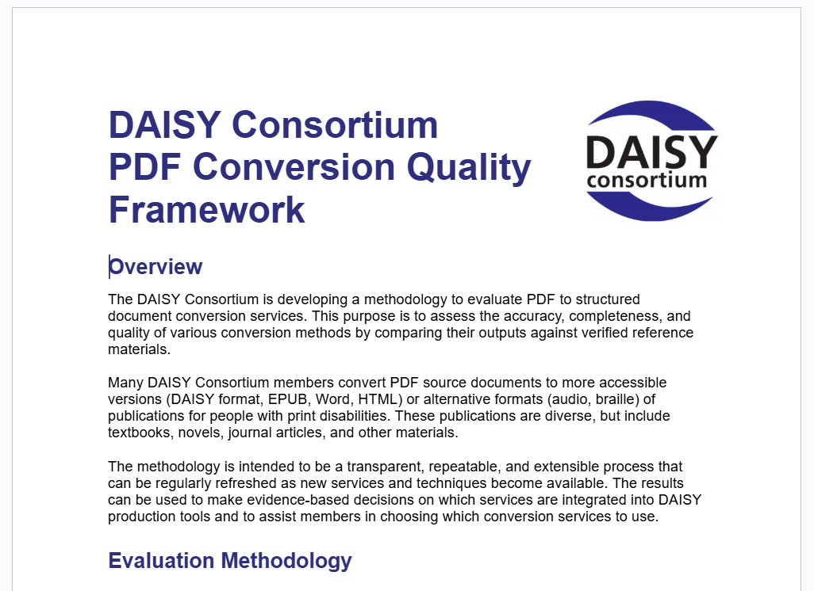
What to evaluate?
DAISY Consortium PDF Conversion Quality Framework
Assess PDF conversion against 25 parameters
Text accuracy
Document structure
Content semantics
Images, tables & math
Metadata

Slide 9
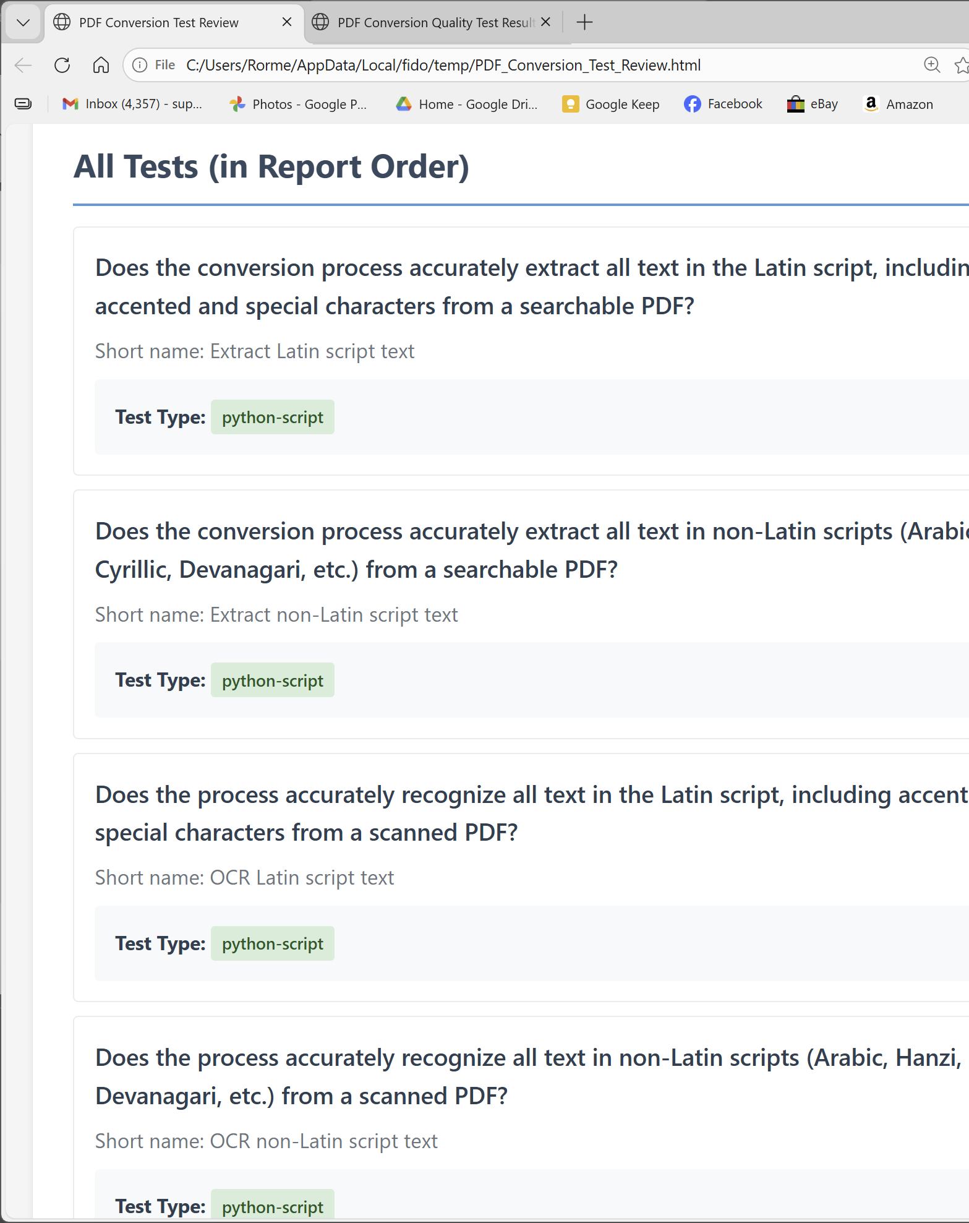

Automated testing #1
Transparent
Repeatable
Extensible
Test with different documents
Test with new conversion solutions
Improve or add more tests

Slide 10
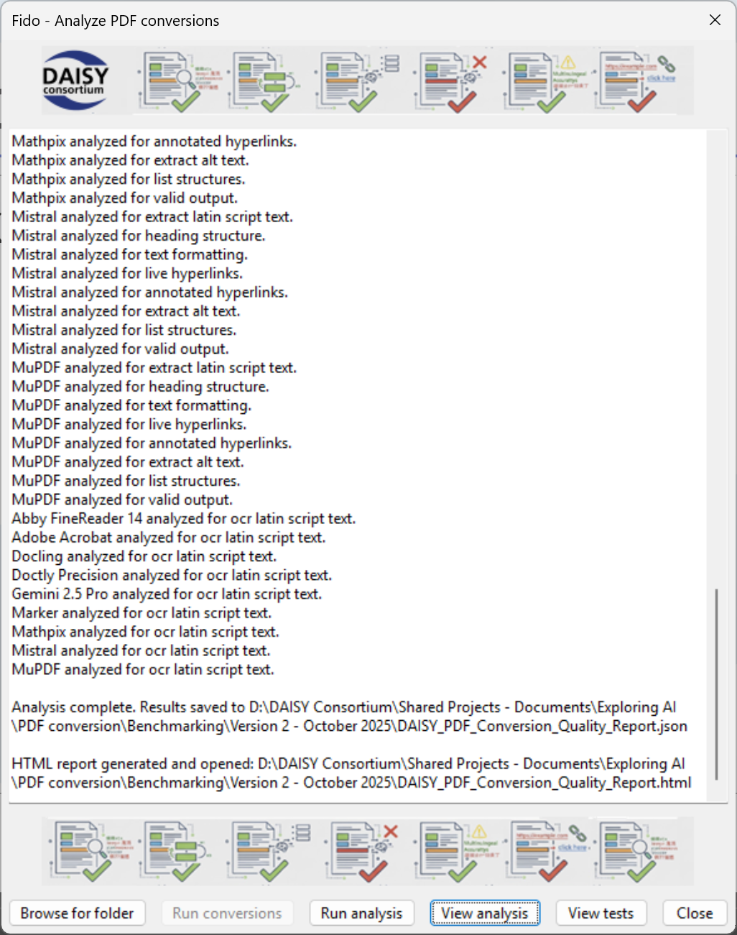
Automated testing #2
Testing against parameters such as extracting text from image PDFs and searchable PDFs, heading structure, identifying links and lists, alt text.

Slide 11
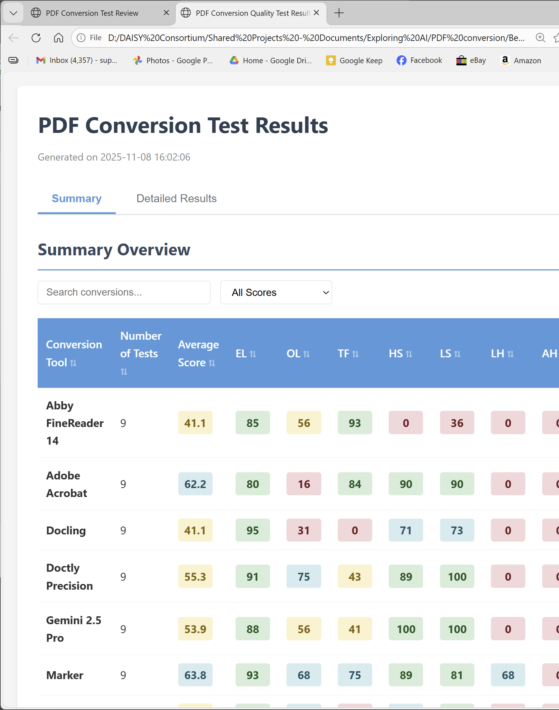
Automated testing #3
Now evaluating variety of PDF conversion solutions to create a matrix of 90 test scores.
For more detailed explanation and to get involved send your technical people along to the AI Special Interest Group.

