Slide 1
DAISY Working Group – Reading Apps User Requirements Kirsten de Haan

Slide 2
Background / start
Users want more from their reading experience, e.g.:
Combination of audio and text
Image descriptions (but not always)
Filling in answers in the publication itself
Reading systems do not all support all requested functionalities
Proposal to DAISY Board, November 11 2024:
Approved December 2024
Project to define an internationally agreed set of user needs for reading apps
Software, not hardware
Focused on specialized apps for people with print disabilities (but mainstream can benefit as well)
DAISY Working Group: Reading Apps User Requirements

Slide 3
How we got here
Kickoff Meeting
December 2024
Series of weekly / biweekly online group meetings
From January 2025 – October 2025
Interrupted by periods of review
Meetings with app developers about technically challenging theme
Filling in Answers
June 2025
Period of review for Release Candidate
October 2025
User Requirements Specification 1.0 LIVE on the DAISY Consortium website
October 31, 2025
DAISY Working Group: Reading Apps User Requirements

Slide 4
Who contributed
Representation from many organizations and countries
User organizations
Accessible content providers
Specialized app developers
Accessibility experts
Passionate engagement
Thanks to everybody involved for sharing expertise in thoughtful contributions, discussions and feedback
DAISY Working Group: Reading Apps User Requirements

Slide 5
What we have (1)
Specification LIVE on DAISY website:
https://daisy.org/activities/standards/reading-apps-user-requirements/
Short URLs
Landing page: https://daisy.org/readingURS/
Specification: https://daisy.org/s/readingURS/
>120 user requirements, ordered by 11 themes
E.g. navigation, read aloud, embedded audio, bookmarking, entering answers, and bookshelf and library management
DAISY Working Group: Reading Apps User Requirements

Slide 6
What we have (2)
Section on additional user requirements for future consideration
18 ideas identified as valuable but not prioritized in the current cycle
a starting point for future work
e.g. integration of AI-powered features
18 user stories
executive summary
DAISY Working Group: Reading Apps User Requirements

Slide 7
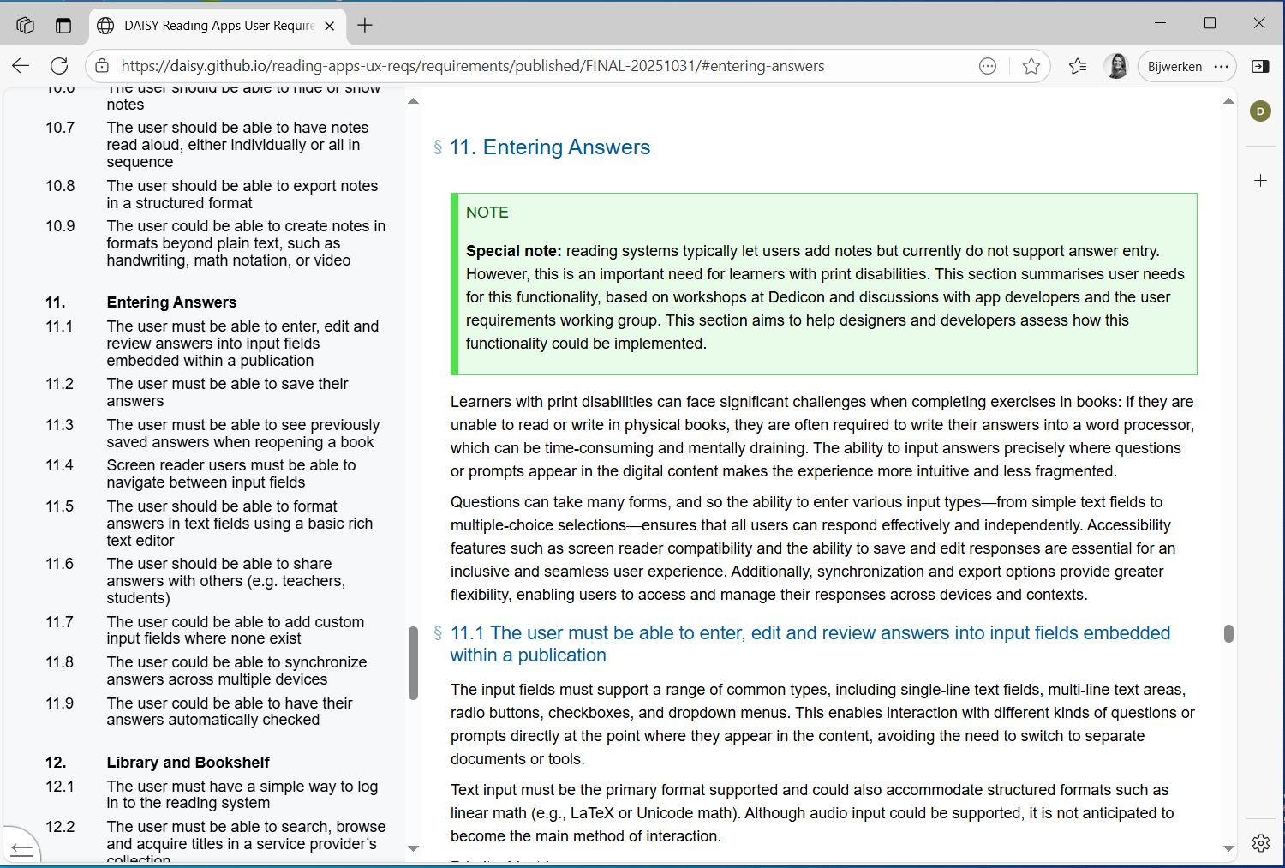
Reading Requirements Screenshot
Notes:
Worked on the presentation – navigable table of contents in the sidebar, etc. Invitation to check out the specification for yourselves

Slide 8
What other are saying
“Appreciate you sharing with us. The user stories are wonderful to read through!”
Google
"This is fantastic! It's comprehensive, well structured, clearly written, and best of all, authoritative.“
Bill Kasdorf
“Thanks to everyone who contributed to this fine document. […] We have already included it in our product development roadmap”
App developer
DAISY Working Group: Reading Apps User Requirements

Slide 9
What’s next
Execute (final steps of) dissemination plan
Motion to the Board: Formal approval of the specification
DAISY Working Group: Reading Apps User Requirements

