Slide 1

Word Document Accessibility 101
March 10th 2021
Accessible Publishing and Reading Webinars
daisy.org/webinars

Slide 2




Your panel
Host: Richard Orme
Erin Williams, Microsoft
Kirsi Ylänne, Celia
Prashant Verma, DAISY Consortium

Slide 3
Overview
Why Accessibility?
Microsoft Accessibility and Word
Demo of Accessibility Barriers and Solutions
Word Document Structure
Graphics, Tables and Content Considerations
Testing for Accessibility
Your Questions

Slide 4
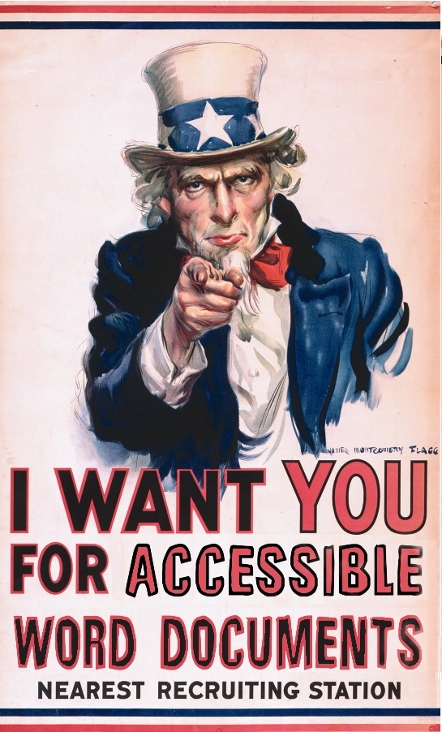
Why accessibility?
Not only is it is the right thing to do…
… but in some case it is the law
Not only about screen reader users
It requires some effort (but not a lot!)
You can do this!

Slide 5
Microsoft and Accessibility
Microsoft’s mission - Empower every person and every organization on the planet to achieve more
  Every person, empowered, in every context
We are taking an integrated approach to inclusion
  Culture
  Systems
  Products
  Future
Notes:
On this slide Erin can talk a little about Word and Microsoft’s commitment to accessibility. There is a later slide specifically on the Accessibility Checker that maybe Erin can speak to. I copied the transcript of Erin’s piece in the WordToEPUB session.

Slide 6

Word and accessibility
Microsoft Word is currently the most widely-used word processor on the market
The application is accessible and widely taught
Built-in features to support and encourage accessibility
The techniques covered in this webinar apply to Windows, macOS and online versions of Word.

Slide 7
Examples of a11y barriers / solutions #1
Text content as an image
Missing heading structure
No image descriptions
Notes:
Now we are going have a look at three examples of accessibility barriers and solutions to barriers.

Slide 8
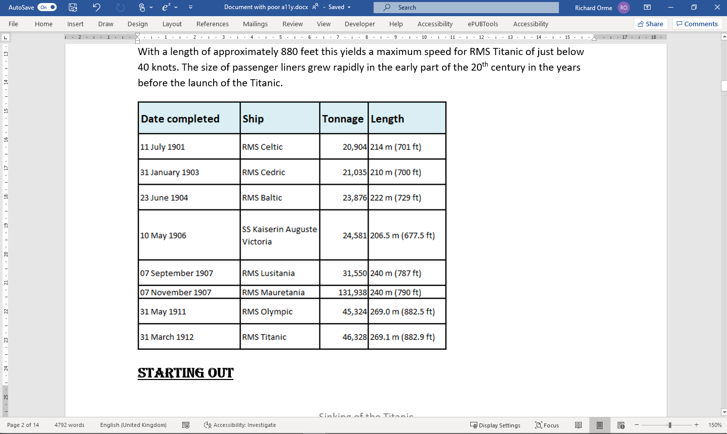
Table as an image #1
Notes:
Sometimes text content is included as an image. Perhaps a quotation with an image behind, a stylized heading or a table copied from a spreadsheet as in this example.
If text is included as an image it cannot be read with read aloud or on a braille display, and it is not possible to copy and paste text from an image.

Slide 9
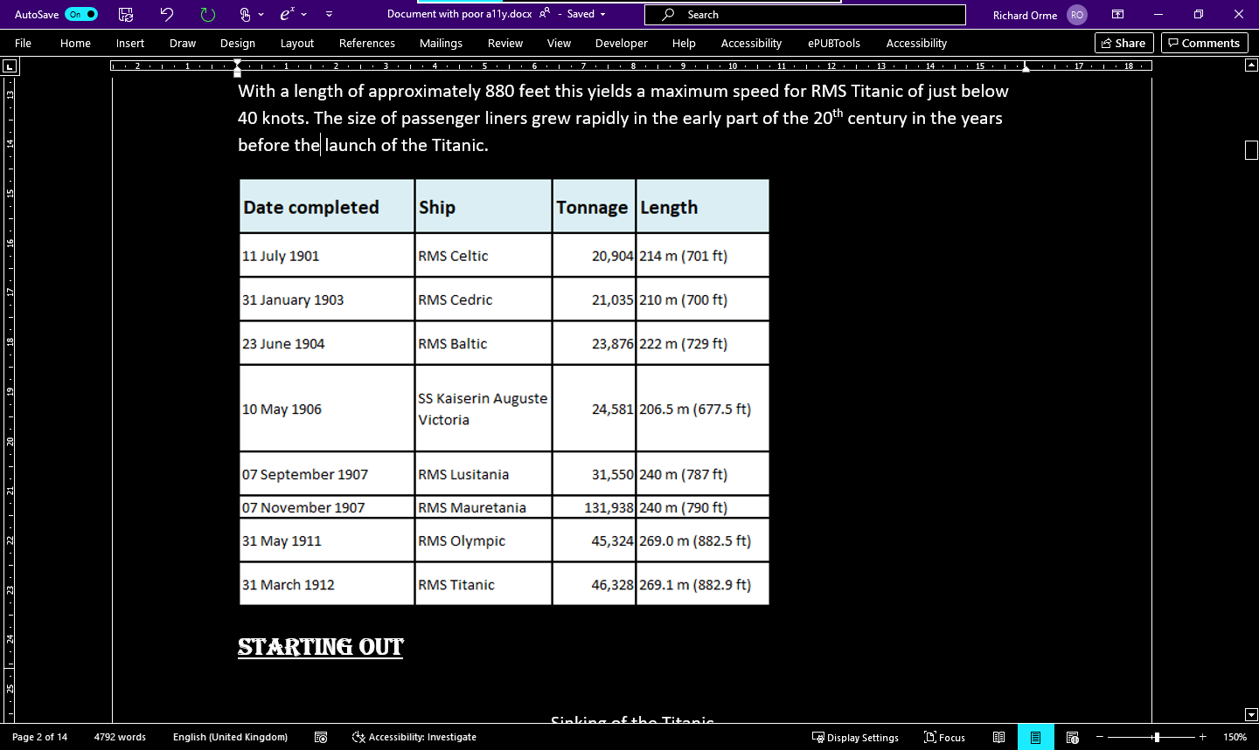
Table as an image #2
Notes:
Also, if someone with low vision uses a high contrast scheme then the table as an image will not display correctly. Here the High contrast scheme in Windows has been used so display becomes white text on black, but the table in the Word document stays in the same colors because it was included as an image.

Slide 10
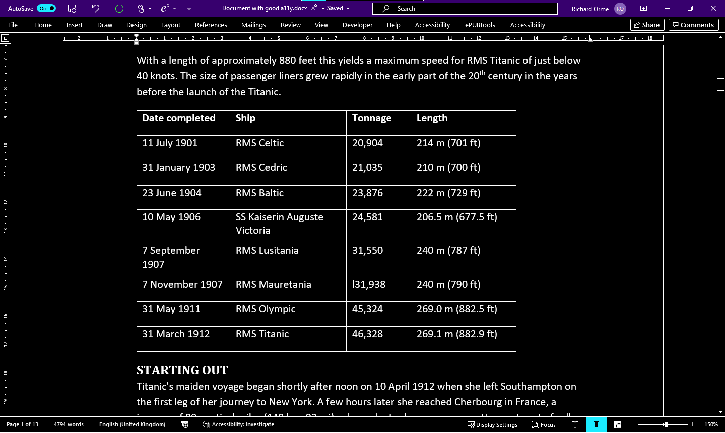
Table as an image #3
Notes:
Now the table is inserted into the Word document as a proper table. It now changes color according to the user preferences. Similarly, the fonts can be changed, the text made bigger, and it can be explored by someone using a screen reader. Text content included as images present a barrier to accessibility, as we see in this example. Following the correct approach means the document is accessible to users with various disabilities.

Slide 11
Examples of a11y barriers / solutions #2
Text content as an image
No heading structure
Missing image descriptions

Slide 12
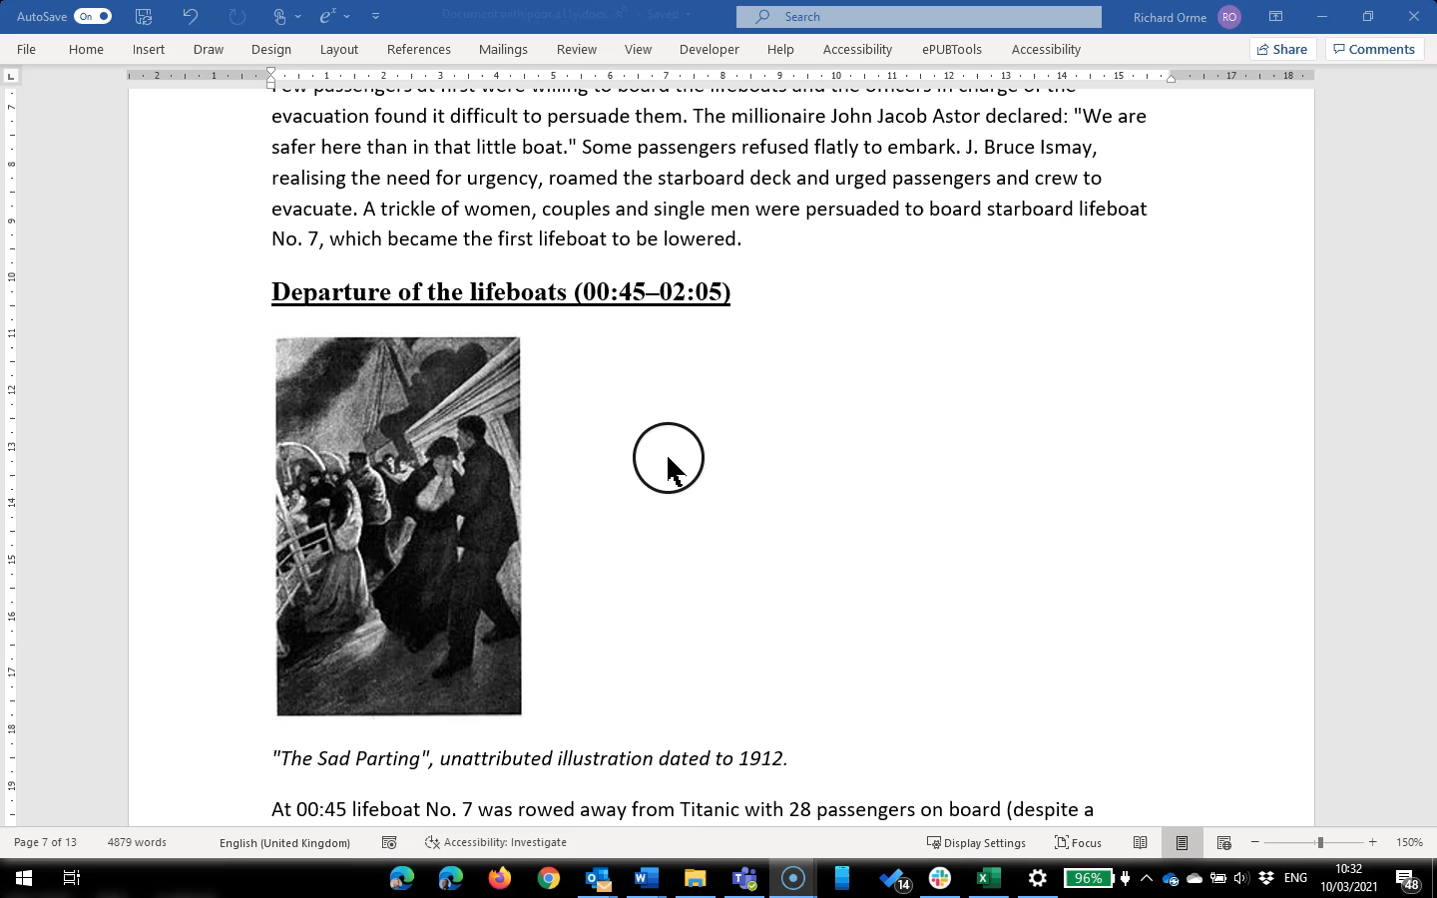
No heading structure

Slide 13
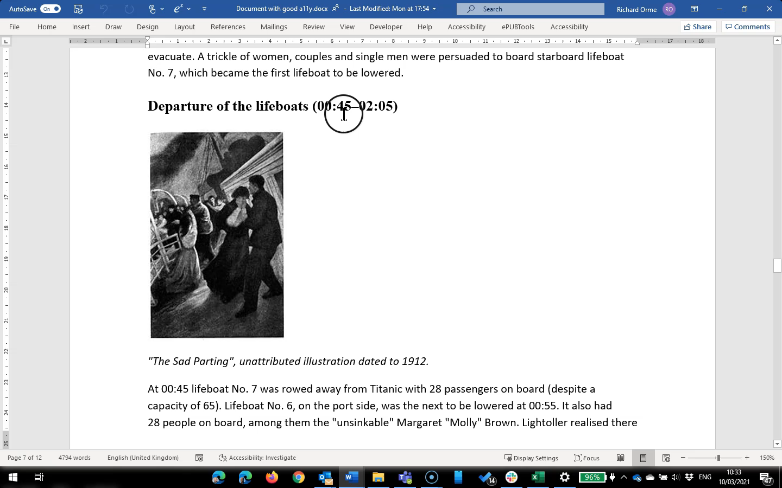
With heading structure

Slide 14
Examples of a11y barriers / solutions #3
Text content as an image
No heading structure
Missing image descriptions

Slide 15
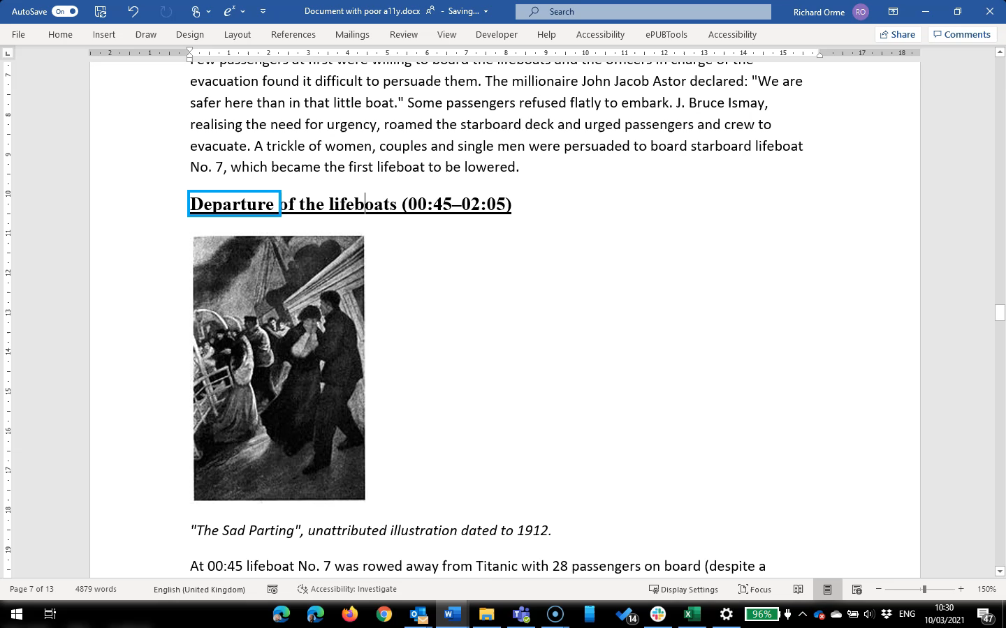
Missing image descriptions
Notes:
Pay attention what happens when the focus in on the image

Slide 16
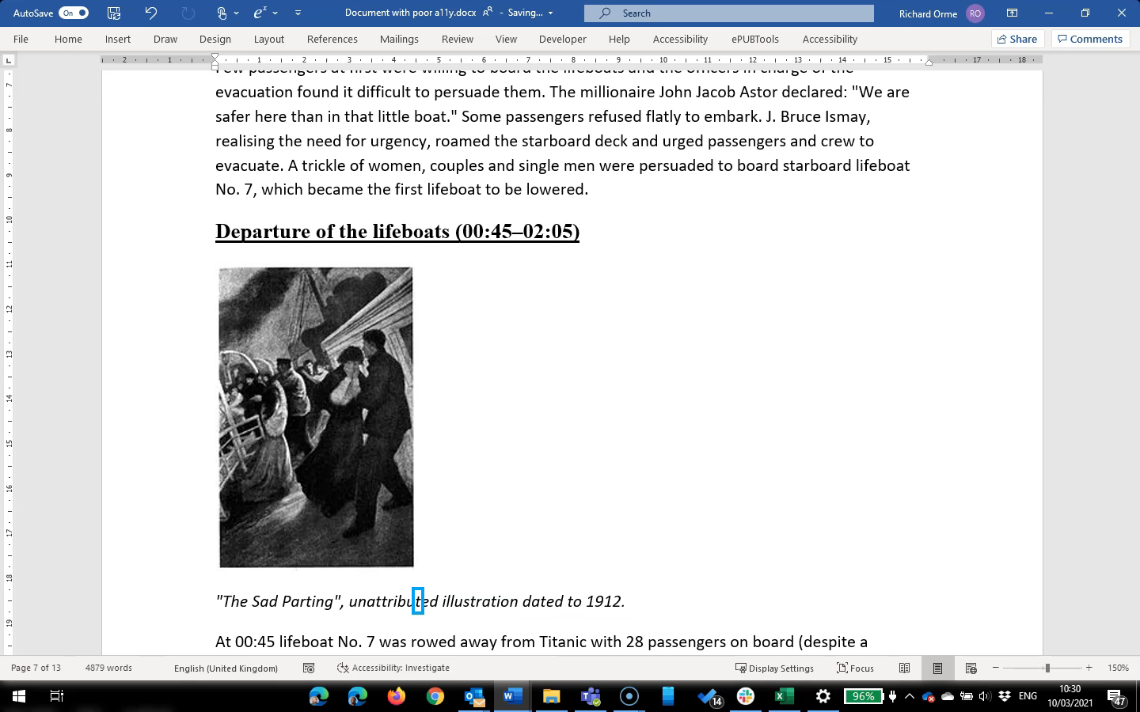
With image descriptions

Slide 17
Word Document Structure
Applying heading style- use Navigation pane
Lists- use proper Word bullet and numbered list feature
Textboxes- (avoid, use paragraph with border instead)
Notes:
(I'm just writing something for me and edit later when I've seen the videos.) In the demo video, we had two Word documents that looked similar. However, only one of them was accessible. The most important thing to know about the accessible Word documents, is that you have to use heading style for marking up headings. Do not rely on the visual layout, but make sure that the structure of the document is marked up correctly. The heading styles contain information that is conveyed to assistive techology. You heard on the video screen reader saying "heading x". If you want to convert your Word document to another format, those styles are needed to create necessary tags in an accessible PDF or EPUB publication. When you use heading styles, use them in a logical and consistent way. Use style Heading 1 for main heading(s) and Heading 2 for subheadings. If you want to use subheadings in sections which have a Heading 2, use Heading 3 etc. Do not skip over heading level, for example from Heading 1 to Heading 3. That is confusing.
If you have many headings in your Word document, you can check the heading hierarchy. Select View tab from the ribbon and then check box Navigation Pane. On the left-hand side of the document will appear a pane which shows all the headings that are made with heading styles. Headings marked with the style Heading 1 are leftmost and subheadings are indented. Using Navigation Pane is one way to check visually fast the heading structure.
Other styles should be used in a same way as headings. So if you want to have a list in your Word document, use the bulleted or numbered list for your list. This makes sure that the users of AT will also know when there is a list in the document. For the normal or main text of the document, use Normal style and modify the font and paragraph settings. If you want to have text in a box, do not insert a Text Box. Text Boxes do not work well with screen readers. Instead of inserting Text Box, edit the text paragraph and add border to the paragraph. In this way screen readers will be able access the text.

Slide 18
Graphics
Image placement (inline vs floating)
Adding alternative descriptions
Decorative images
Notes:
You might already use styles in Word documents, so you are producing quite accessible Word documents. You can further improve the accessibility of your Word documents by making sure that your pictures and images are accessible.
When you insert a picture, make sure that the picture is in line with text. Check the layout options of the picture. When the picture is in line with text, screen readers can access the alternative text of the picture. If the picture is floating, the screen readers may ignore the image and its alternative text. There may also be problems if you are converting the Word document into another format.
The screen readers cannot magically scan images. You need to add alternative texts for images. Before you start writing the alternative text or alt text, you should think what is the purpose of the image. What information the image contains and what is told in the body text? Don't repeat things that are already told in the text, but focus on the information that is important and only seen in the image. Remember that the alt text is meant for people who use screen readers and only they can access the alt text.
Unfortunately, we don't have now time discuss more how to write alt texts, but previous Daisy webinars have covered this matter. Go to the Daisy webinar page and look three webinars titles The Art and Science of Describing Images. You will find excellent information about how to describe image. Let's now have a look how to add alt text in Word.

Slide 19
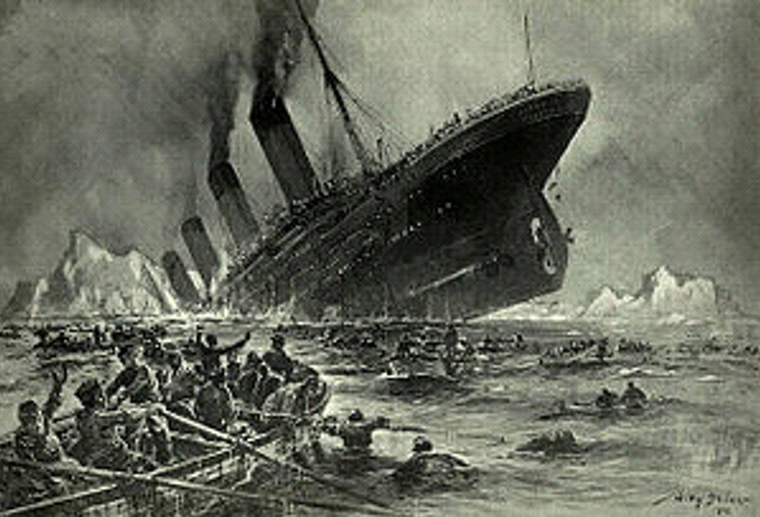
Alt text #1
Notes:
Select the image. If you use a mouse, right-click on the image and choose Edit Alt Text.

Slide 20
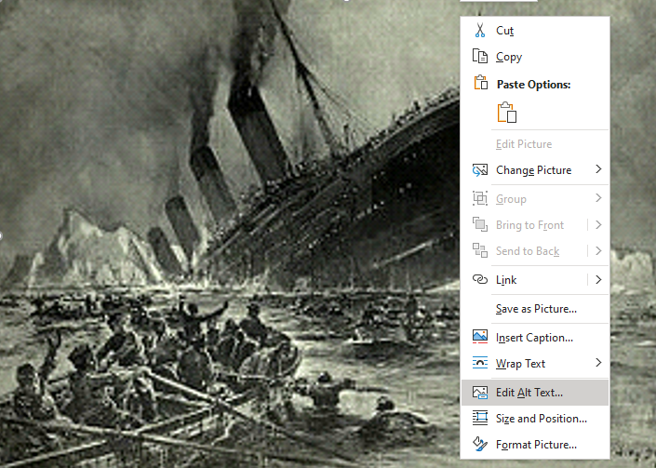
Alt text #2
Notes:
Select the image. If you use a mouse, right-click on the image and choose Edit Alt Text. Then a Alt Text sidebar will appear on the right-hand side.

Slide 21
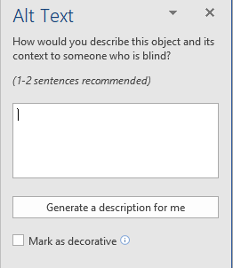
Alt text #3
Notes:
The Alt Text sidebar has a question How would you describe this object and its context to someone who is blind? 1-2 sentences recommended.
In the newest versions of Word have an option to Generate a description. You can try that and see what kind of result artificial intelligence can make. The artificial intelligence describes this painting as “A battleship in the water”. But please, write the alt text yourself. Humans can guarantee the quality, and you need to consider the context of the image, which is not currently done by the artificial intelligence.

Slide 22
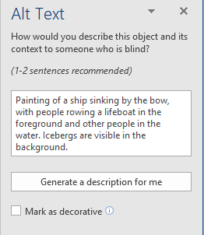
Alt text #4
Notes:
The Word document explains that the image is showing the Titanic sinking, so I can use the alt text to explain the content of the painting in more detail. In this example the alt text was written: "Painting of a ship sinking by the bow, with people rowing a lifeboat in the foreground and other people in the water. Icebergs are visible in the background.“
In the newest versions of Word it is also possible to mark an image as decorative. You can use this with images that do not contain any information, for example abstract forms that are inserted in the document just to bring colour. If you have an older version of Word, you don't have the option Mark as decorative. Then you can write a word Decorative in the alt text field.
Then it is Prashant's turn to tell about tables.

Slide 23
Tables
Simple as possible
Use for tabular data not to lay out lists
Row headings
Merged cells (avoid)

Slide 24
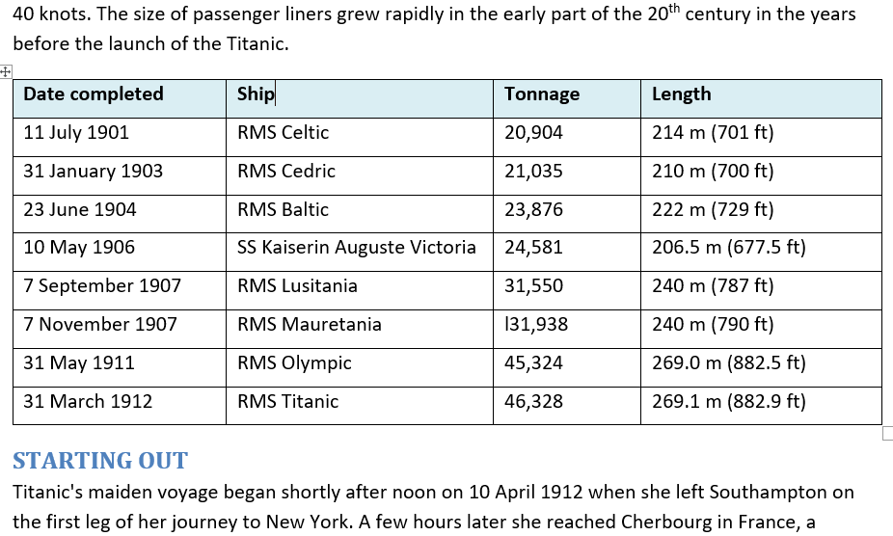
Row headings #1

Slide 25
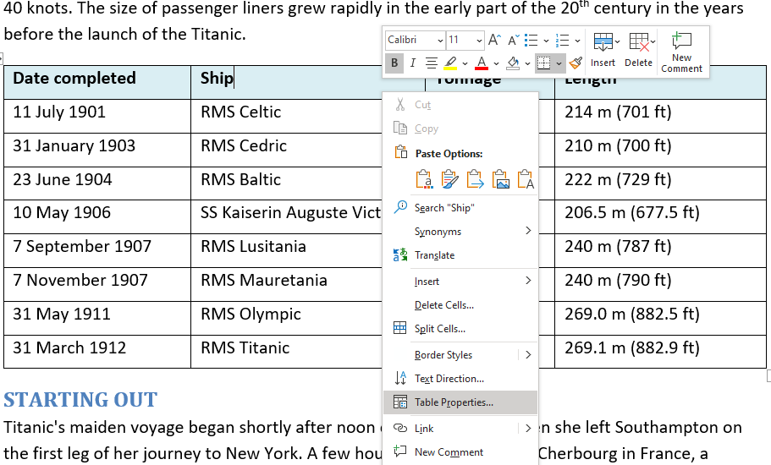
Row headings #2

Slide 26
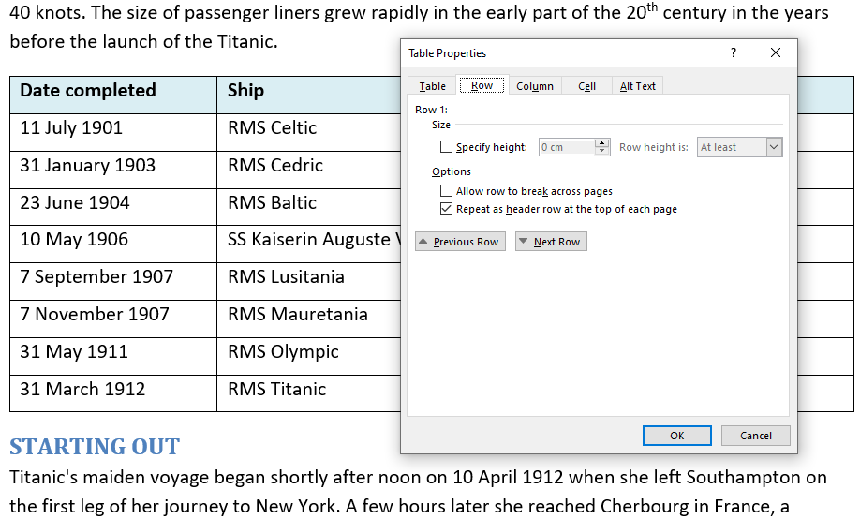
Row headings #3

Slide 27
Content considerations
Headers and footers
Document language
Footnotes and endnotes
Display text for links

Slide 28
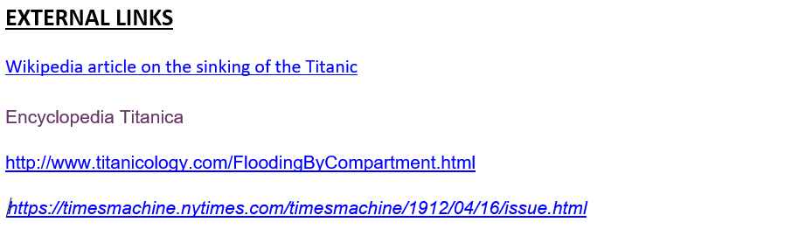
Display text for links #1

Slide 29
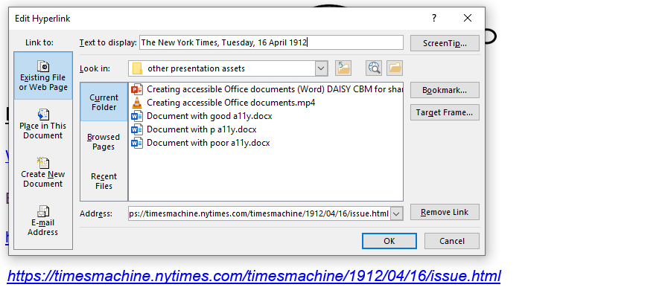
Display text for links #2

Slide 30
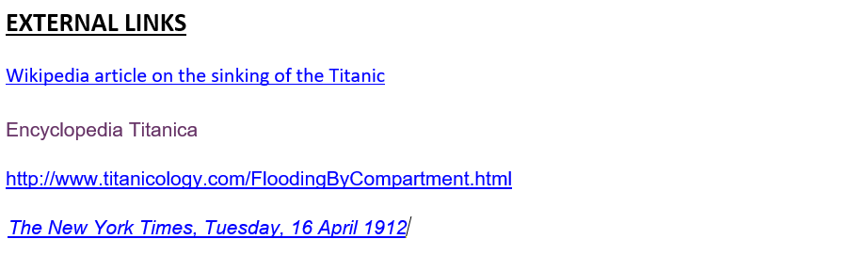
Display text for links #3

Slide 31
Testing for Accessibility
Running the Accessibility Checker
Working through the results (errors, warnings, tips)
Fixing common issues
What warnings can you ignore?
What issues are not detected?
Notes:
Word has an Accessibility Checker which helps you to find accessibility errors and fix them. In the newest versions of Word, select Review tab and then select Check Accessibility. In the older versions of Word, select File tab > Info > Check for Issues and then select Check Accessibility. A sidebar will appear on the right-hand side and you will have a list of inspection results. There may be errors and warnings. Fix all the errors. Often you can have an error that says Missing alternative text. You can select the item in the list and you will see additional information why to fix the error and how to do it. If an option Automatically generate alt text for me is checked in Word options, you will have in the results Intelligent services and Suggested alternative text. ALWAYS check that alt text. I don't myself have that option to generate automatically alt text checked.
Another common result is "Image or object not inline". This means that you have a floting object in the document. Fix that.
There may also be some warnings in the results. Some of them you can ignore. For example, if you have merced or split cells in table. If you have merced or split the cells on purpose, you don't need to fix that.
Unfortunately, Accessibility Checker does not find all the errors. If the document has no heading at all, there is no warning. Always have at least one heading in a word document. Also if you have skipped heading levels, for example using Heading 3 after Heading 1, there is no warning in the newest versions of Word. The Accessibility Checker only checks if an image has an alt text, it does not check the quality of the alt text. So the document can contain a photo of a cute cat which has alt text saying "A drawing of an angry dog." You need to manually check your Word document. Do not only rely on the Accessibility Checker.

Slide 32

Conclusions
Making your document accessible also benefits other formats you generate from it
Accessibility techniques can help you be more efficient
Usability is better for all your readers

Slide 33

Discussion and Q&A

Slide 34

Wrap up
Webinar video, slide deck and links to resources will be posted at:
daisy.org/webinars
Coming up:
March 24th Exploring the accessible mobile reading revolution

