Slide 1
Word Document Accessibility – Part 2
April 7th 2021
Accessible Publishing and Reading Webinars daisy.org/webinars

Slide 2
Your panel
Host: Erin Williams, Microsoft
Prashant Verma
Richard Orme

Slide 3
Overview
Top tips for checking alt text on images
Magically apply headings
Power search and replace
Turning the Tables (into accessible ones)
Accessible textboxes
Charts
Filenames and templates
Your Questions

Slide 4
Reminder
The video and slide deck for “Word Document Accessibility 101” are available for you to review
daisy.org/webinars

Slide 5
Top tips for checking alt text
Bring up the alt text pane
Search for a graphic (ctrl f, ^g)
Cancel the dialog
Move between the graphics with crtl PgUp and PgDn to see the images in place and review the alt text

Slide 6
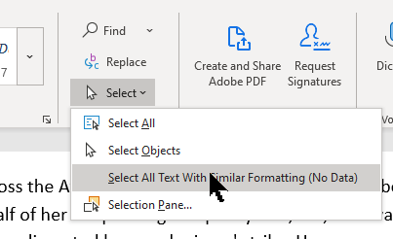
Magically apply headings
How to quickly apply headings where there are none
Select one of your ‘pseudo headings
On the Home tab
In the Editing group
Choose the Select button
Choose Select All Text With Similar Formatting
Apply the chosen heading style
And you can change the look of the headings you have

Slide 7
Power search and replace
Remove empty headings and paragraphs
(use paragraph and line spacing instead)
Remove extra spaces
Also possible to remove Tabs, manual line breaks etc.

Slide 8
Turning the Tables
Dealing with multiple heading rows/columns
Alt text and tables

Slide 9
Accessible textboxes
Create textboxes that work for everyone

Slide 10
Charting the way forward
Convert charts to images
Add alt text
Consider extended descriptions and alternative presentation

Slide 11
Filenames and templates
Do filenames matter?
Templates, good or bad?
File > New and type "accessible templates" in the Search for online templates box
Make your own templates with the accessibility guides from Templates.Office.com
Notes:
The accessible templates use the accessibility features provided by Word and have been improved with better color contrast, larger fonts, described images, simple table structures, heading structure, meaningful link text

Slide 12
Recap
Top tips for efficient a11y improvements
Move through images
Apply styles and adjust styles
Search and replace caret (^)
Rethinking tables
Boxes can be made with borders and shading
Charts
Filenames and templates

Slide 13
Discussion and Q&A

Slide 14
Wrap up
Webinar video, slide deck and links to resources will be posted at:
daisy.org/webinars
Coming up:
April 21st Exploring Reading App Accessibility

