Slide 1
Describing Images in Publications
June 17, 2020
Guidance, Best Practices and the Promise of Technology
Accessible Publishing and Reading Webinars daisy.org/webinars

Slide 2
Your panel
Host: Richard Orme
Valerie Morrison
Center for Inclusive Design & Innovation, Georgia Institute of Technology
Charles LaPierre
Benetech
Gregorio Pellegrino Fondazione LIA
Notes:
- Charles LaPierre - Benetech - Gregorio Pellegrino - Fondazione LIA - Valerie Morrison - Center for Inclusive Design & Innovation, Georgia Institute of Technology

Slide 3
Overview
Image Descriptions
Training and Best Practices
Using AI to automate image description
Publisher approaches

Slide 4
Image Descriptions
By: Valerie Morrison
Center for Inclusive Design & Innovation, Georgia Institute of Technology

Slide 5
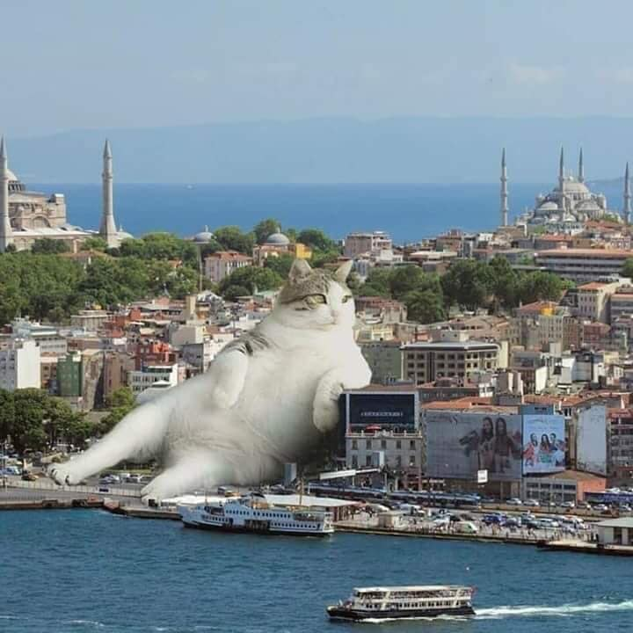
How to Describe Images
First summarize what you see in one general informative sentence.
Keep your description neutral and informative.
Use proper grammar, spelling and punctuation.
Avoid acronyms and symbols.

Slide 6
How Much Is Too Much?
Best practice is 125 characters, or the length of a Tweet.
The default setting for JAWS screen reading software pauses after 250 characters.
However, depending on purpose or audience, alt text can get quite long.

Slide 7
General Tips
Always use proper grammar, spelling, and punctuation, and do not include any hard line breaks in your image description.
Work from general to specific to provide a framework for the listener, keeping in mind that long descriptions may be cut off.
Provide information in multiple modalities if possible, such as adding captions as well as alt text description.
Try to reduce redundancy when possible. If the surrounding text describes the image, your description can be brief.

Slide 8
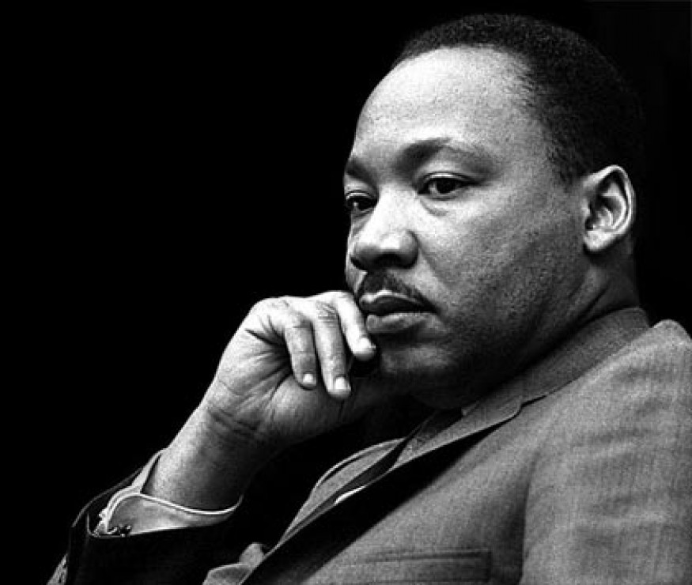
Simple Images
Photographs of people just need a name: Martin Luther King, Jr.
Simple graphics can often be described in one sentence: A magnified image of the human coronavirus.
Note: further details about its appearance could be added depending on audience and context.

Slide 9
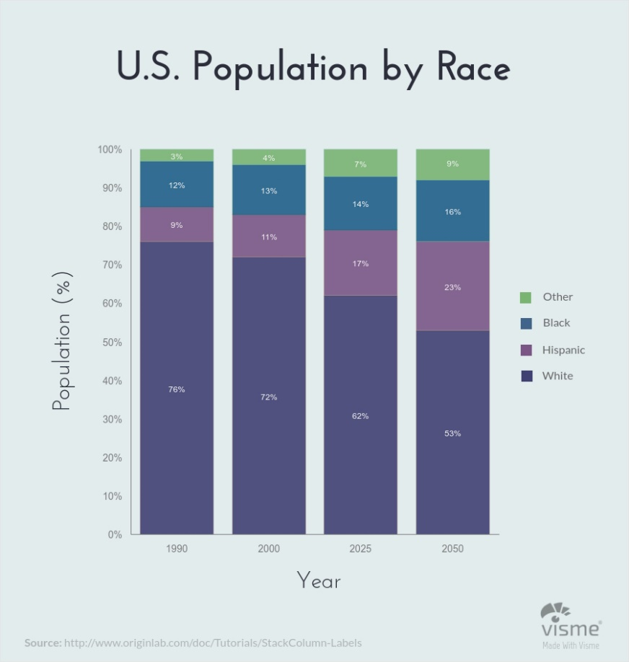
Graphs
Work from general to specific. Begin by naming the type of graph and title. Then describe the horizontal and vertical axes if applicable. Finally, describe the data. A bar graph titled U.S. Population by Race that compares the percentages of Black, Hispanic, White, and Other races in the United States for the years 1990, 2000, projected 2025, and projected 2050. In 1990, there were 76% White, 9% Hispanic, 12% Black, and 3% Other. In 2000, there were…

Slide 10
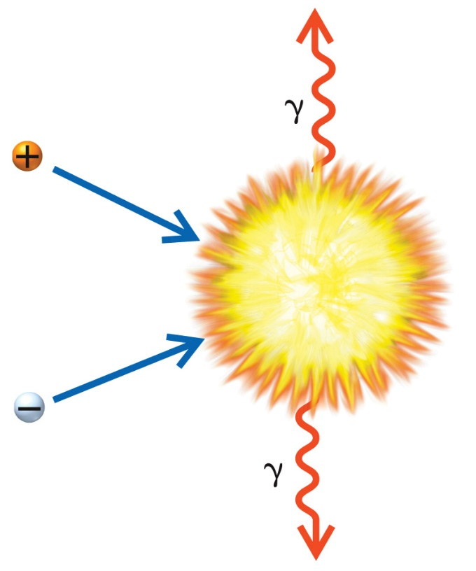
Focus on Meaning
Avoid the common mistake of spending your time describing the appearance of symbols rather than their meaning.
For example, in this image, you would want to avoid describing “a ball labeled with a plus sign” and instead you should call it “a positron.” Avoid describing “a squiggly arrow labeled with a weird y” and instead call it “a gamma ray.”

Slide 11
Implied Visual Information
Charts and graphs are visualizations for a reason: to make implications. Leaving out the visual impression leaves out important information.
Graphs should not be described solely by the raw data they offer but rather by what they are communicating.
What is the visual impact of this graph?
What relationships are implied here?

Slide 12
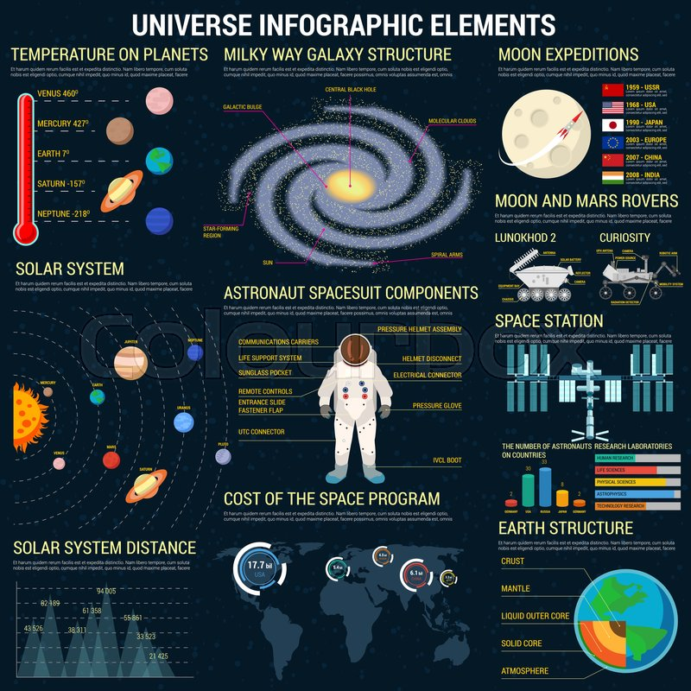
Consider Cognitive Load
Cognitive load, also referred to as Auditory Fatigue, is something to consider when describing images, so that you don’t overwhelm the listener’s working memory.
Begin with the type of image.
Follow up with a one sentence overview that provides a general summary of the content.
Work from general to specific, filling in the details as needed.

Slide 13
DIAGRAM Center – Tools, Tips, & Training
By: Charles LaPierre
(Technical Lead, DIAGRAM and Born Accessible, Benetech)

Slide 14
DIAGRAM Center – Image Descriptions
http://diagramcenter.org/making-images-accessible.html

Slide 15
POET Image Description Training Tool
https://poet.diagramcenter.org

Slide 16
Accessible Image Sample Book
http://diagramcenter.org/accessible-image-sample-book.html

Slide 17
General / Specific Description Guidance
http://diagramcenter.org/table-of-contents-2.html

Slide 18
Diagrammar
http://diagramcenter.org/standards-and-practices/content-model.html

Slide 19
Using AI to automate image description
By: Gregorio Pellegrino Fondazione LIA

Slide 20
Different tools available on the market
Microsoft Computer Vision
and more…

Slide 21
Available tools
Some returned a list of tags, instead of a human readable description (e.g. «car», «red», «open space»)
They are trained on photographs (and in some cases they also have problems with these ☺)

Slide 22
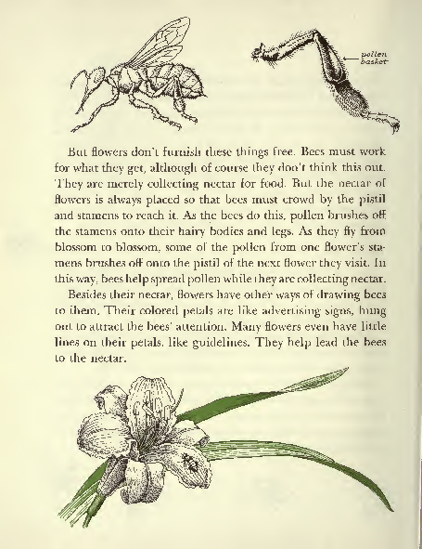
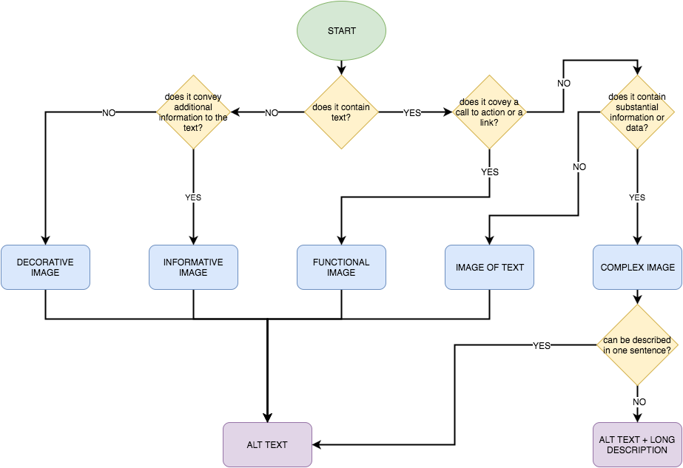
But…
In publishing we have many other type of images

Slide 23
And we’ve found that
some tools are better than others to describe certain types of images (e.g. works of art, images containing text, photographs, logos and icons, etc.)
some tools are vertical on: OCR, entity recognition, colour and shape identification, etc.

Slide 24
So…
image category
description of the image

Slide 25
Our process
tool 1
images
category
description
tool 2
classifier
tool n

Slide 26
Accuracy of results

Slide 27
Next steps
We are working with the Italian National Research Centre to define an all-embracing taxonomy for the classification of images
With this taxonomy we will create datasets to train the classifier with

Slide 28
Publisher approaches
Let’s hear from:
Kogan Page
Macmillan Learning
John Wiley
WW Norton

Slide 29
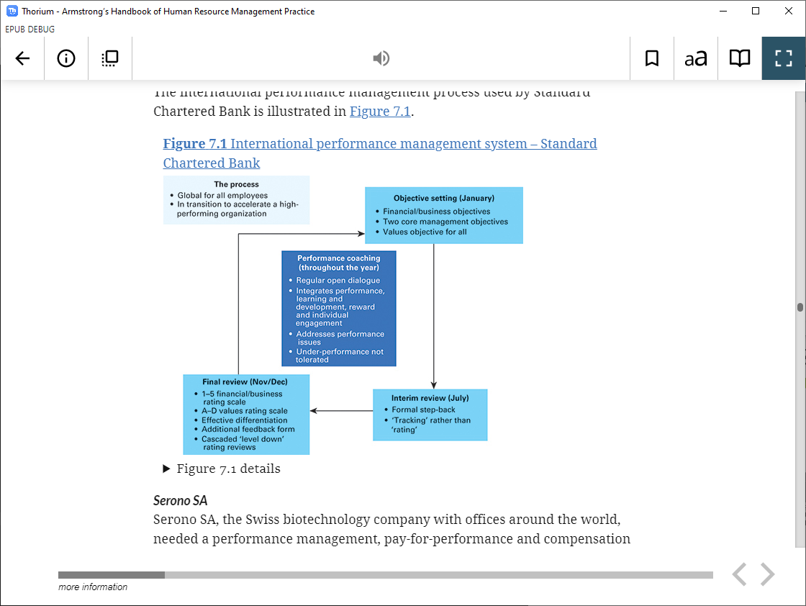
Kogan Page
Current practice:
Descriptions outsourced to the vendors
One vendor has team in house
Another has a panel
Decided against author descriptions
Alt text and extended descriptions
Notes:
Martin Klopstock says: The creation of image descriptions is part of our default workflow and is handled by the vendors. One vendor has their own image description team, the other one uses freelancers with different subject matter expertise. The vendors handle the outsourcing at agreed rates. We discussed whether to involve authors but felt that this had several disadvantages: it would be difficult to get a ‘methodology’ applied between dozens of authors; our images are not sufficiently specialised (as they might be in medical or STM publishing) to require author-level expertise to generate a description; one of the key skills the description author needs to possess is to put themselves in the shoes of a print impaired reader and generate a description that allows any reader (including one who cannot see the graphic) to make sense of the image.

Slide 30
Kogan Page
What advice do you have for publishers just getting started with image descriptions?
Develop guideline for your vendors
Develop a small library of ‘exemplar figures/tables’
Control costs
Spot check vendor descriptions for QA
Notes:
Martin Klopstock says: 1. Develop your own vendor guidelines. It helps to clarify your own thoughts and there might well be issues that are specific to your publications and would benefit from the publisher’s take on those and how they might impact image descriptions.
2. Develop a small library of ‘exemplar figures/tables’. Give these your own descriptions and use this ‘library’ to get vendors to provide their descriptions. Then compare the two. Ensure the vendor has fully understood what you are asking them to do.
3. Descriptions can quickly become very expensive. To control costs, consider imposing length limits on alt text and long descriptions.
4. For QA, spot check vendor descriptions on each of your publications. This can be done at proof stage along with the other usual checks.

Slide 31
Macmillan Learning
How are you currently producing your image descriptions?
Originated by Author
Outsourced as part of eBook creation
Description specialist with subject matter expertise
In house authoring
Notes:
RC> Image descriptions authoring is a mix for us depending on the complexity of the subject matter and the availability of the internal team members and the authoring team. Generally, we keep the author team for the textbook pretty busy with revisions and reviews and they don't get a lot of time in that schedule for alt text authoring but if they do, it's great to have those contributions. Vendors play an important part in alt text creation though because of their experience in understanding the audience - we work with vendors that have developed their subject matter experts to also have a keen eye for what elements of the image need to be described without being redundant with information in the text. We also have a team of in-house development editors that look at the content with an eye for how it fits in with the book as a whole.

Slide 32
Macmillan Learning
What advice do you have for publishers just getting started with image descriptions?
Iterative improvement rather than aiming for perfection
Don't err on the side of too much or too little
Descriptions are content- remember to apply the same rules you use for anything else you publish
Notes:
1. We've found that iterative improvement rather than aiming for perfection at the first go has allowed us to make an impact for a larger number of users. Customer feedback is much easier to give and to gather on something that already exists and is in use.
2. Don't err on the side of too much or too little. If you're describing an image to "get it done" the description is likely not sufficient. If you've written a novella about the oceanic shade of blue of a naval officer's uniform in the painting of battle - you may have gone off on a creative writing tangent.
3. This may not be visible on a page but it is still content. No matter what method you use to write it, remember to apply the same rules you use for anything else you publish. For example - consider diversity and inclusion in your language. Are you using appropriate pronouns? Is it appropriate or necessary to identify race, gender, ethnicity, etc in the alt text? How are you identifying these traits?

Slide 33
John Wiley & Sons
Current practice:
All alt text is written by trained subject matter experts
Training includes understanding how descriptions are used with assistive technology
All alt text also goes through a QA process
Involve end users
Alt text creation begins during EPUB production
Care is taken when images are re-used
Notes:
How are you currently producing your image descriptions?
Outsourced to description specialist: Yes. All of our alt text is written by subject matter experts who have also been trained in how to write appropriate alt text descriptions. Ideally, all image descriptions need to be written by someone who understands the particular subject, as well as how assistive technologies and the user experience impacts writing.
All of our alt text also goes through a QA process to ensure that it is well written and adheres to Wiley requirements.
The QA validation can include many hurdles, but it is really important to speak to end users to ensure that you are on the right path. That type of validation may also help you to uncover where there are gaps in our policy.
In house authoring: No
Outsourced as part of ebook creation: Alt text creation begins during ePub production. However images that are re-used in other supplements and/or questions go through an additional editing process to adjust the alt text to fit the context for that supplement/question (e.g. if an ePub image is re-used in a question, alt text is adjusted to ensure that it does not give away the answer and may also be modified to include a more detailed long description). Also for courseware-based titles, some supplements/questions will have unique artwork that is not found in the book; when this occurs descriptions are written for those images.
Originated by Author: No, but some authors do choose to be involved in some way during QA.
All alt text also needs to be validated. That validation can include many hurdles, but it is really important to speak to end users to ensure that you are on the right path. That type of validation may also help you to uncover where there are gaps in our policy

Slide 34
John Wiley & Sons
What advice do you have for publishers just getting started with image descriptions?
Become familiar with the different image concepts
Understand the difference between short and long descriptions, when to apply them to an image
Create internal requirements around style and language to help create consistency in the learner’s experience
Alt text should not be used to teach, but to describe.
Don’t forget spelling, punctuation, and grammar. And validate, validate, validate.
Notes:
Alt text authoring can be very difficult because you need to account for many things such as how images are visualized, cognitive load, subject accuracy, etc. Writing alt text is truly an art form and it takes practice to master. There are lots of suggestions that can be followed, but a few items to think about when first starting out:
Become familiar with the different image concepts as described by the W3C (e.g informational, decorative, functional, etc.). This impacts how and when to write alt text.
Understand the difference between long and short descriptions and when to best apply them to an image according to context. For example, within an ePub, is an image sufficiently described by the surrounding text or caption? If the answer is yes, alt text does not need to be robust b/c the image is already described by surrounding content.
Create some internal requirements around style and language to help create consistency in the learner’s experience. You can even do this by disciple. You can even do this down to the figure types (e.g bar graphs, coordinate planes, lines graphs, vectors, etc.)
Do not introduce additional exposition to the image. Alt text should not be used to teach, but to describe.
Once you have written alt text, don’t forget spelling, punctuation, and grammar. And be sure to validate, validate, validate.

Slide 35
W.W. Norton
Current practice:
The norm is to outsource to images description specialists, toward the end of the book’s production cycle
In house editorial staff are responsible for reviewing all third-party image descriptions and are trained on this quite extensively.
Editorial assistants do sometimes author image descriptions in-house. Mainly when a non-STEM book revises and only a small number of images change
STEM or complex materials always require a specialist
Authors volunteer to describe images rarely. It’s preferable that they spend their time on content development
Notes:
Outsourced to description specialist
This is the norm—I’d argue that authoring good image descriptions is more difficult to scale than meeting most other accessibility requirements because it requires specialists. They do this toward the end of the book’s production cycle since images and contextual surrounding text needs to be final before we can produce the descriptions.
In house authoring
Our editorial assistants do sometimes author image descriptions in-house, but it is not the norm. We’ll do it when a non-STEM book revises and only a small number of images change (STEM or complex materials always require a specialist). I know our editorial team has opted to author more in-house since COVID-19 as a cost saving measure as well, but that’s not typical. Even when they’re not authoring it in-house, our editorial staff are responsible for reviewing all third-party image descriptions and are trained on this quite extensively.
Originated by Author
This has happened once or twice in my time at Norton but only because the author volunteered to write descriptions. We don’t ever ask authors to create image descriptions because they usually don’t have a good handle on how to write them and we prefer that they spend their time on content development. It can be difficult to get authors to meet their content development deadlines so asking them to add image descriptions on top of that is just not feasible.
Outsourced as part of ebook creation
Descriptions are not typically authored during ebook production but there are some exceptions. We are currently in the process of updating our workflow to provide more maintainable, reusable, structured descriptions in HTML and that may end up happening during ebook production. The workflow has yet to be decided, though.

Slide 36
W.W. Norton
From your experience, what advice do you have for others just getting started with image descriptions?
Aim for an equivalent experience to how people consume images visually. This is best accomplished by a short description and structured extended descriptions
Write guidelines for yourself and other authors so that your chosen nomenclature is clear—whether you use “alt text,” “image description,” “short description,” etc.
There is no single solution for all images. Best practices and examples will help but authoring alt text ultimately requires quite a lot of executive functioning and decision making.
Notes:
Aim for an equivalent experience to how people consume images visually. This is best accomplished by a short description (the experience of glancing at an image in passing), and structured extended descriptions (the experience of deciding to look closely at an image).
Write guidelines for yourself and other authors so that your chosen nomenclature is clear—whether you use “alt text,” “image description,” “short description,” etc., usage needs to be clear and consistent in your practices.
There is no single solution for all images. Best practices and examples will help but authoring alt text ultimately requires quite a lot of executive functioning and decision making.

Slide 37
Thank you

Slide 38
Contact information
Charles LaPierre from Benetech: charlesl@benetech.org
Gregorio Pellegrino from Fondazione LIA: gregorio.pellegrino@fondazionelia.org
Valerie Morrison from CIDI: valerie.morrison@design.gatech.edu

