Slide 1
WordToEPUB Extended Tutorial
July 29, 2020
Accessible Publishing and Reading Webinars daisy.org/webinars

Slide 2
Your panel
Host: Dara Ryder
Nancy Zhang Provincial Resource Centre for the Visually Impaired British Columbia, Canada
Joseph Polizzotto UC Berkeley California, USA
Richard Orme DAISY Warwick, England

Slide 3
Overview
Point and shoot with WordToEPUB
Advanced features
Preferences
Getting help
Getting updates
Q & A
Notes:
Richard will narrate this slide

Slide 4
The basics
WordToEPUB is free to download and use
Start with an accessible, structured Word document
Create EPUBs for any platform, any reading app
Windows only
Localized into multiple languages
Download from: daisy.org/wordtoepub
This is the extended tutorial
Notes:
Richard will cover the basics

Slide 5
Point and shoot
Demo
Notes:
Richard:
This demo will show a conversion from a Word document using the ribbon button with simple mode, verbose messages off, Sigil and QA wizard off.
Key point: you can have an EPUB in two clicks

Slide 6
WordToEPUB button on the Word ribbon

Slide 7
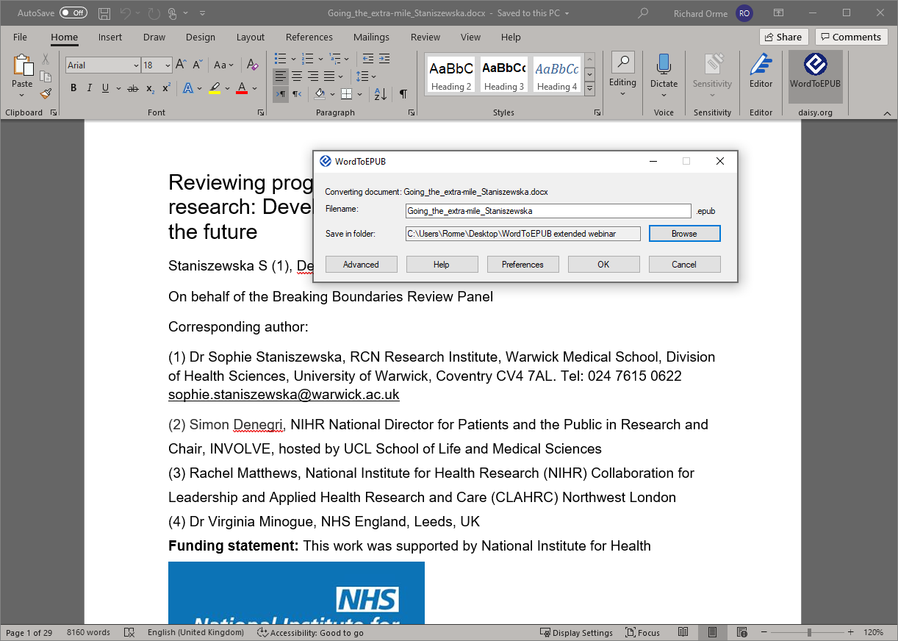
WordToEPUB simple dialog

Slide 8
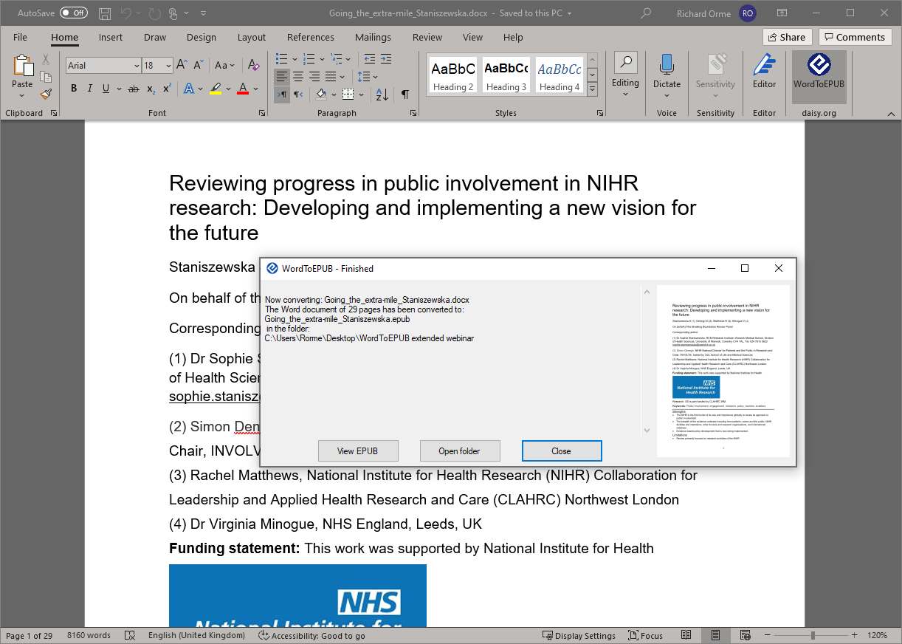
WordToEPUB finished

Slide 9
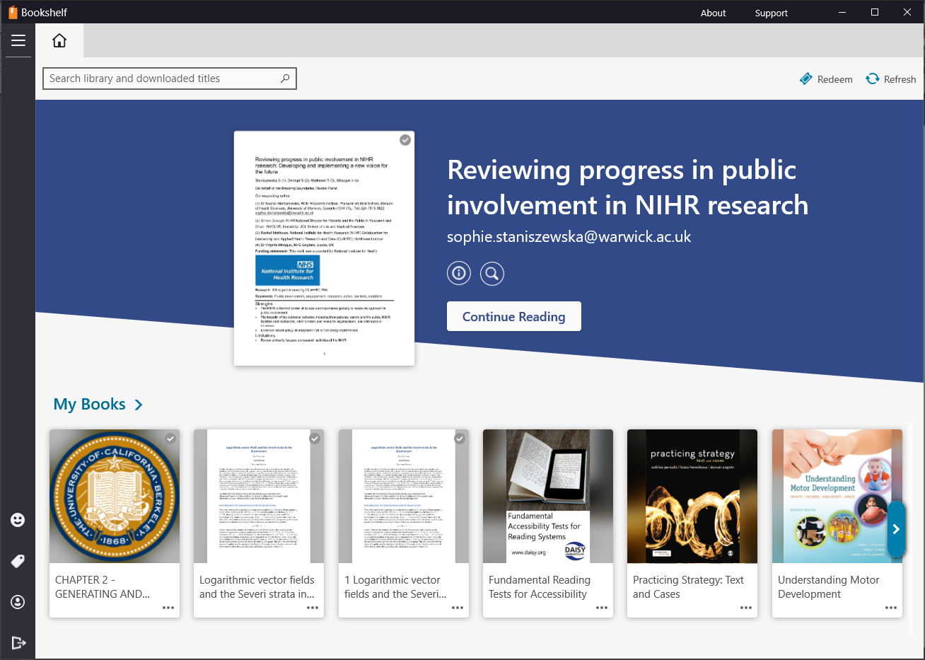
Newly created EPUB added to Bookshelf reading app

Slide 10
Reading the newly created EPUB in Bookshelf reading app

Slide 11
Advanced Features
Accessibility checker and Headings report
Metadata and Word properties
Cover images
Languages
Table of Contents
Splitting level
Stylesheets
Pagination
Notes:
Richard:
Here are the advanced features will talk about.

Slide 12
Accessibility checker
Notes:
Richard:
This isn’t a webinar on how to create accessible Word documents. But basically, follow those principles, use the simple mode and you will end up with a great EPUB.
Headings, lists, proper tables, alt text for images, you can use captions for images and tables, correctly entered hyperlinks, use the Word feature for footnotes and endnotes, these will all be supported in the EPUB.
A couple of workarounds to note at this stage before we get into the tool: decorative check box not there in all versions of Word, so you can add the alt ‘decorative’. And skipped heading levels are not flagged in all versions.

Slide 13
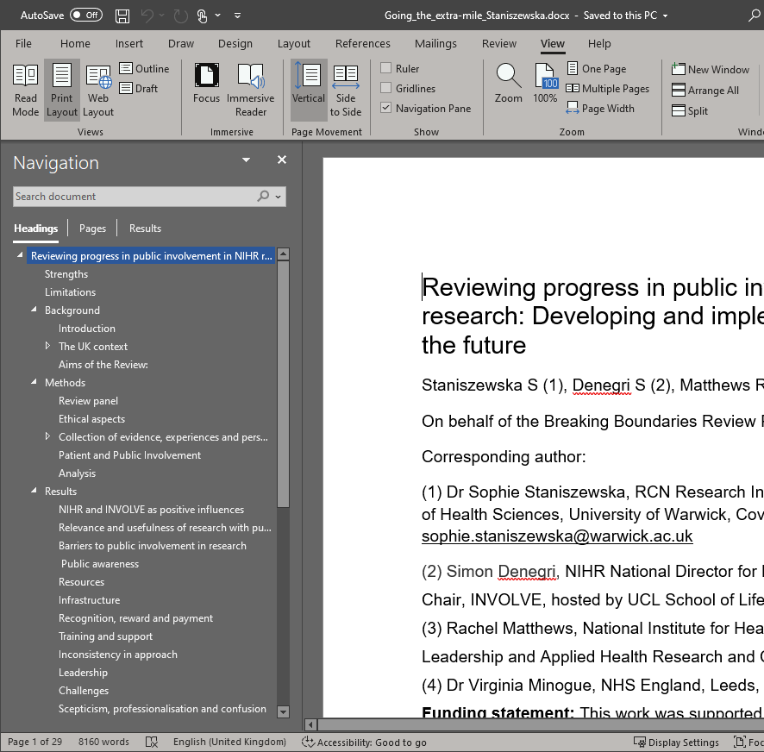
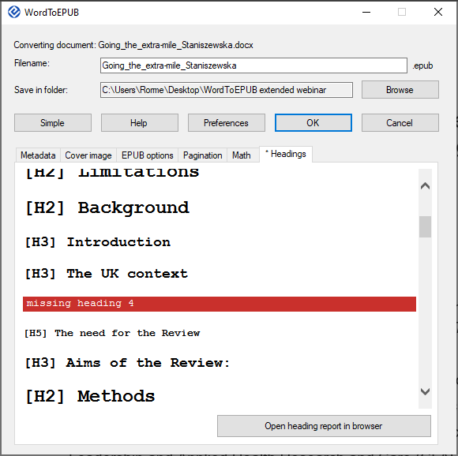
Headings report
Notes:
Richard:
The heading structure is critical to good navigation in any digital document. View this in View / Navigation pane. If a heading level is skipped (say 3 to 5) then this is not picked up in the accessibility checker of some version of Word. Use the Advanced / Headings pane for this. It may be easier to view this in the browser for longer documents.

Slide 14
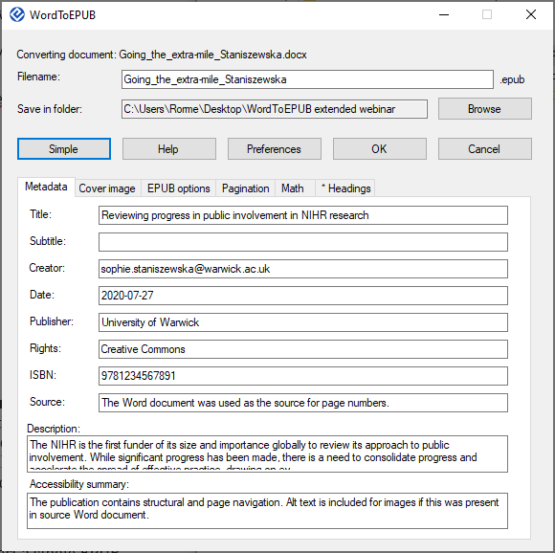
Editing metadata
Notes:
Joseph:
The tool makes it really easy to add or edit metadata for the EPUB you are creating. If you are likely to generate the EPUB a few times, then a better approach is to add to Word document properties. These are then picked up by the tool.

Slide 15
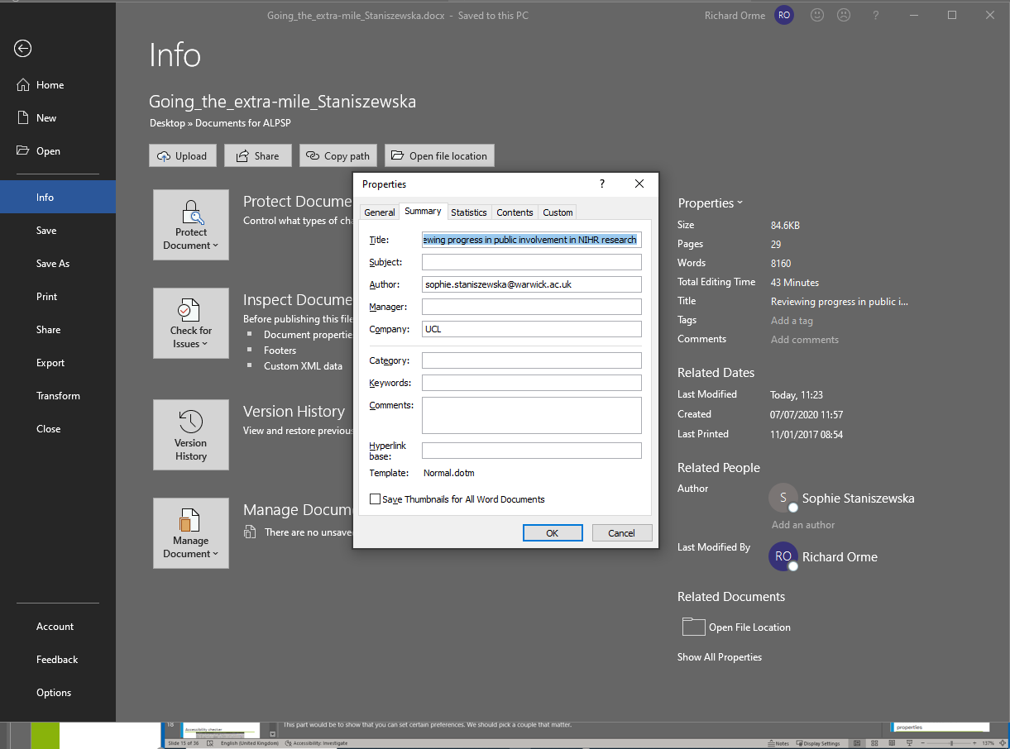
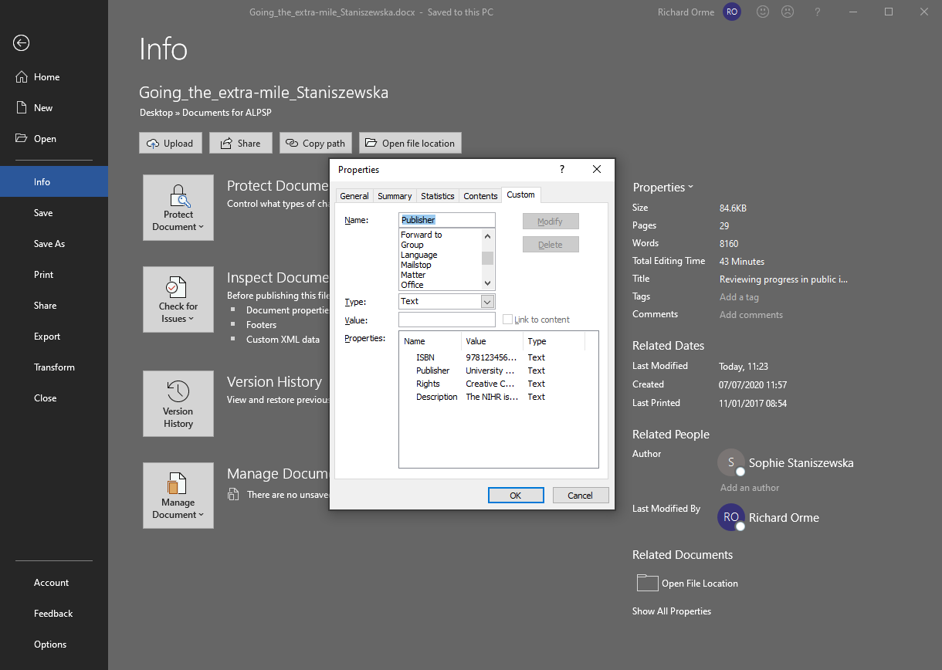
Document properties
Notes:
Richard:
Edit document properties in File / Info / Properties / Advanced properties
In General you can add Title and Author.
In custom you can add ISBN, publisher, rights, description.

Slide 16
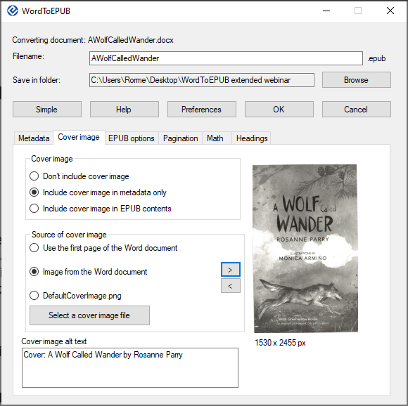
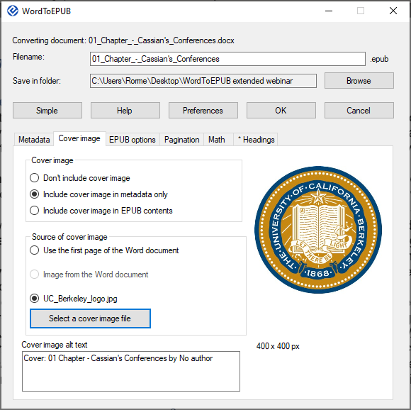
Cover image
Notes:
Joseph:
The cover image is usually for display in a library view or as a thumbnail in a catalog.
By default a thumbnail of the first page is generated by the tool. Alternatively, an image on the local device or from within the Word document can be selected.

Slide 17
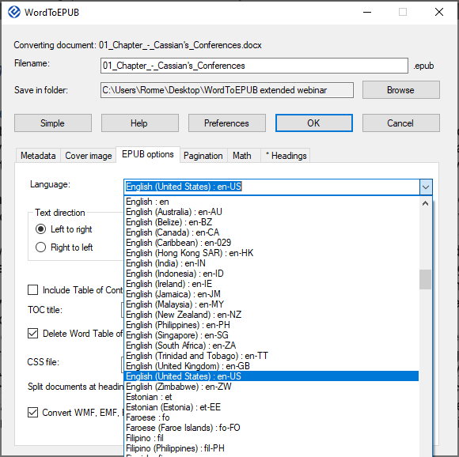
Language
Notes:
Joseph:
Identifying the base language of the EPUB is important for the correct selection of TTS or braille translation table. This is done automatically by the tool, or it can be set by the user in Advanced / EPUB options / Language.

Slide 18
Voice switching (read aloud & screen reader)

Slide 19
Set proofing language in Word
Notes:
Joseph:
Narrates how to set the proofing language whilst Richard drives Word. Will fix that phrase so that it is marked as French.

Slide 20
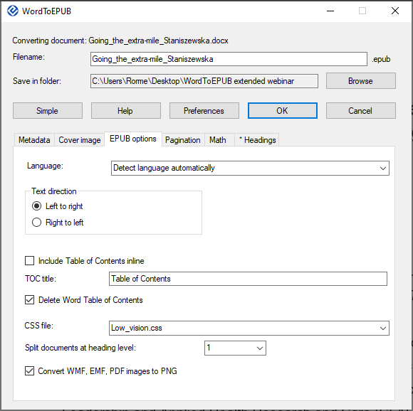
Table of contents
Notes:
Richard:
The heading structure is used to generate the TOC in the EPUB. The title paragraph is the same as H1.
In most reading apps the best experience is to use the app’s table of contents feature, but it is also possible to include the TOC inline at the start of the book.
The title of the TOC can be customized.
In most cases the Word TOC is deleted since this can contain anomalies such as different page numbers, but it can be left in place if desired.

Slide 21
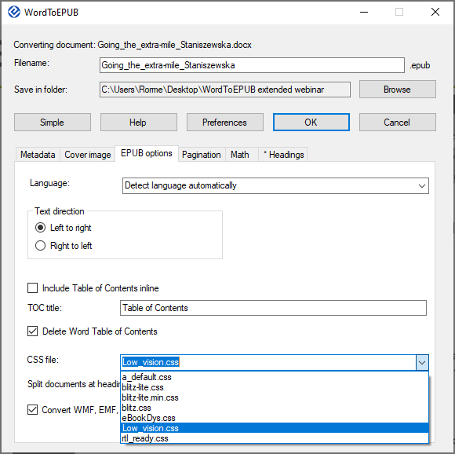
Stylesheets
Notes:
Joseph:
The visual presentation of the EPUB can be adjusted using different stylesheets. There are some default and other stylesheets for you to experiment with. One of note is the low_vision one, that embeds a different font. The different CSS features are supported to different degrees in various EPUB apps.
Nancy will now explain how you can adjust the stylesheet in an EPUB you made. (next slide)

Slide 22
Customizing stylesheet in Sigil
Open the publication in the EPUB editor, Sigil
Go to the Book Browser pane, click the arrow beside “Styles” and double click the name of the stylesheet to open it.
Add your rules or make desired changes to the stylesheet

Slide 23
Add stylesheet to WordToEPUB
In Sigil, right click on the stylesheet in the tree view and select “Save as”, then save the file to your desktop
Drag the file to the folder, C:\Program Files(x86)\DAISY\WordToEPUB\CSS
The stylesheet will now show up in WordToEPUB

Slide 24
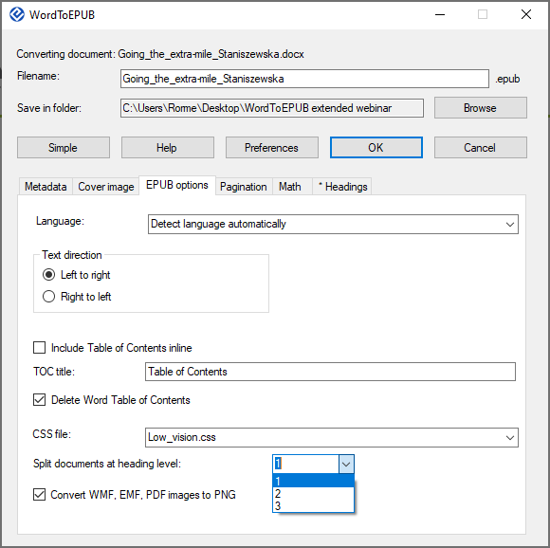
Splitting level and image conversions
Notes:
Richard:
Inside the EPUB container the document is split into XHTML files, to assist in performance when used on devices with lower compute power/memory.
By default this happens at H1, but you can split at a lower level if desired.
A Word document can include images that are not supported in EPUB, so the tool will convert these into PNG if you want.

Slide 25
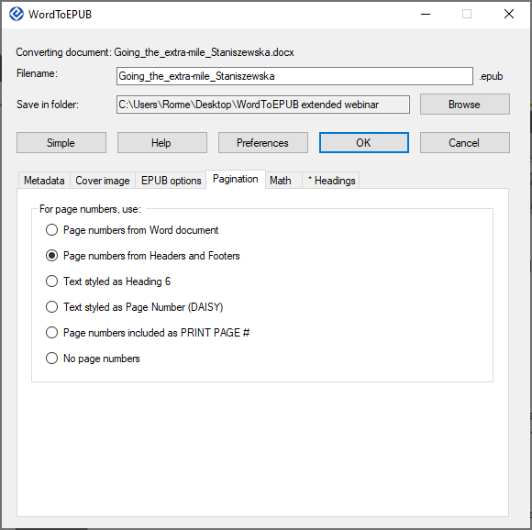
Pagination
Notes:
Joseph:
Rock solid page navigation in reflowable text is a killer feature of EPUB.
Pages are marked in Word in different ways by different people. WordToEPUB supports page numbers in Word, those from headers and footers, paragraphs styled as H6, Page number (DAISY) and included on its own line as ‘PRINT PAGE #’.
It may be appropriate not to include page numbers.
Now Nancy will explain what they do at PRCVI (next slide)

Slide 26
Using print page # tags for page numbers and splitting documents 1
Add Print page # tags in Word, at the start of each page
Select “Page numbers included as PRINT PAGE #” for page numbers on Pagination page

Slide 27
Using Print page # tags for page numbers and splitting documents 2
Challenge in conversion to EPUB when splitting documents: page number tags for chapter title page appear at the end of the previous file.
Resolution: Formatting page number tags: PRINT PAGE 14 Chapter Three (H1)

Slide 28
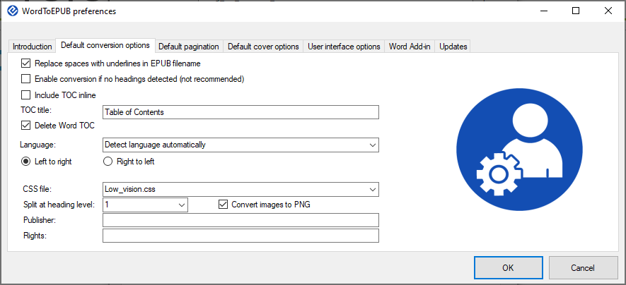
Preferences
Notes:
Joseph:
In the preferences dialog you can change some of the advanced settings so that you don’t need to alter them every time.
This is also where you can change the behavior of the tool in respect of verbose messages, advanced mode by default, UI language

Slide 29
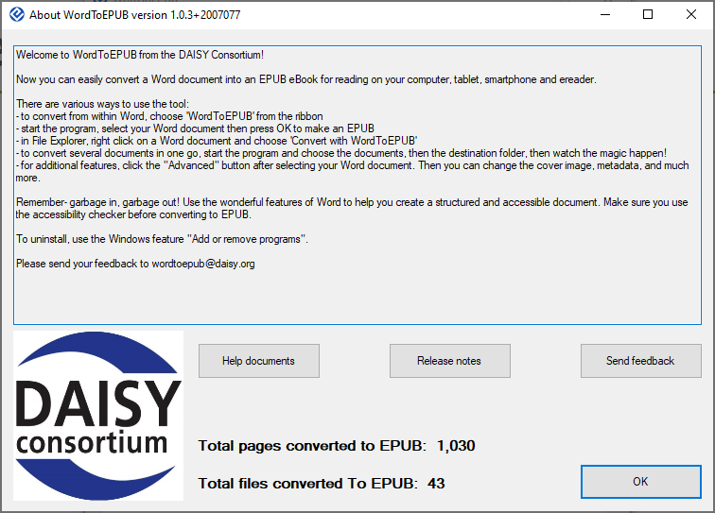
Getting help
Notes:
Richard:
Where to go to for help:
Use the help button
Read the help documents
Send an question by email
Join the GitHub to report a bug

Slide 30
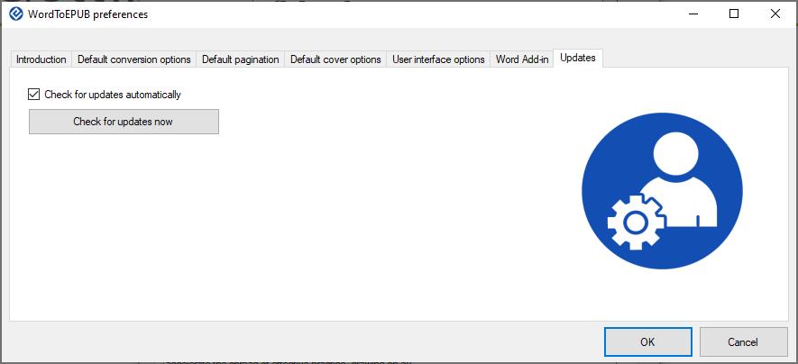
Getting updates
Notes:
Richard:
How to get updates:
Preferences / Updates
At the website daisy.org/wordtoepub
Join the community to get prereleases

Slide 31
Downloads and Contact Information
WordToEPUB Download and Support:
daisy.org/wordtoepub
Email: wordtoepub@daisy.org
Sigil editor:
sigil-ebook.com

Slide 32
What we didn’t cover
Quality assurance wizard
Math and converting from LaTeX
Citations
Asides
Coming in the next webinar later this year!

Slide 33
Discussion and Q&A

Slide 34
Wrap up
Webinar video, slide deck and links to resources will be posted at:
daisy.org/webinars
See you in September!

