Slide 1
Accessible Publishing in Africa The Fundamentals Reach more readers! Do the right thing!
July 5, 2022
Accessible Publishing and Reading for everyone, regardless of disabilities daisy.org

Slide 2
Introduction
Your webinar host: Ben Steward Chief of Staff Kalimat Group

Slide 3
Your panel
Martin Kieti
Richard Orme

Slide 4
Overview
Welcomes
Introduction to accessible publishing
About Print Disability
How could people read your publications?
Accessible digital publishing practices
Next steps
Questions and Answers

Slide 5
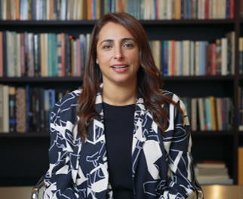
Welcome from IPA
Bodour Al Qasimi
President International Publishers Association - IPA

Slide 6
Welcome from APNET
Ernest Oppong
Ag. Executive Director
African Publishers Network (APNET)

Slide 7
Introduction to Accessible Publishing
Huge growth in electronic (digital) publishing
Digital books can be accessible books – can be read by anyone irrespective of disabilities
Later you will hear reasons that publishers give for why they practice accessible publishing
Notes:
In developed countries, digital publishing is big business, and has been for some time. In 2011, e-book sales in the US overtook print sales for the first time and this has continued ever since. In the UK, sales income in the education sector grew by 1% for print, and 28% for digital.
The increasing digitization of books and educational information is contributing to the growth of the digital publishing market. Conversion of the information into digital format contributed to the change in learning methods like the shift from traditional printed textbooks to digital modes such as e-readers, smartphones, and tablets. For instance, due to COVID-19 lockdown in mid-2020 across the globe, the sale of physical books has gone down as most of the publishing houses and bookstores were closed and readers spent most of their time reading e-books. In India, the sale of physical books went down by 80% and sales of e-books had almost doubled during the lockdown. Earlier, pre-COVID-19, e-books or online newspapers and journals were popular among younger people but during COVID-19 older people too got aligned to this. Therefore, this trend is expected to be continued post-COVID-19 also, thus driving the market for digital publishing during the period.
People with disabilities, who find it difficult to read print books, can read digital books if they follow practices of accessible publishing.
Later we will learn from publishers for the reasons that they are on board with accessible publishing, let’s first learn more about print disabilities.

Slide 8
About Print Disability #1
One definition is: “a person who cannot effectively read print because of a visual, physical, perceptual, developmental, cognitive, or learning disability”
People with print disability includes those who:
cannot see the text, because of blindness or low vision;
cannot read the text, due to a learning difficulty such as dyslexia;
cannot hold a book or turn pages, due to physical disability.

Slide 9
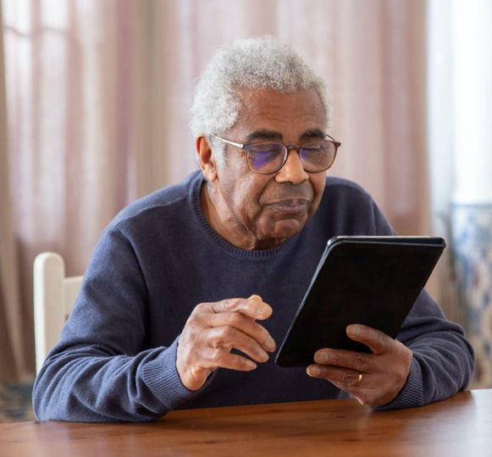
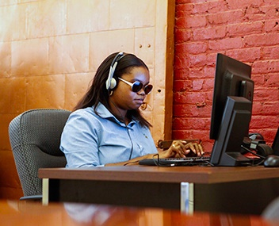
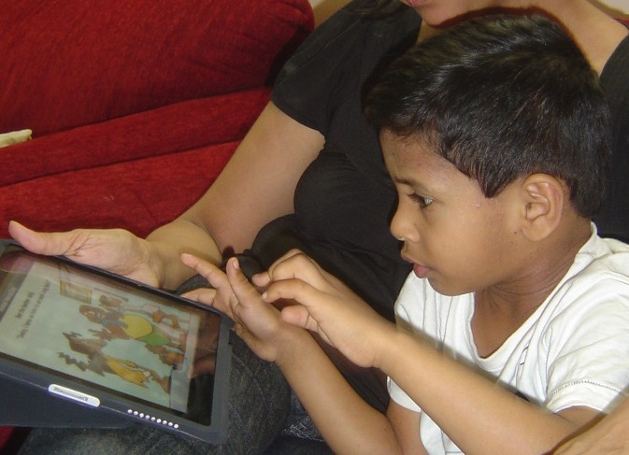
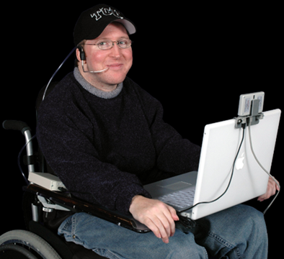
About Print Disability #2
Let’s meet some people with print disabilities and find out how they read!

Slide 10
Low vision
Persons with low vision increase the text size and adjust colours and fonts

Slide 11
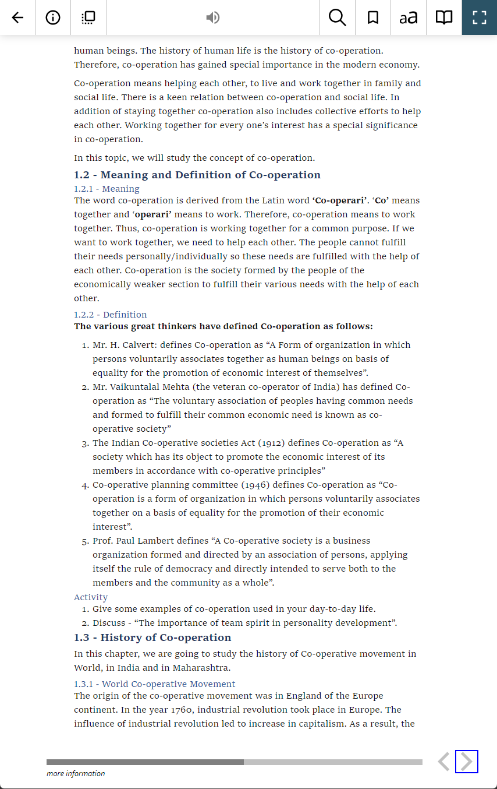
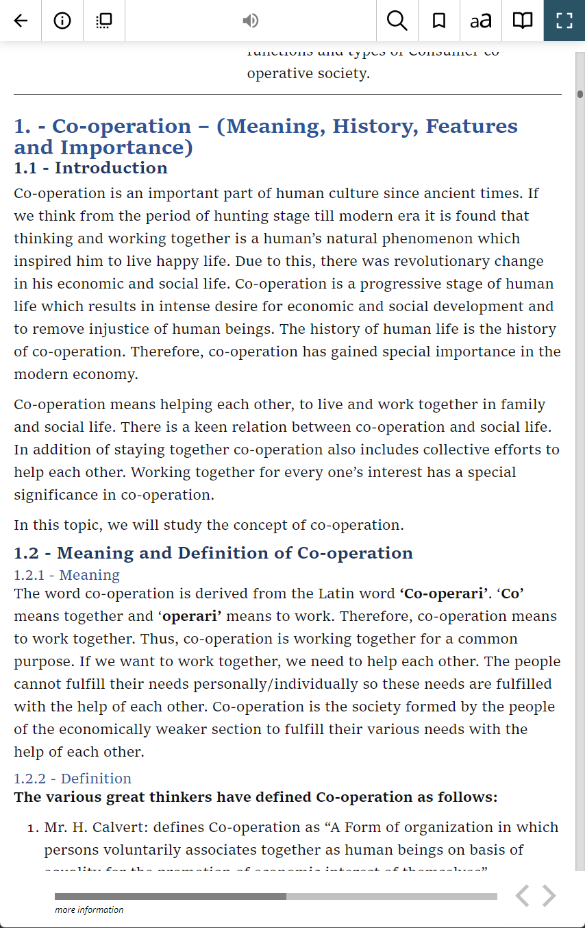
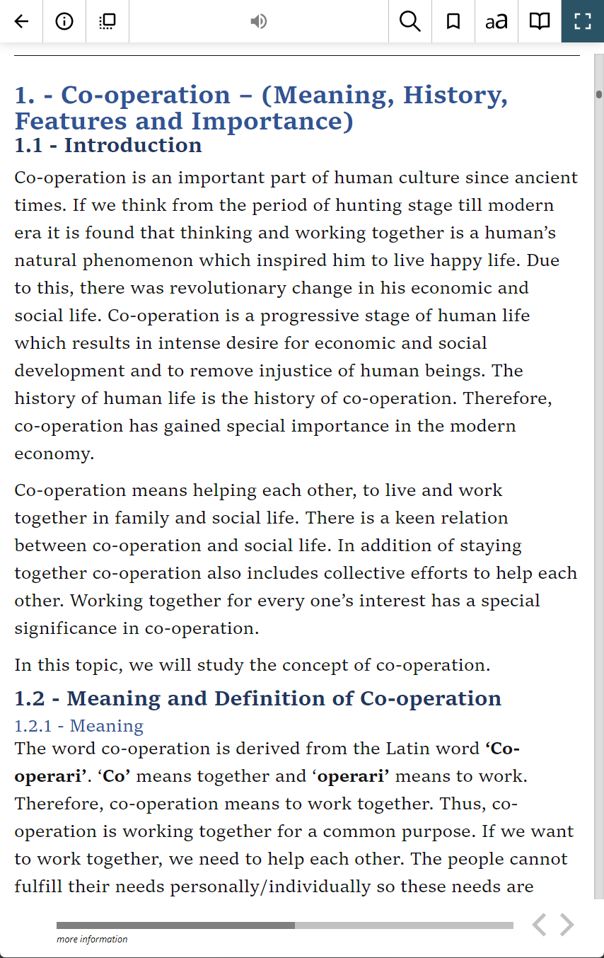
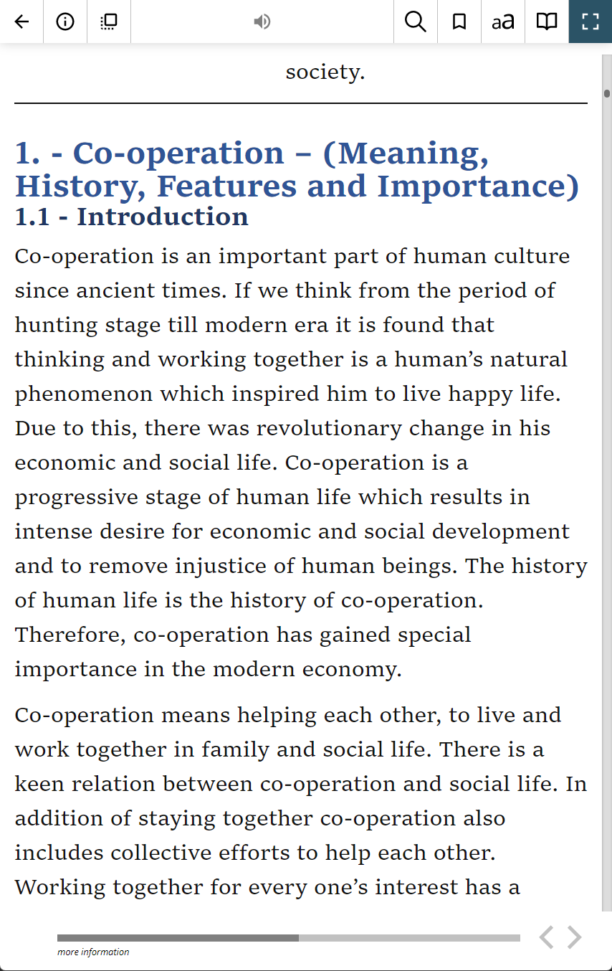
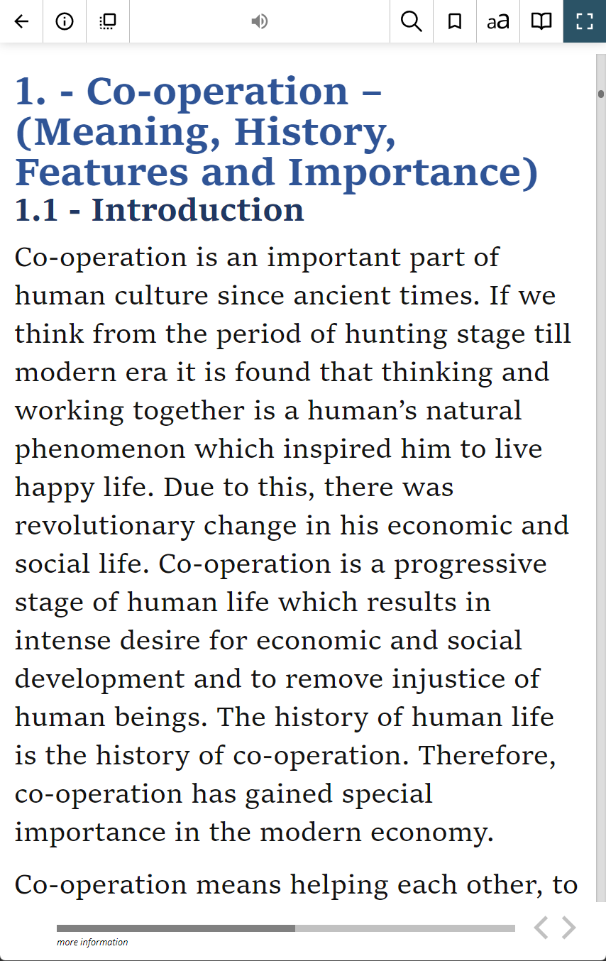
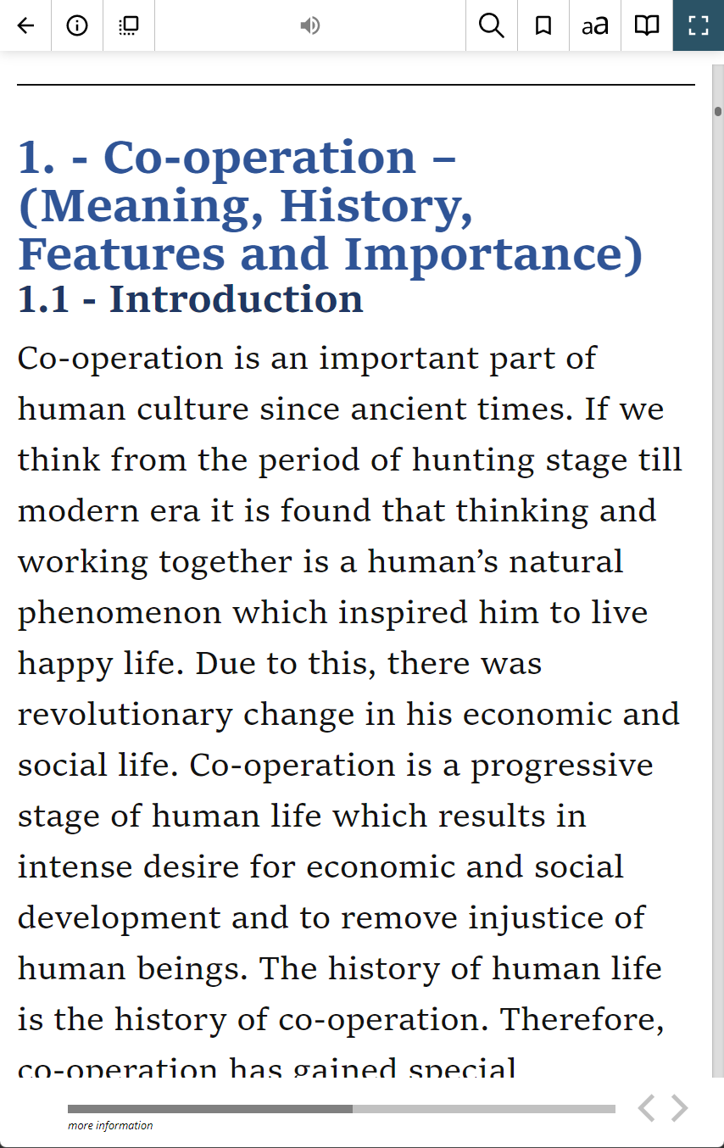
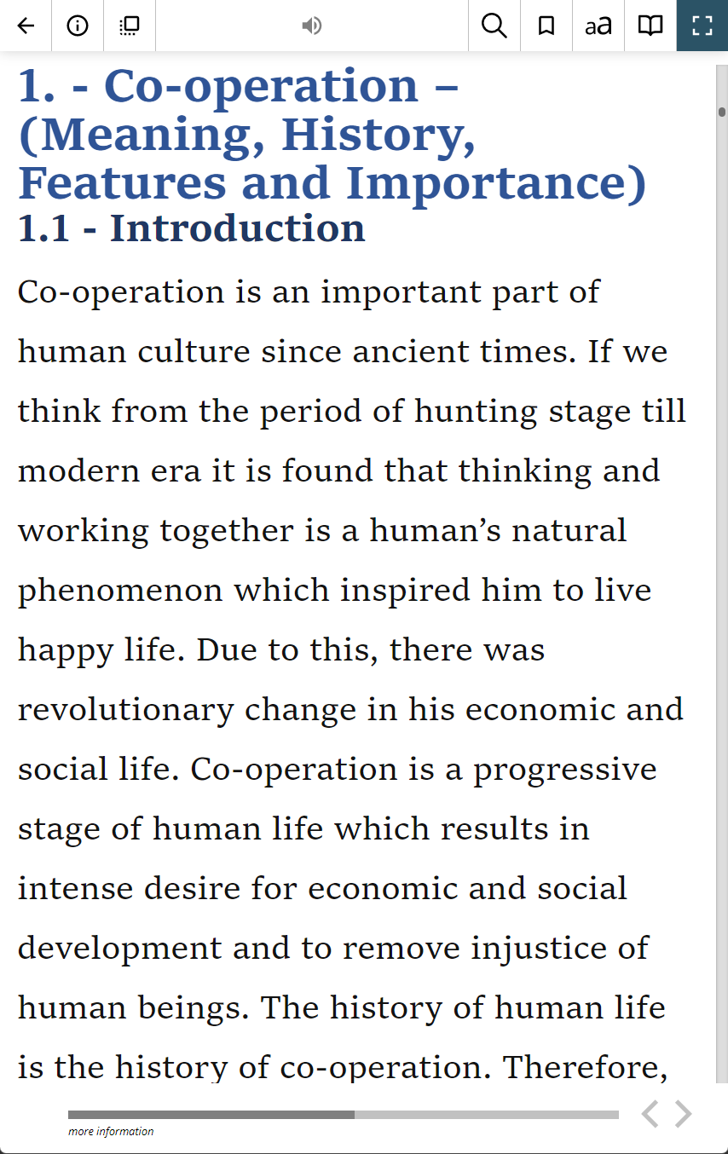
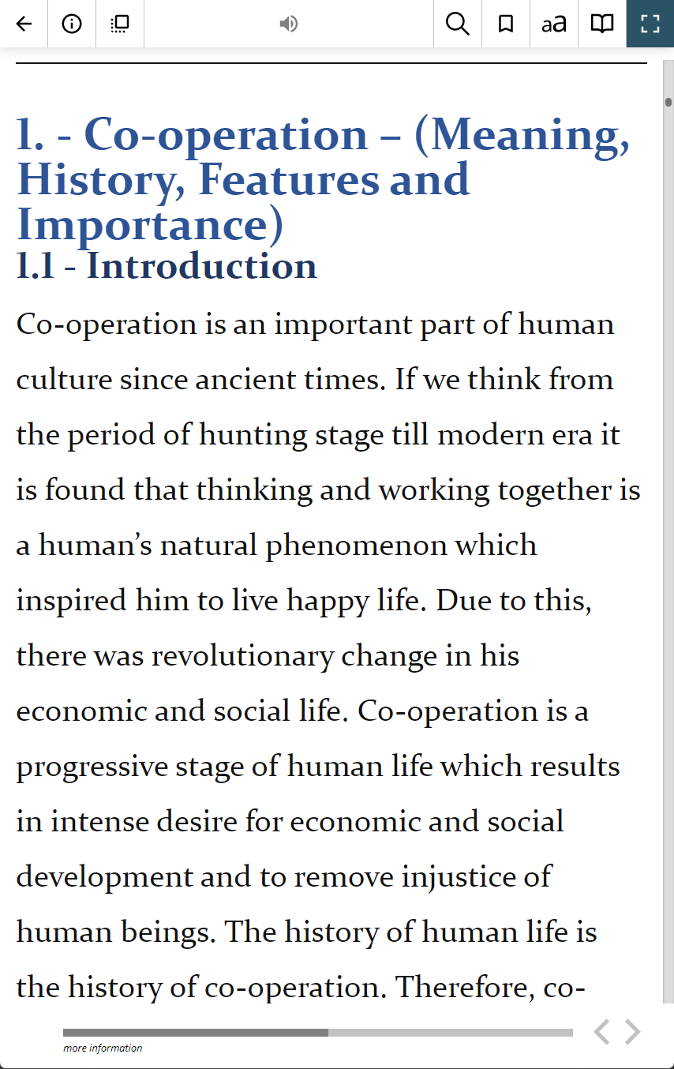
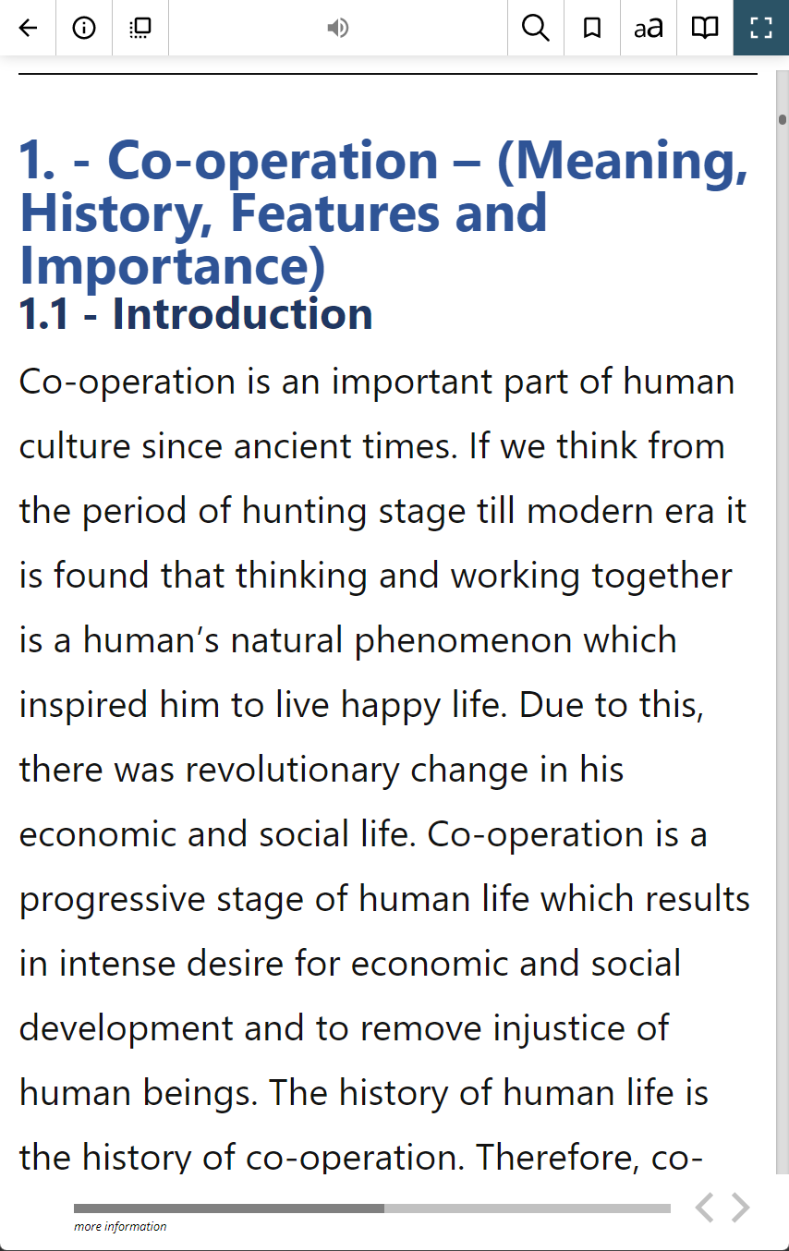
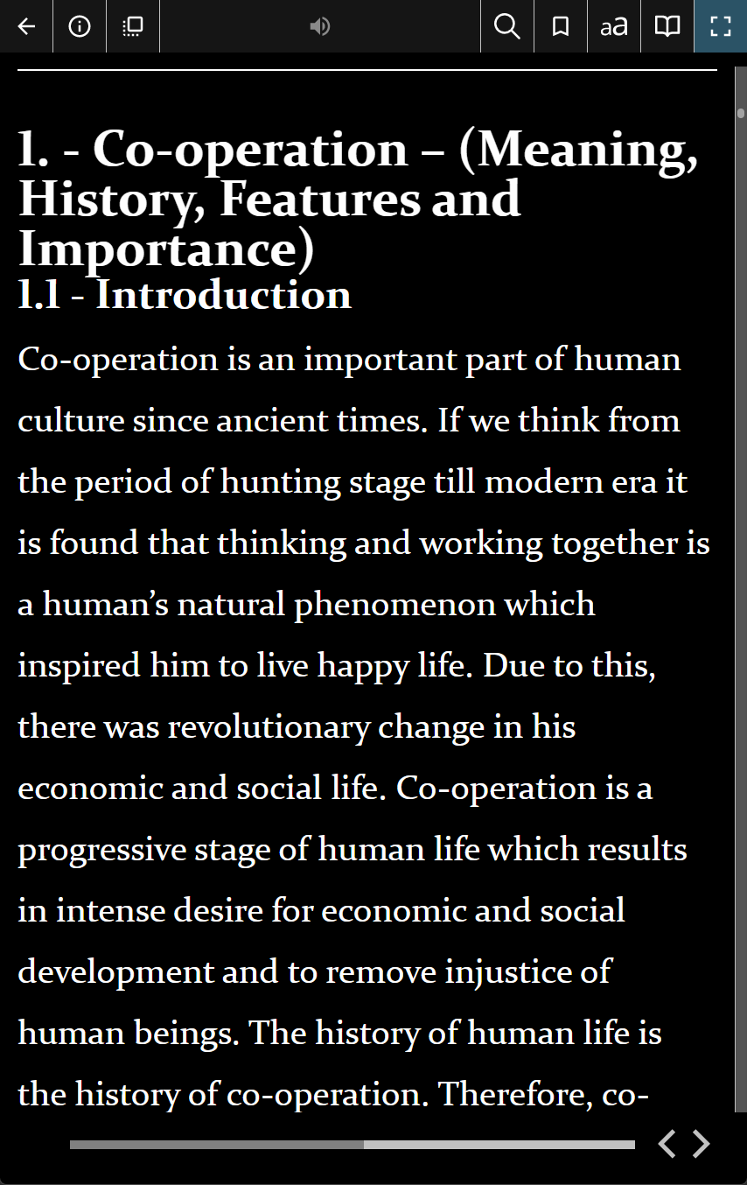
Adjusting the display for low vision
11

Slide 12
Blind people
Persons who are blind use talking programs called ‘screen readers’

Slide 13
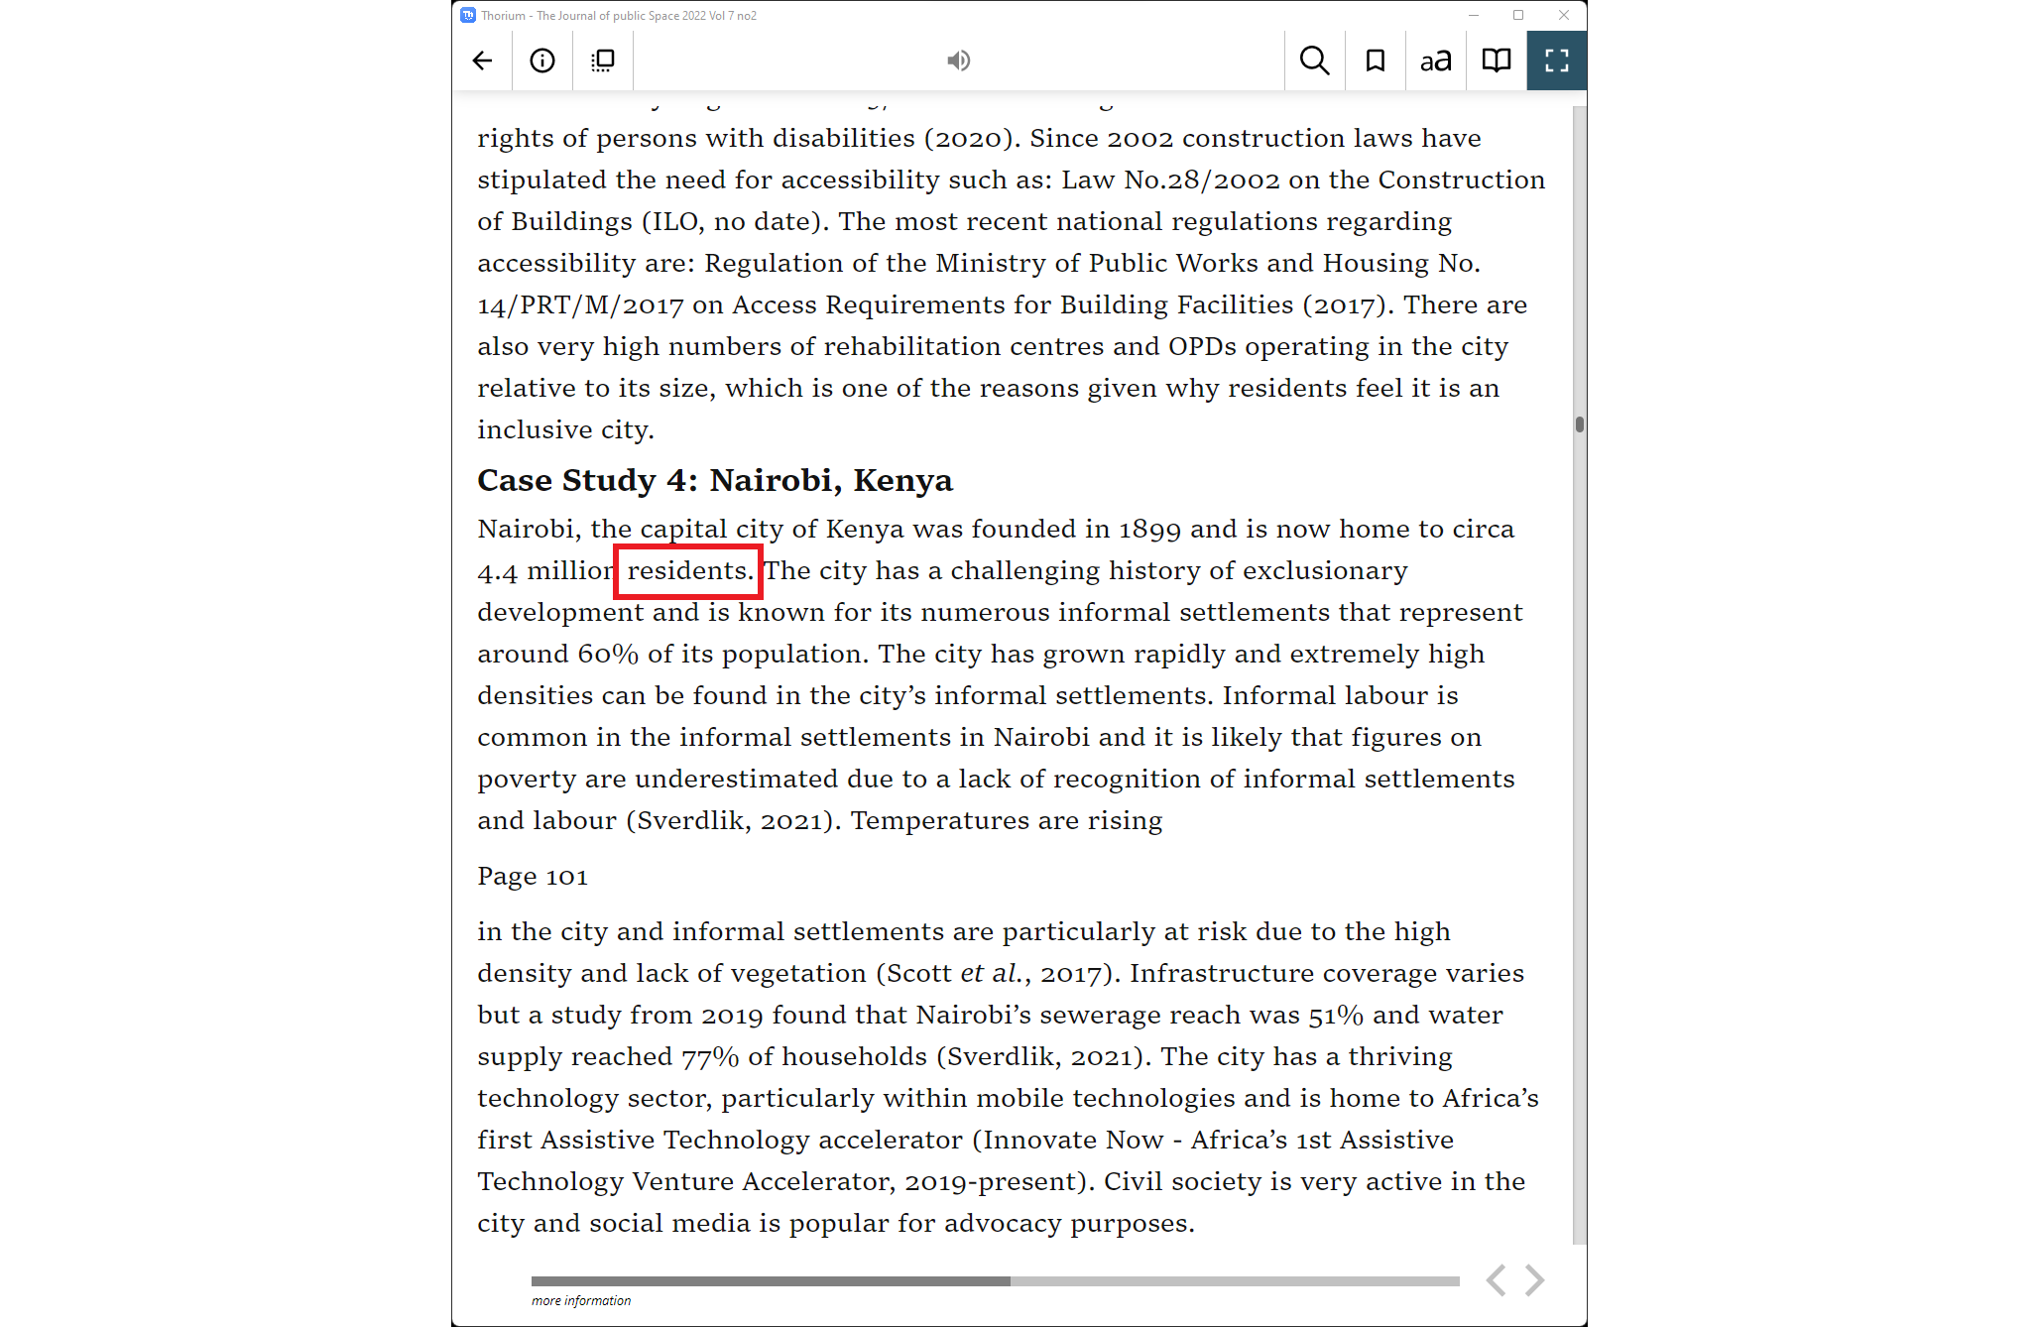
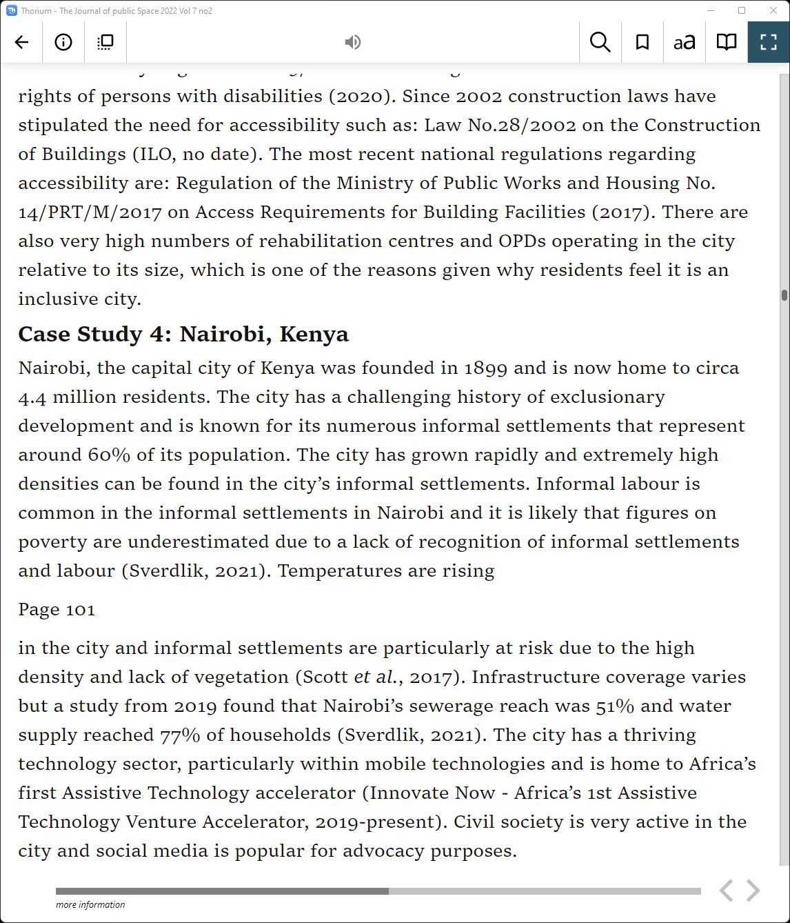
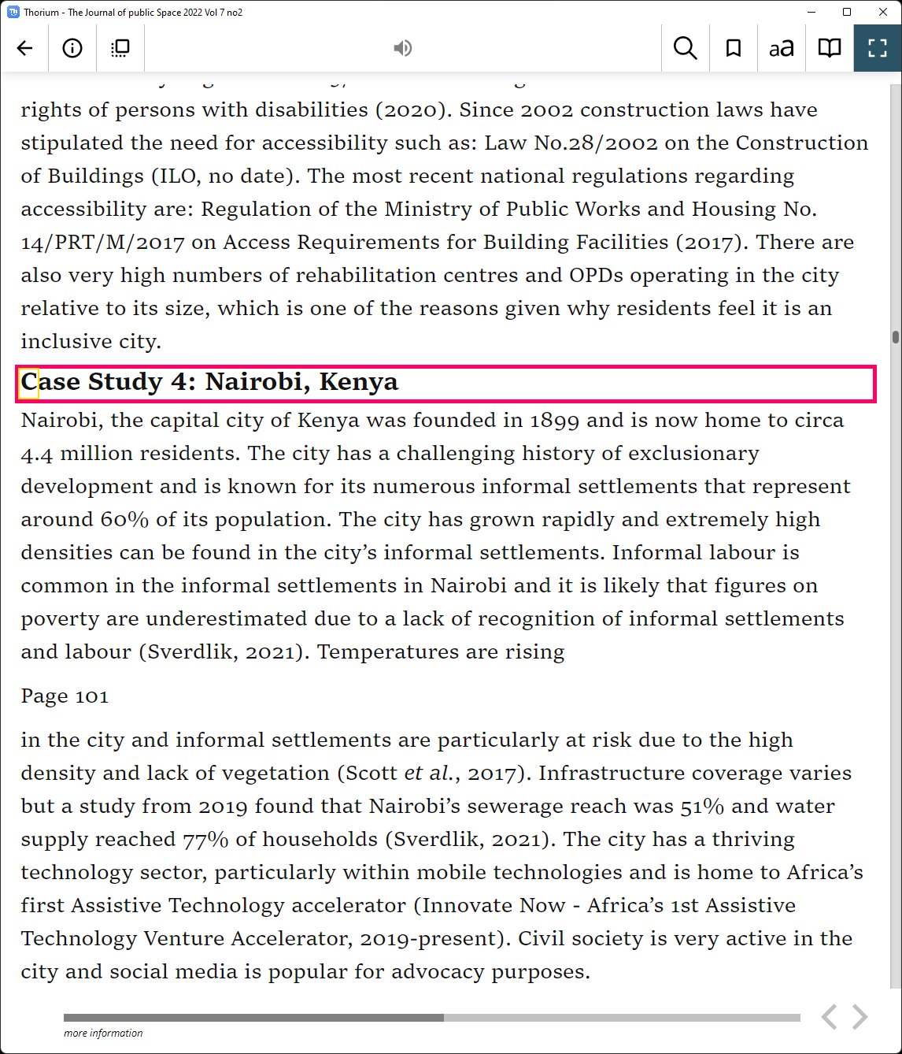
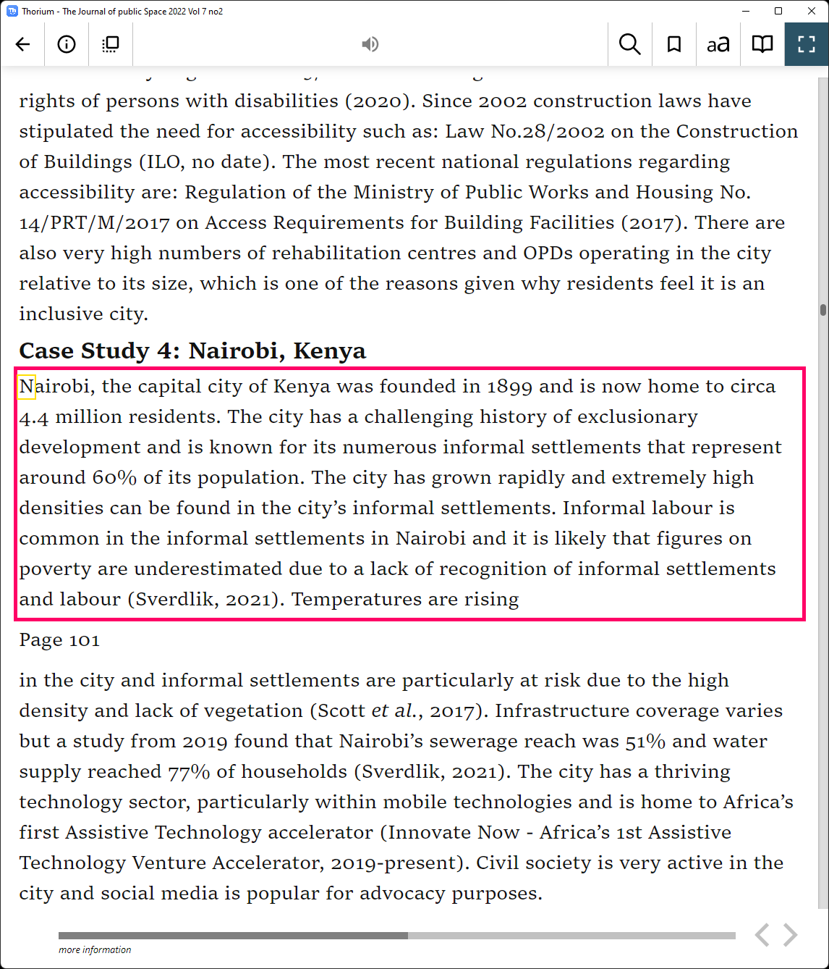
Screen reader – how it sounds
How it sounds

Slide 14
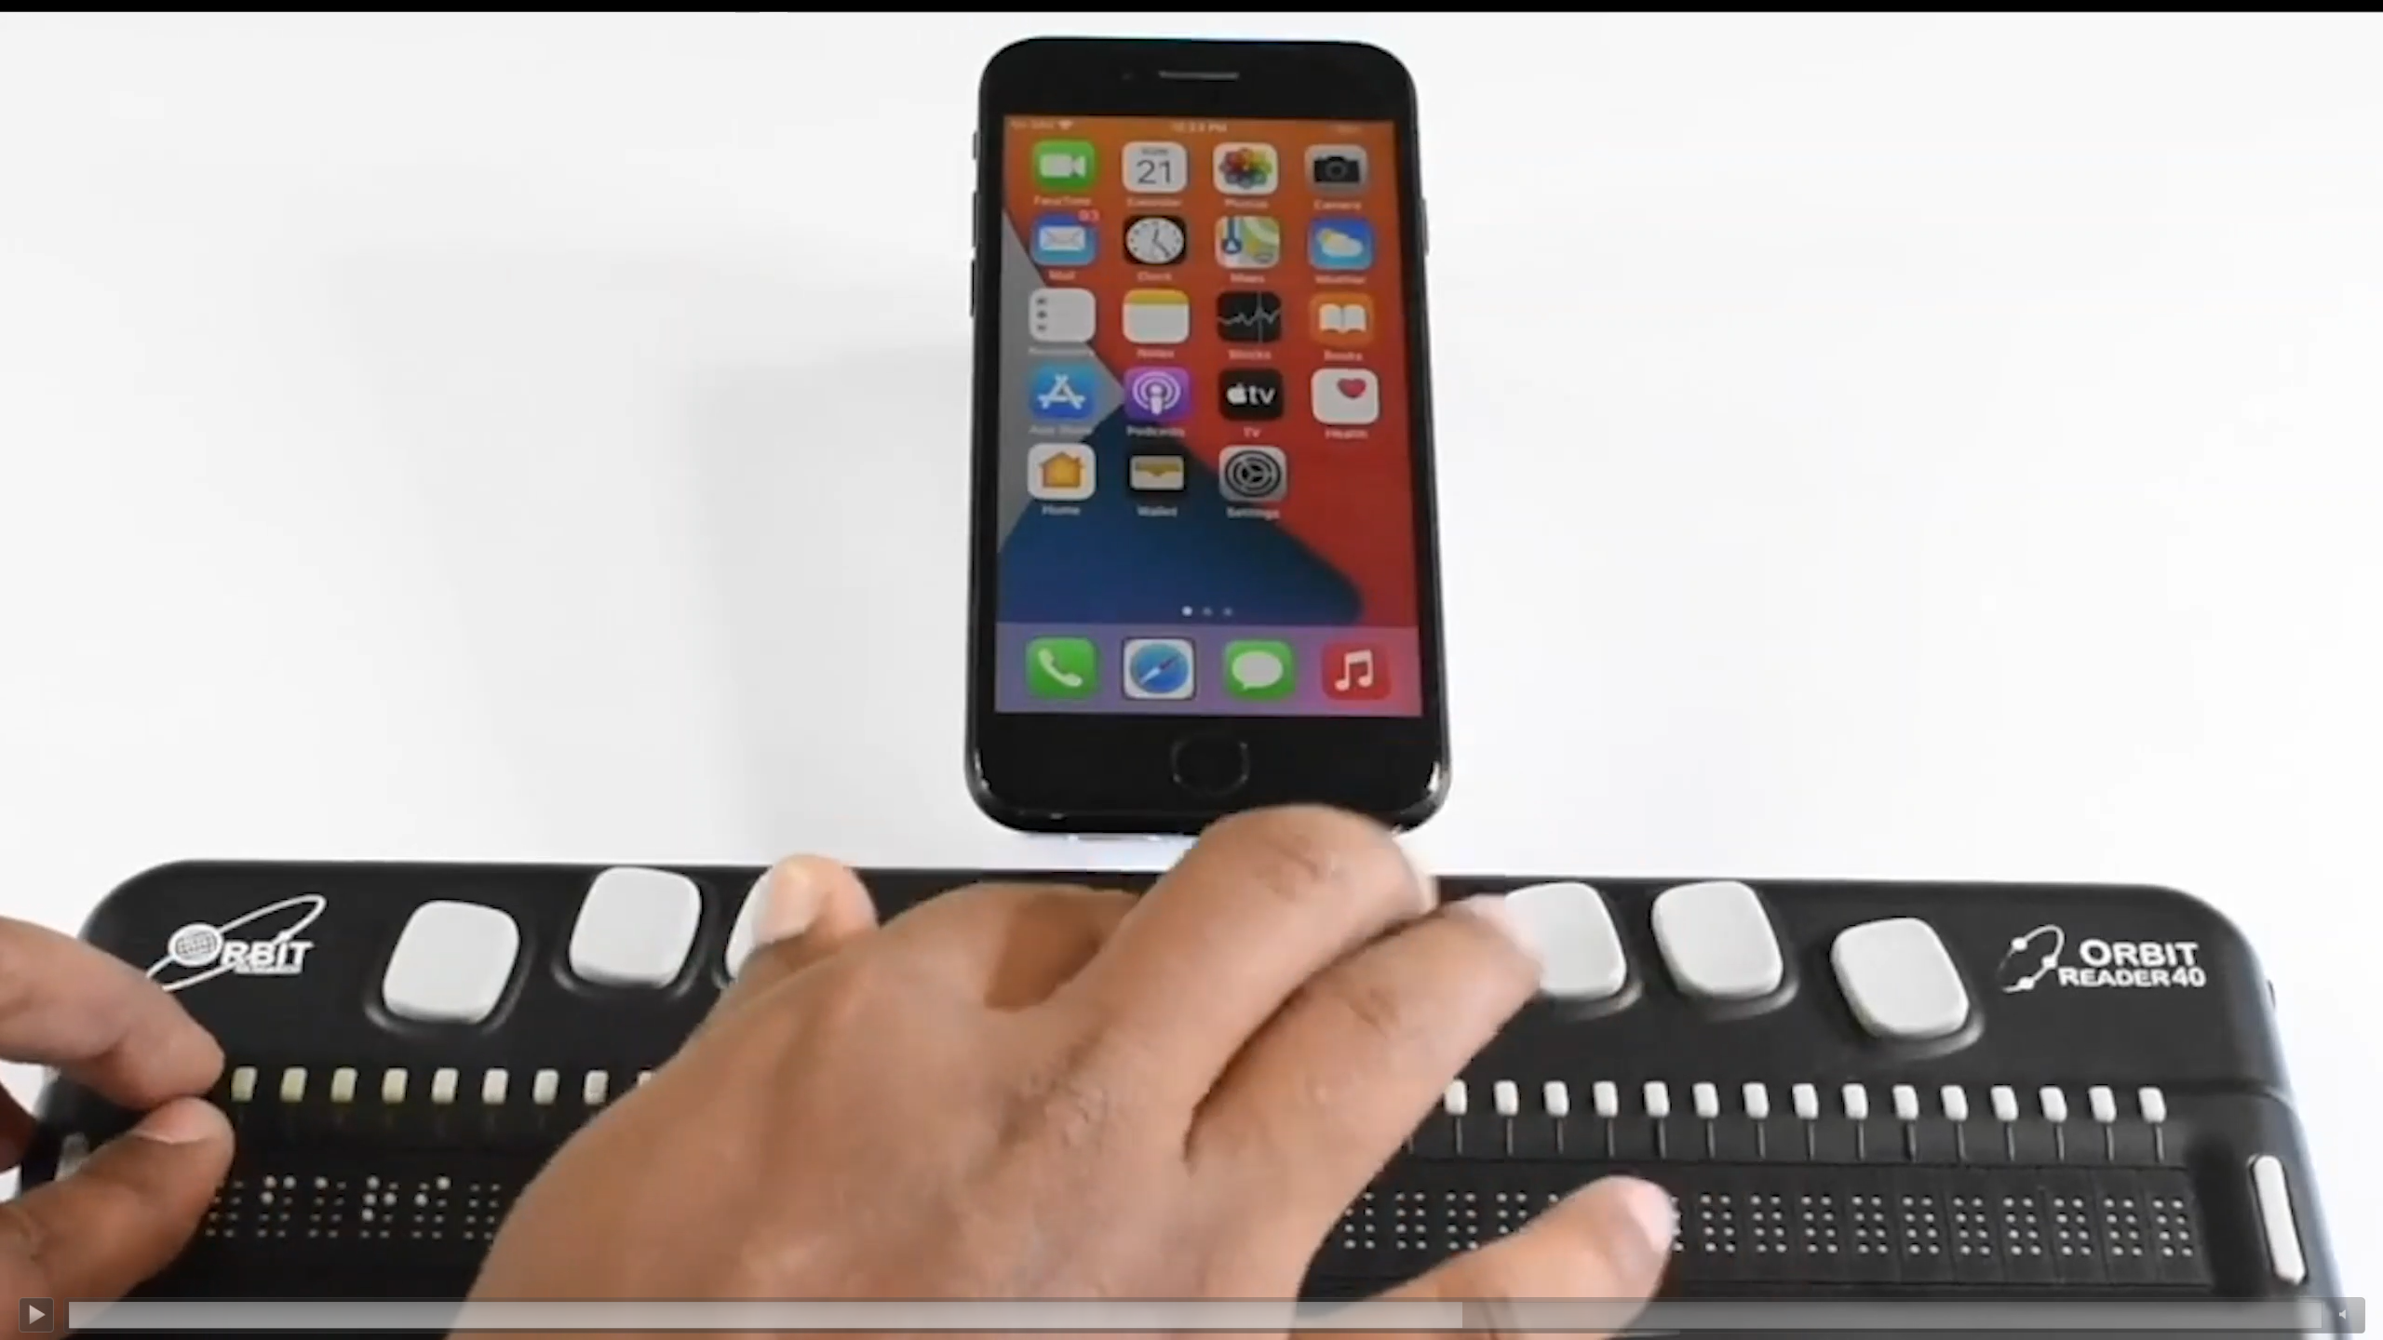
Electronic braille
A refreshable braille display can be connected to a computer or smartphone to read a book with fingers

Slide 15
Reading through touch
These devices control small plastic pins to form the braille patterns that can be read with the fingers

Slide 16
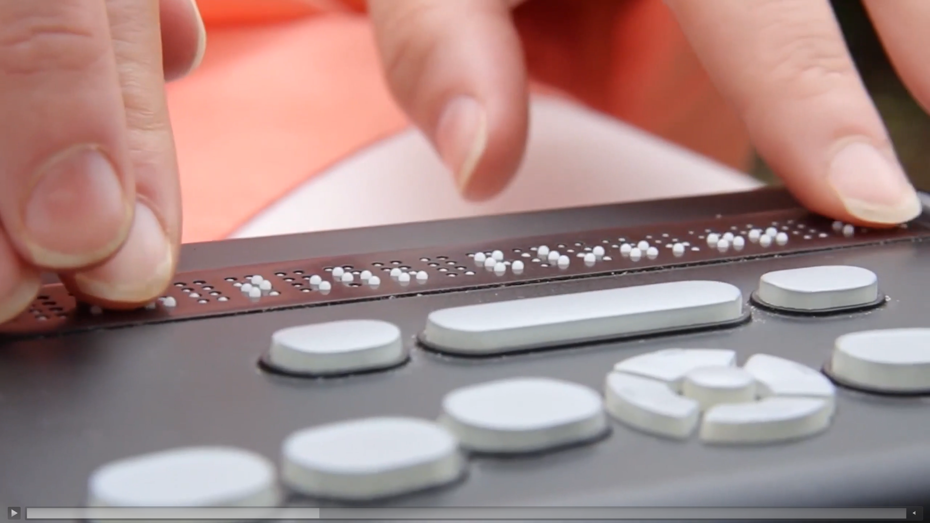
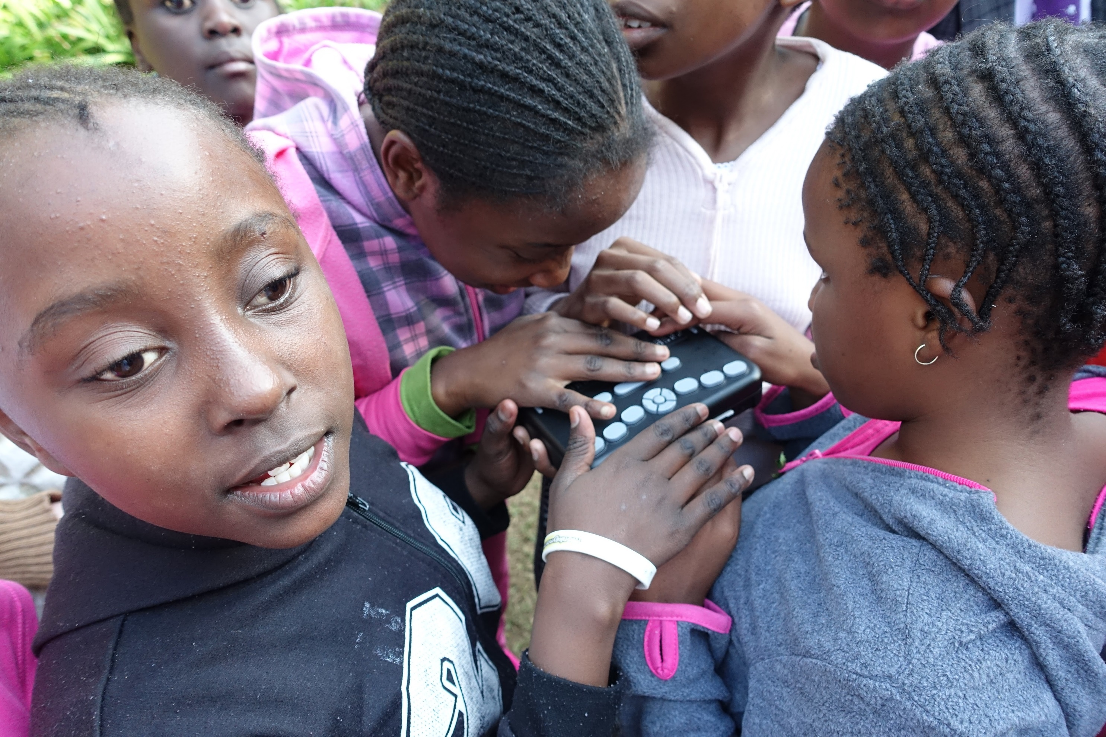
Images of Refreshable Braille

Slide 17
Learning disability / difference
Persons with dyslexia or other learning disabilities may customize the text layout and use Read Aloud
Notes:
A boy in India enjoys his books on a tablet computer with combined pictures, text and sound

Slide 18
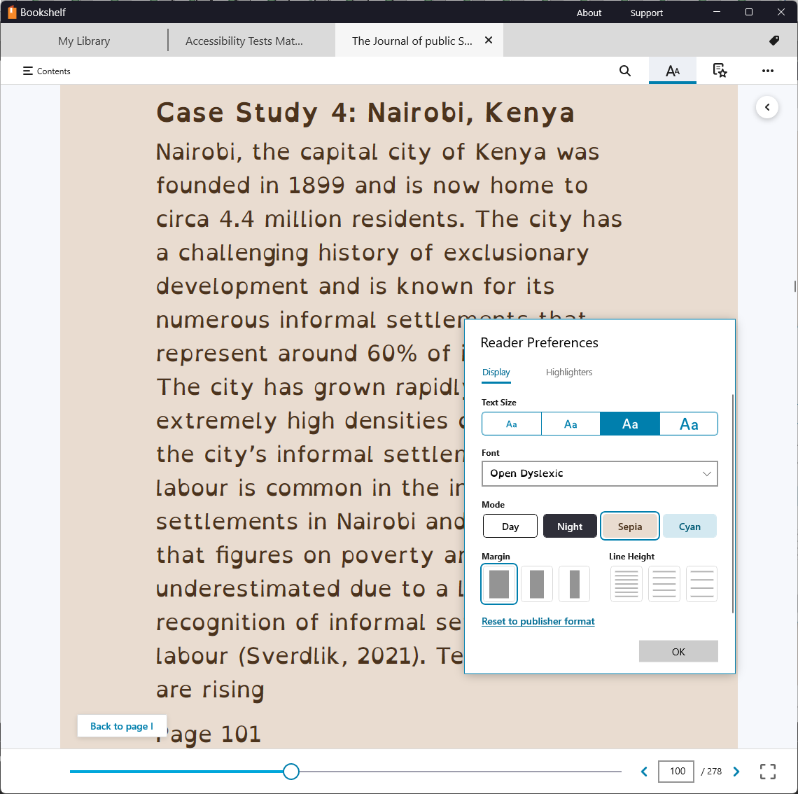
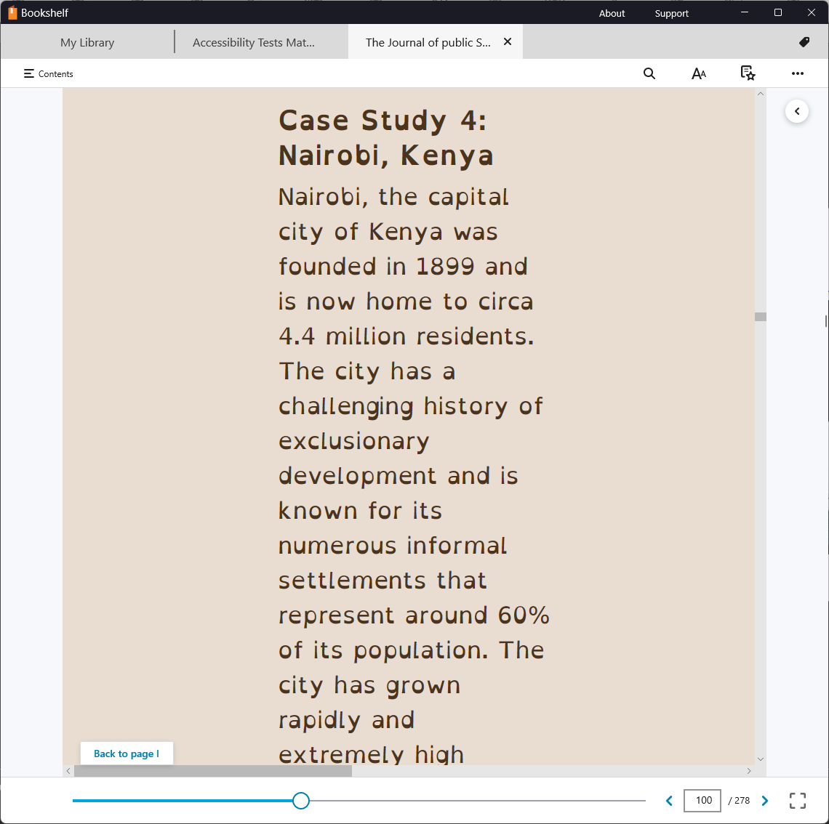
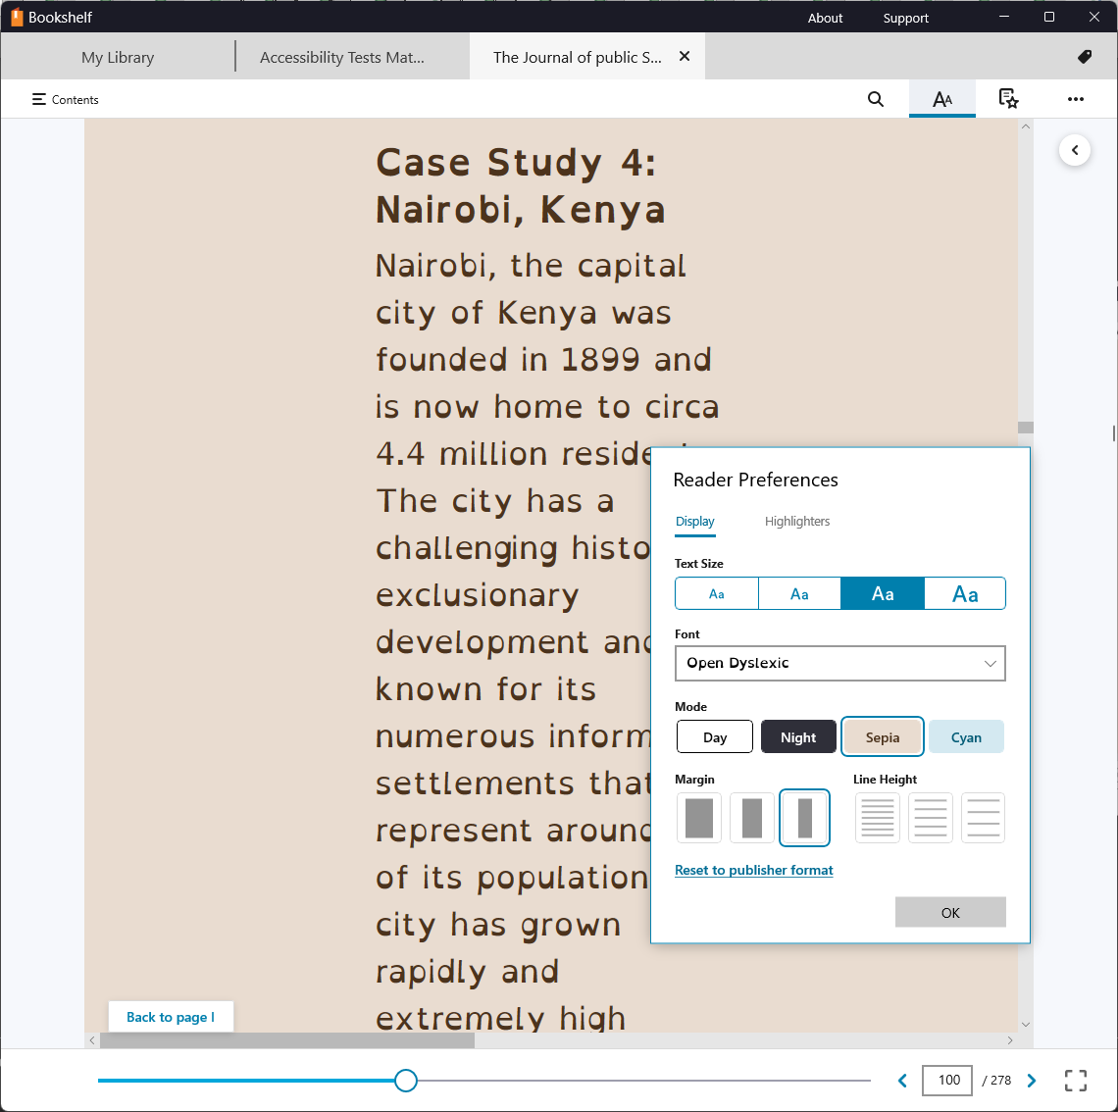
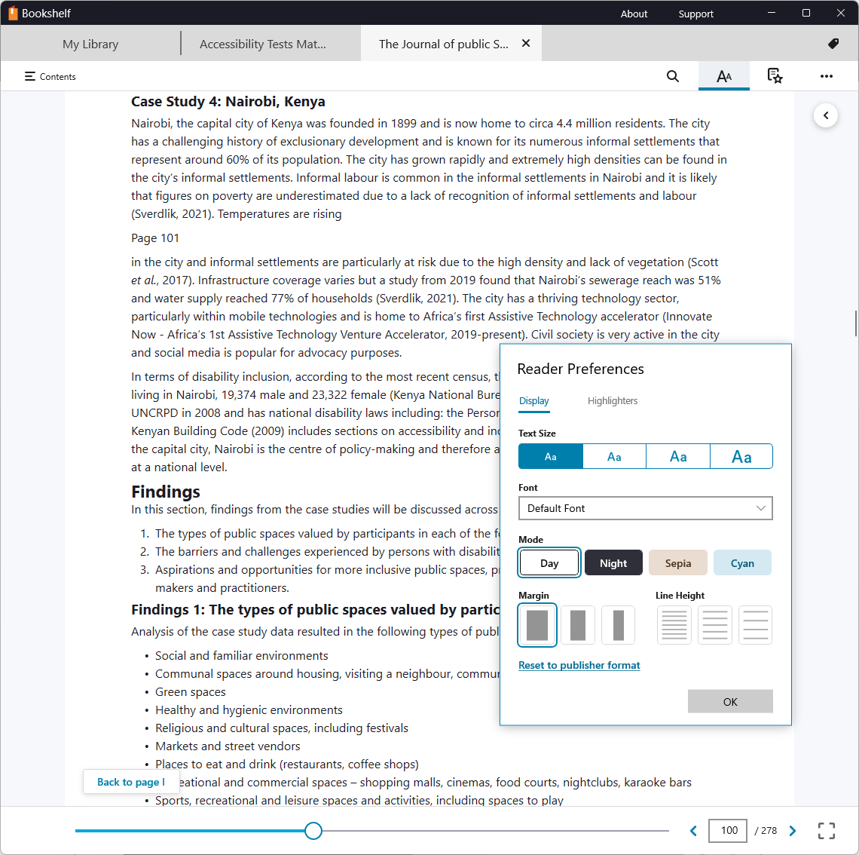
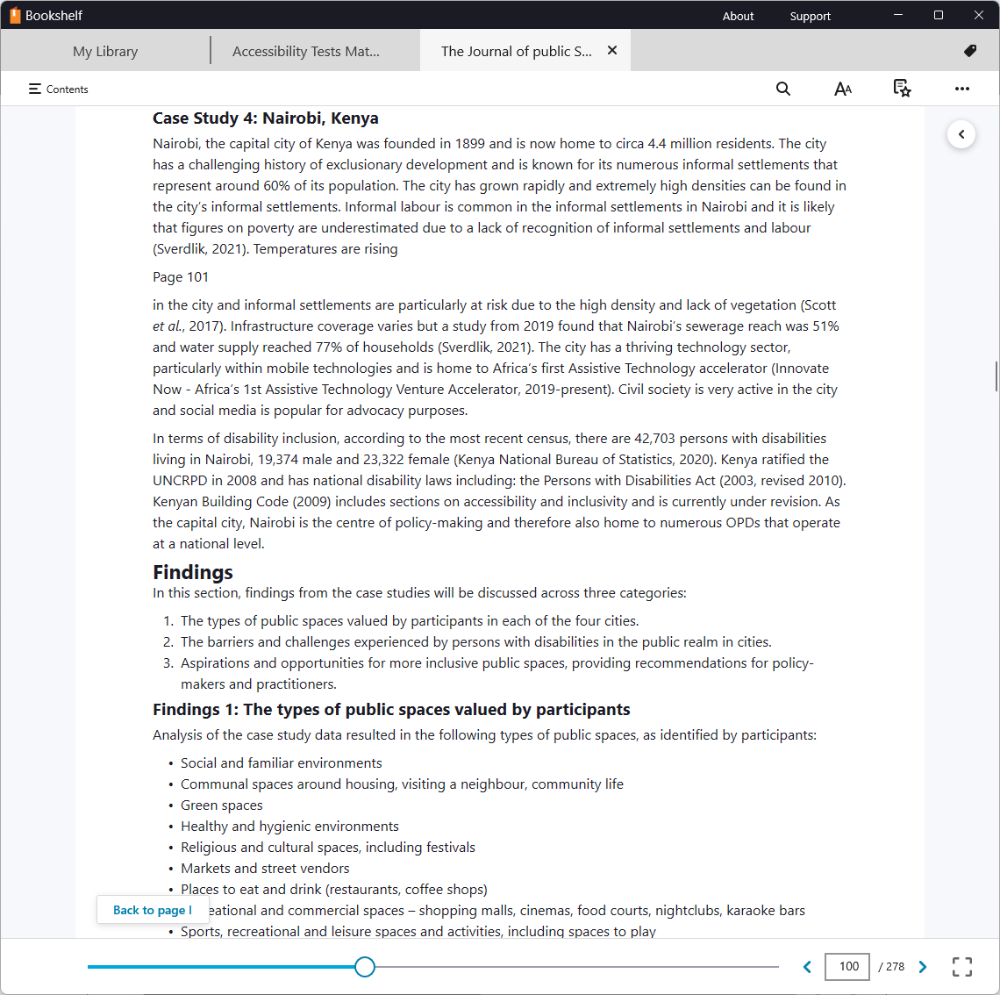
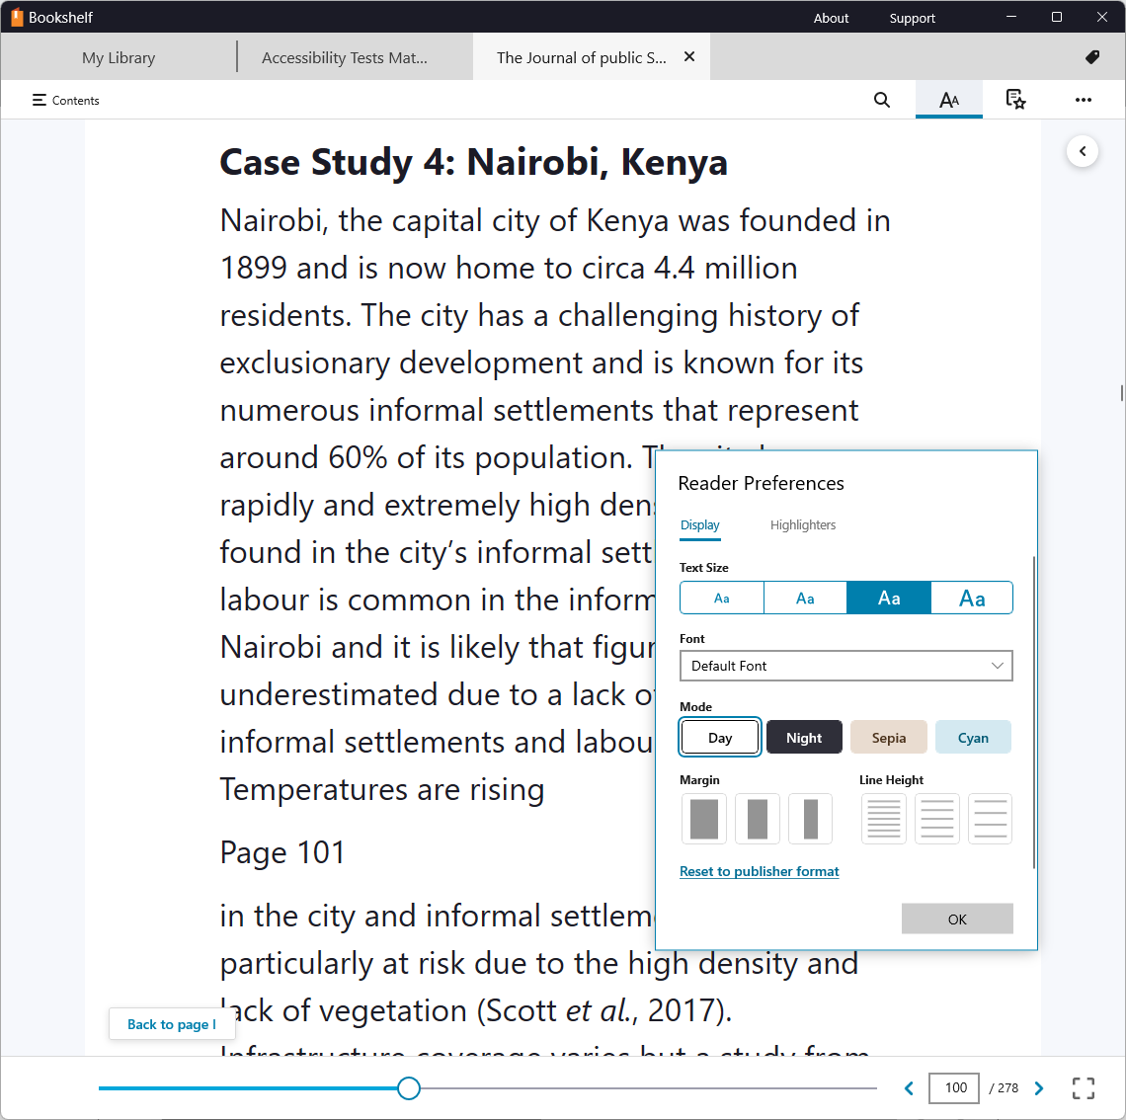
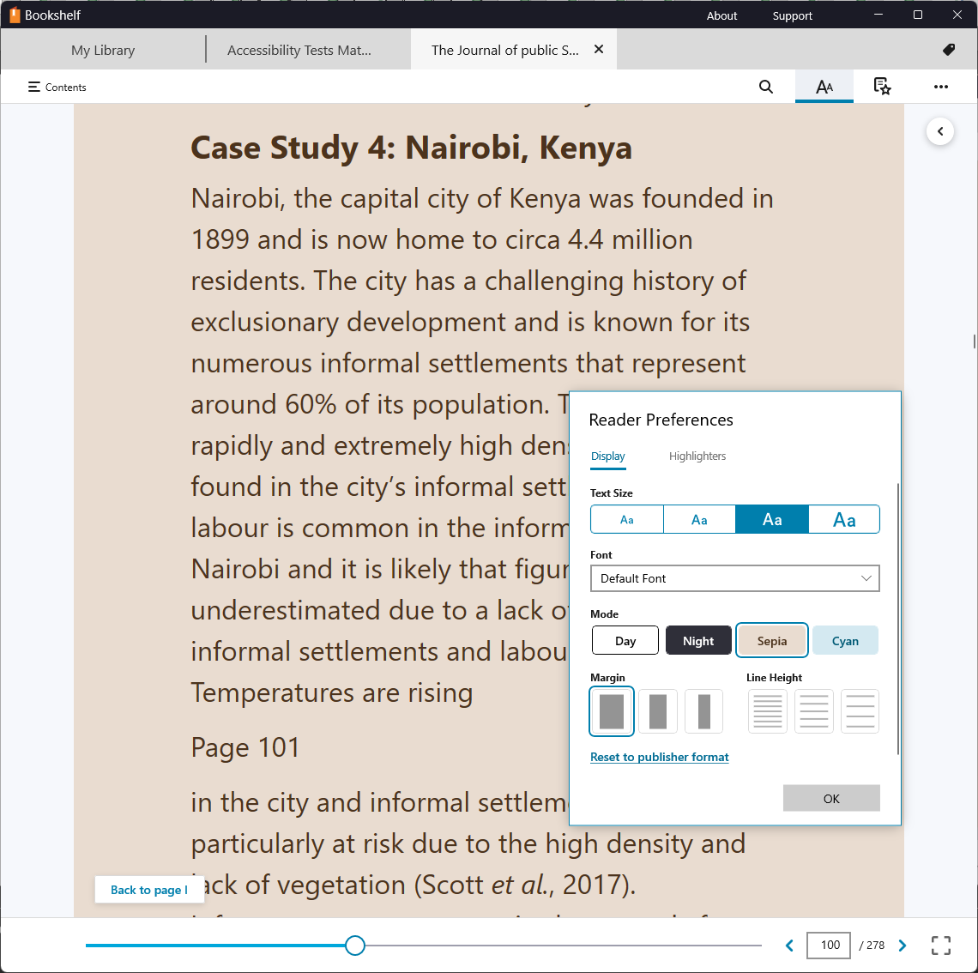
Dyslexia
To aid reading the user can:
Make text bigger
Change colours
Change font
Shorten line length

Slide 19
Physical disability
Persons with physical disabilities may use switch or voice control technology

Slide 20
How could people read your publications?
Persons with low vision could increase the text size and adjust colours
Persons who are blind use screen readers or refreshable braille
Persons with dyslexia or other learning disabilities may customize the text layout and use Read Aloud
Persons with physical disabilities may use switch or voice control technology

Slide 21
Examples of accessibility practises
Ensure text is text
Images of text can’t be read by assistive technology
Provide good structure
Use headings, lists, tables, links
Describe images
Short text descriptions make them accessible
Provide accessibility metadata
Let people know you did good work!

Slide 22
The Case for Accessible Publishing
Reach more readers
Comply with the law
Meet purchasing requirements
Enhance your image
Make better ebooks
Impact the Supply Chain
Promote your good work

Slide 23
Access training and support
Coming in 2022:
More webinars on Accessible Publishing Concepts (Zoom)
Online training course on IPA Academy (website)
Training on software for small groups (Zoom)
Technical support to answer your questions (email, WhatsApp)

Slide 24
Questions & Answers

Slide 25
Next steps
Watch out for an email from us
It will have a link to an online form
Answer the questions to be in the list for free technical trainings

Slide 26
Close
inclusivepublishing.org

