Slide 1





Accessible Math Unlocks STEM Education and Careers
Abstract:
People with disabilities are locked out of STEM education and careers because math is typically inaccessible. Learn how Microsoft 365 is changing that with improvements to the accessibility of math and easier ways to create accessible math. In partnership with DAISY Consortium, instructional designer and disability advocate from Johns Hopkins, Sara Shunkwiler, and many others in the community, the Microsoft 365 team learned about challenges with complex STEM accessibility and delivered life-changing updates to impact who gets to be in STEM and Medicine.
Presenters:
Peter Wu
Microsoft
Richard Orme
DAISY Consortium
George Kerscher
DAISY Consortium
Sara Shunkwiler
Hopkins Engineering
Resources:
Slides
Writing and presenting about math is easy and inclusive with Microsoft 365
Make math inclusive for everyone with Microsoft 365

Slide 2






Partnering with the Community
Inaccessible math is typical in education, research, & STEM workplaces
Complex workflows required outside apps to create accessible math
Rampant use of inaccessible plain text or images of math equations

Slide 3
Improved accessibility of reading and editing math in Microsoft 365

Slide 4
Provide Feedback with Sound
Word, Excel, PowerPoint, and OneNote for Windows

Slide 5
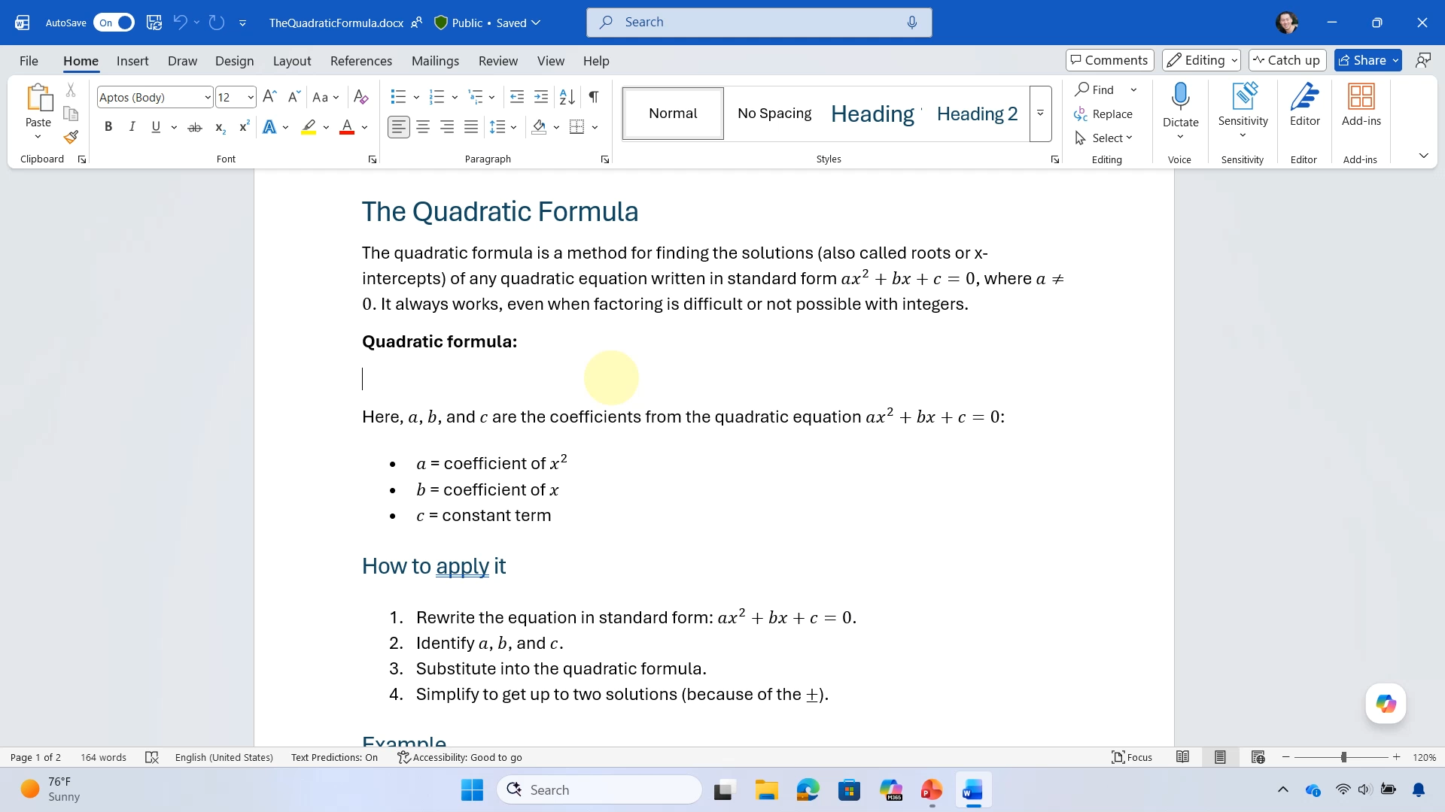
Provide Feedback with Sound in Word for Windows
Notes:
Provide Feedback with Sound in Word for Windows

Slide 6

Typing math using Unicode Math in Word for Windows
Notes:
Typing math using Unicode Math in Word for WIndows

Slide 7
Reading Math with NVDA and MathCAT
Word for Windows

Slide 8
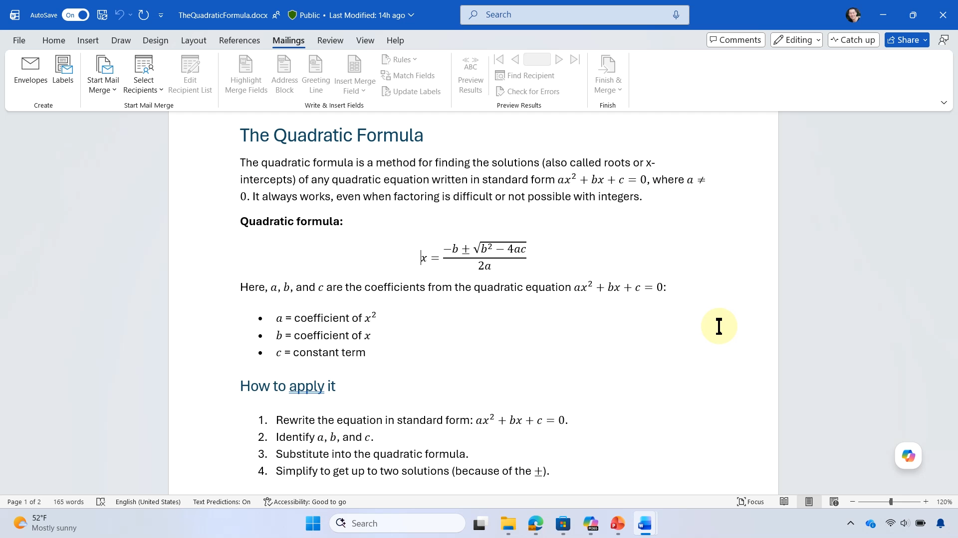
Reading math with NVDA and MathCAT in Word for Windows
⇨
⇩ (2x)
⇩
⇨
⇩
⇦
⇨
⇩
⇨ (2x)
⇨
NVDA + Alt + M
⇨
Notes:
Reading math with NVDA and MathCAT inWord for Windows

Slide 9
Additional Context when Editing Math with a Screen Reader
Word, Excel, PowerPoint, and OneNote for Windows

Slide 10
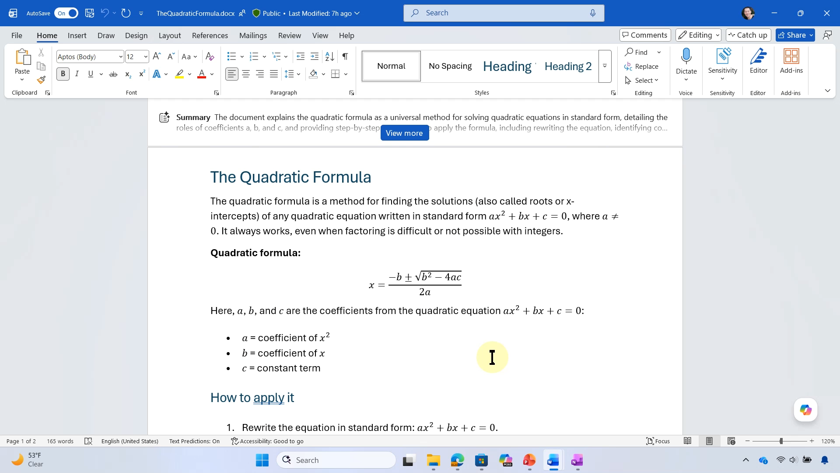
Navigate math in Word for Windows with NVDA
Notes:
Navigate math in Word for Windows with NVDA

Slide 11
100+ Additional Math Autocorrect Codes
Word, Excel, PowerPoint, and OneNote for Windows and Mac

Slide 12
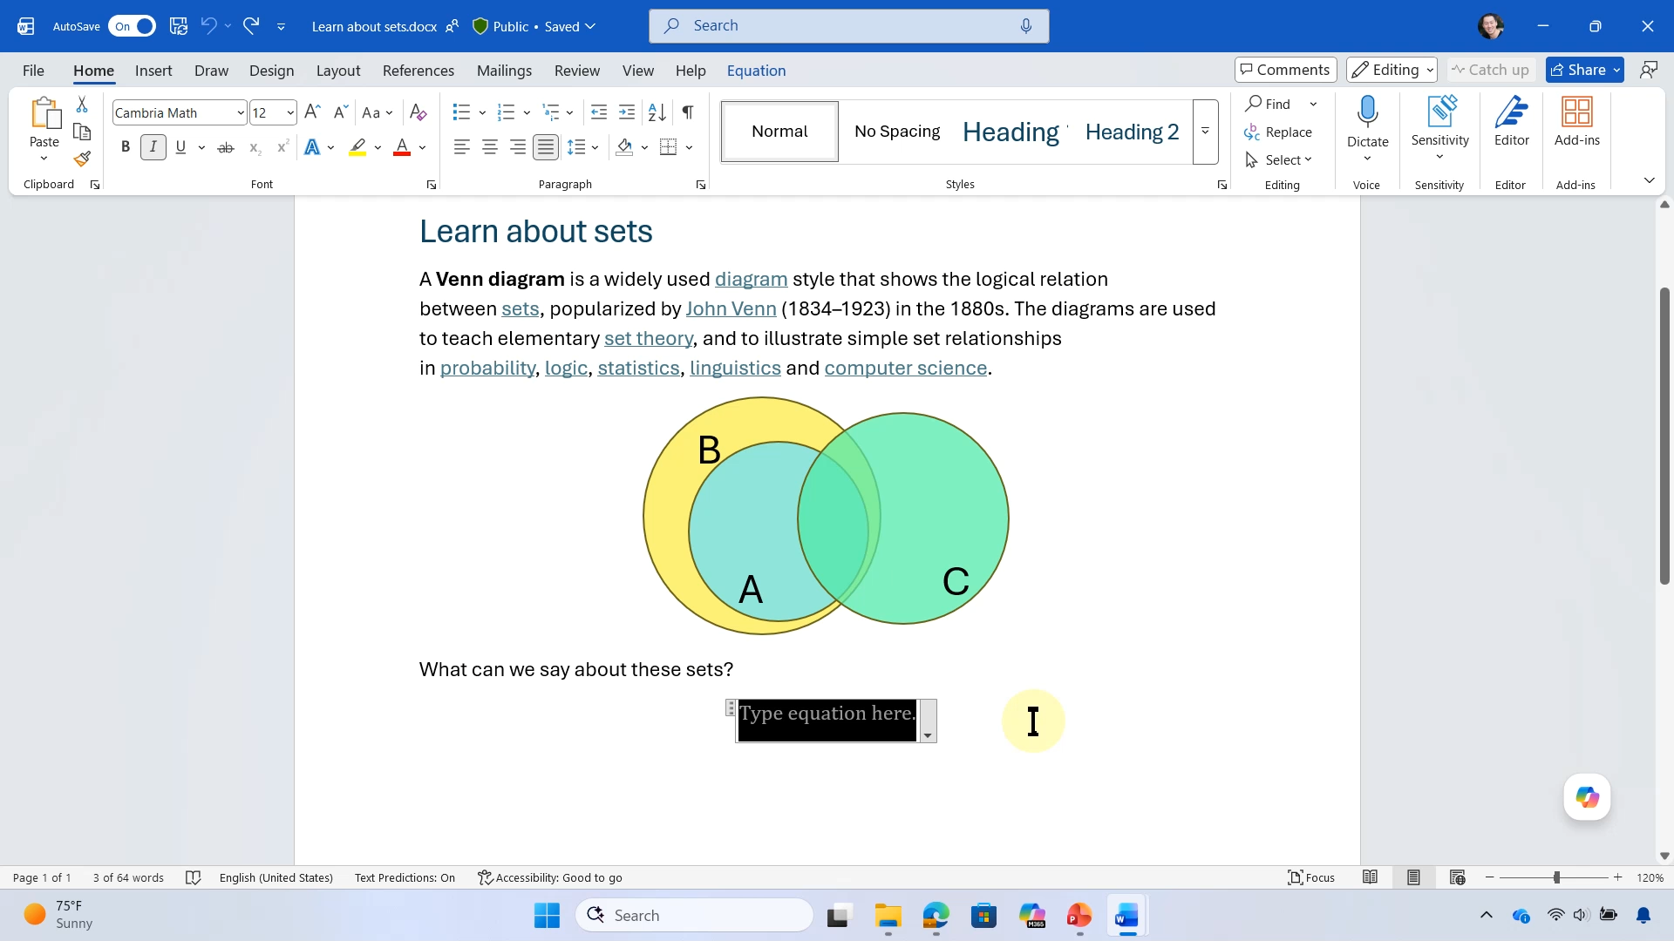
Math autocorrect
Notes:
Math Autocorrect

Slide 13
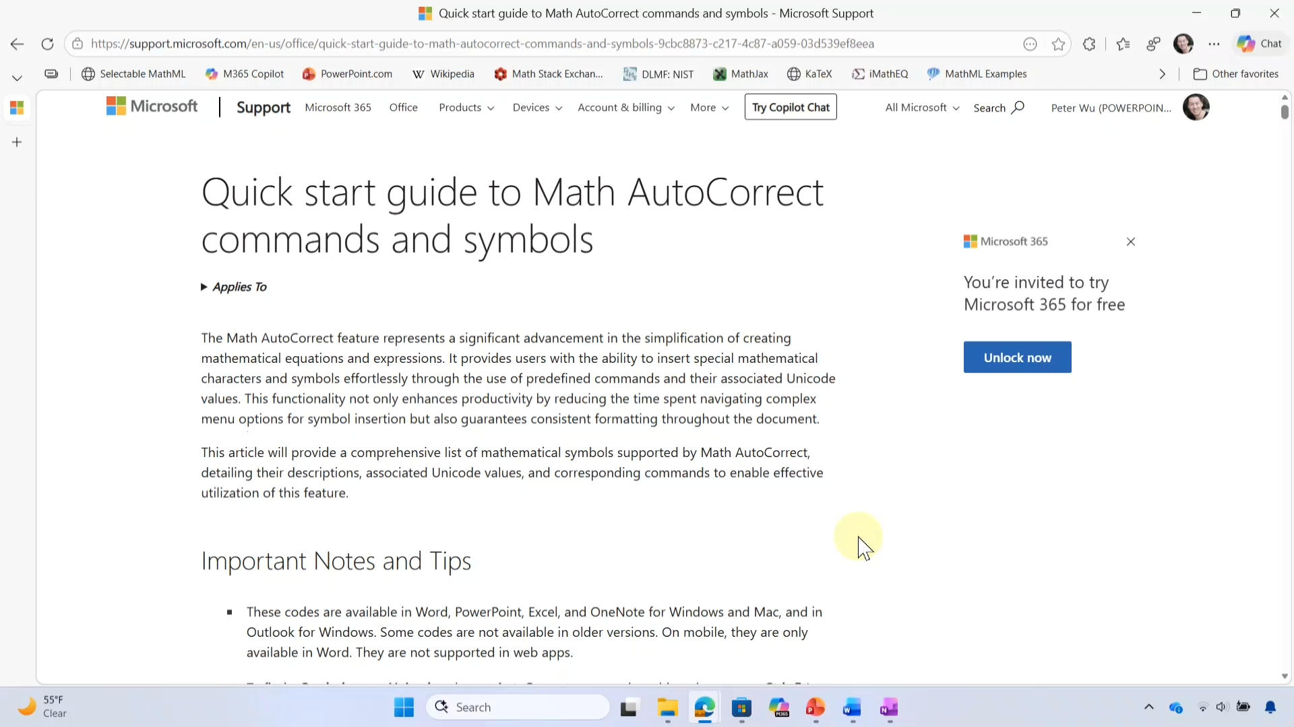
Math autocorrect Documentation
Notes:
Math autocorrect Documentation
https://support.microsoft.com/en-US/accessibility/word/quick-start-guide-to-math-autocorrect-commands-and-symbols

Slide 14
Improved math reading with a screen reader
Word, Excel, PowerPoint, and OneNote
PowerPoint Live in Teams

Slide 15
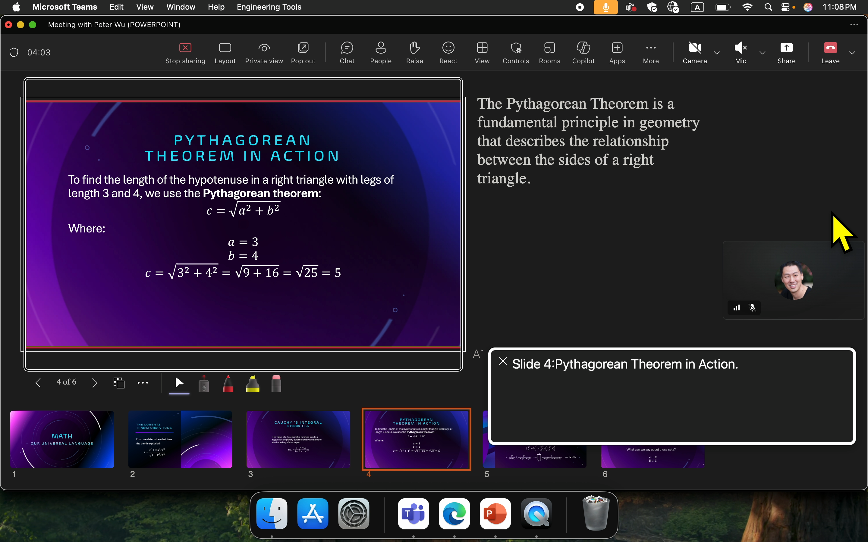
Reading math on the slide in PowerPoint Live in Teams using VoiceOver
Notes:
Reading math on the slide in PowerPoint Livein Teams using VoiceOver

Slide 16






Microsoft 365 makes native math accessible using MathML
Microsoft 365
MathML
Assistive Tech

Slide 17
Math in the real world is mostly inaccessible!

Slide 18


Images of Equations
$${\left(x+Δx\right)}^{n}=x^{n}+nx^{n−1}Δx+\left({n \atop 2}\right)x^{n−2}{\left(Δx\right)}^{2}+⋯$$

Slide 19

Plain Text as Equations
Plain text visually confusing and read incorrectly
e^(x^2 + y^2)^(1/2) / (1 + e^(x-y)^2)
Math equation that is navigable and read correctly as math
$$\frac{e^{{\left(x^{2}+y^{2}\right)}^{\frac{1}{2}}}}{1+e^{{\left(x−y\right)}^{2}}}$$

Slide 20
Improvements in Microsoft 365 make it easier to create accessible math!

Slide 21








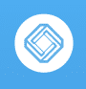

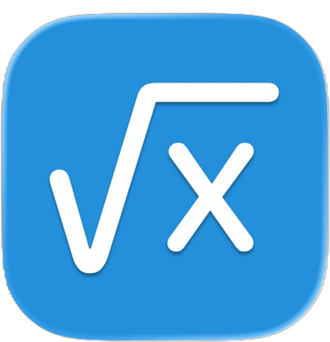







It's easy to bring accessible math into Microsoft 365 using MathML
AI
Web Content
Apps
MathML
MathML
Browsers
MathML
EPUB
MathML
MathML
Microsoft 365
MathML
MathML
Assistive Tech

Slide 22
Paste math from web and other apps
Word, Excel, PowerPoint for Windows and Mac

Slide 23
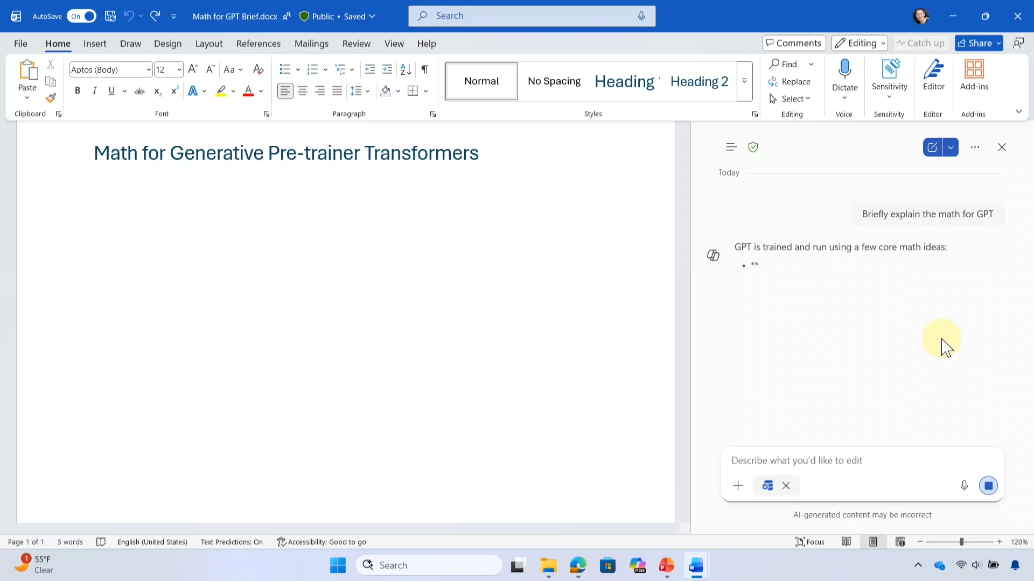
Copy math from Copilot Pane, paste into Word for Windows

Slide 24
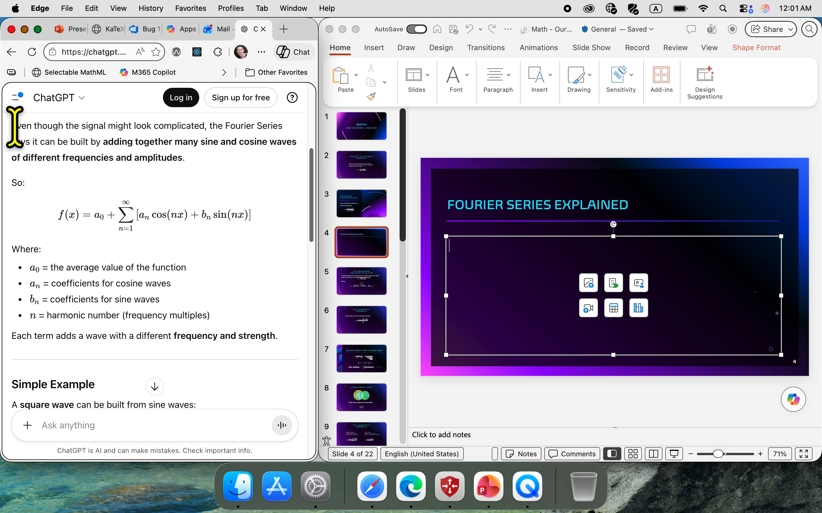
Copy math from ChatGPT in Edge; Paste into PowerPoint for Mac

Slide 25
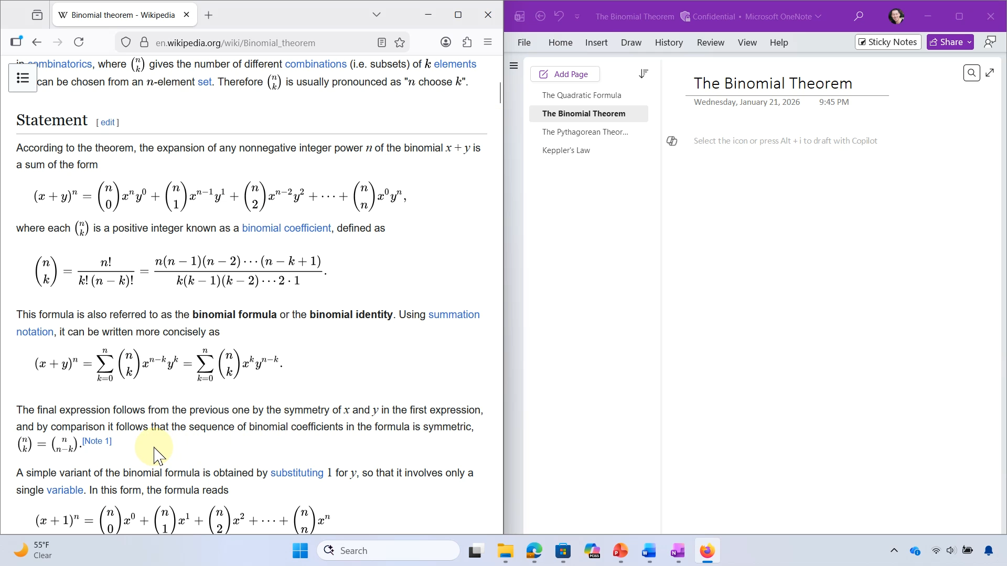
Copy math from Wikipedia in Firefox, Paste into OneNote for Windows

Slide 26
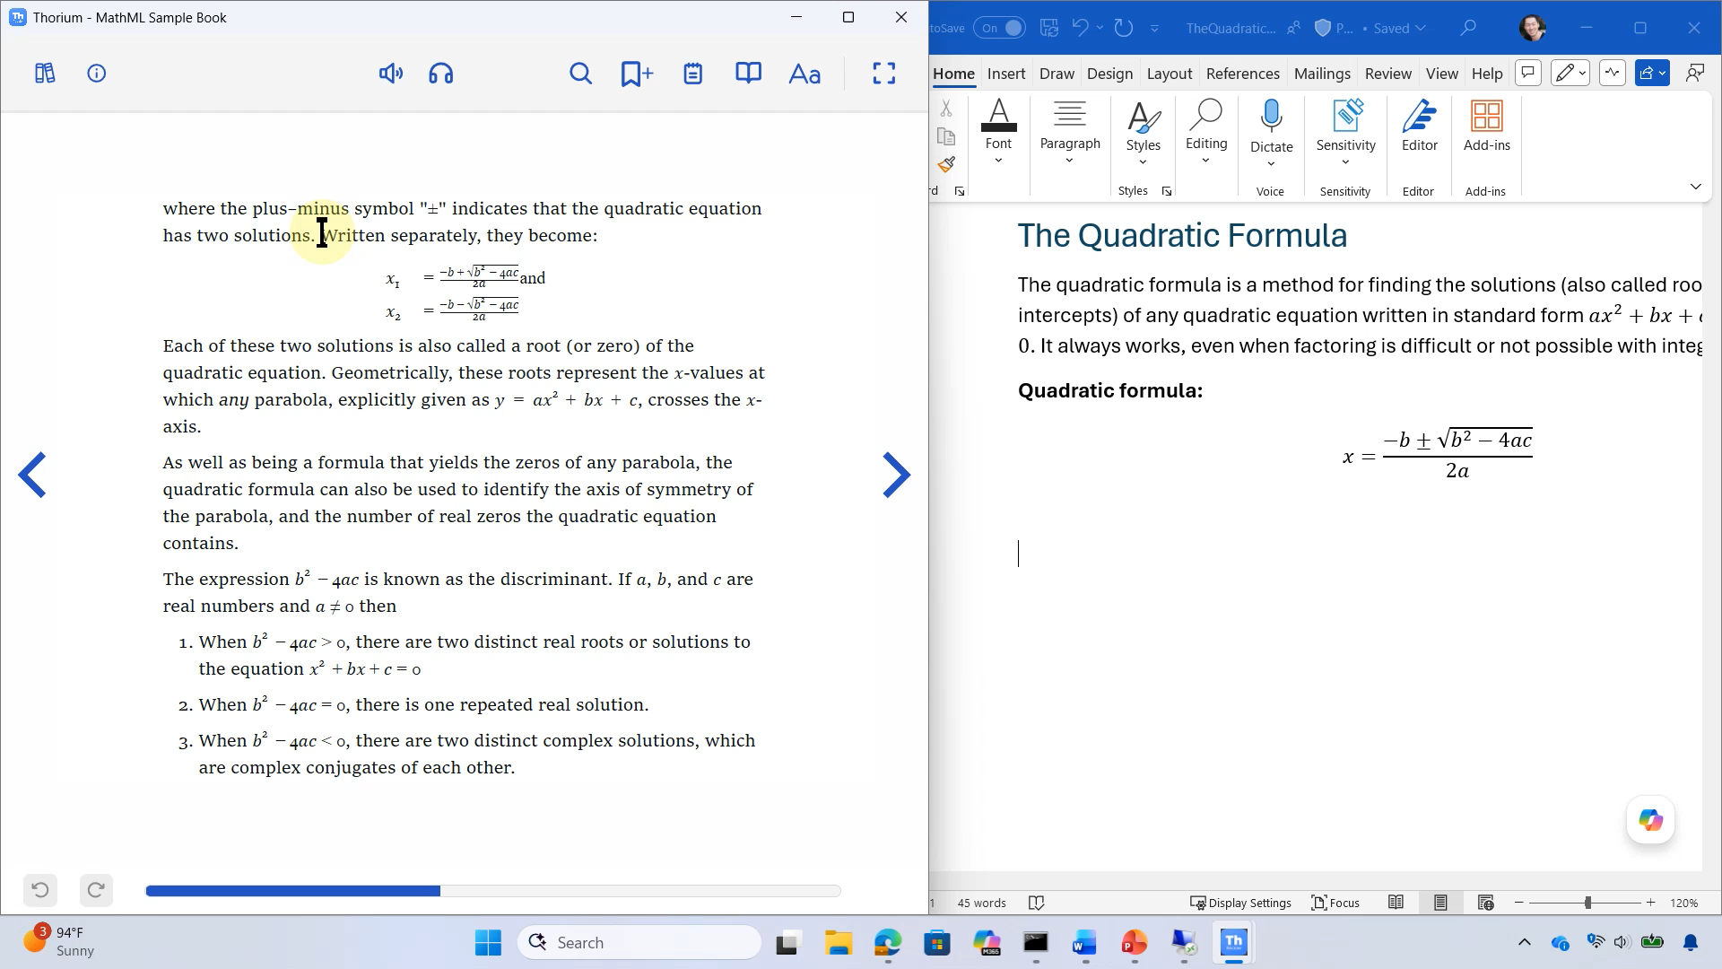
Copy math from Thorium ePub reader into Word for Windows

Slide 27
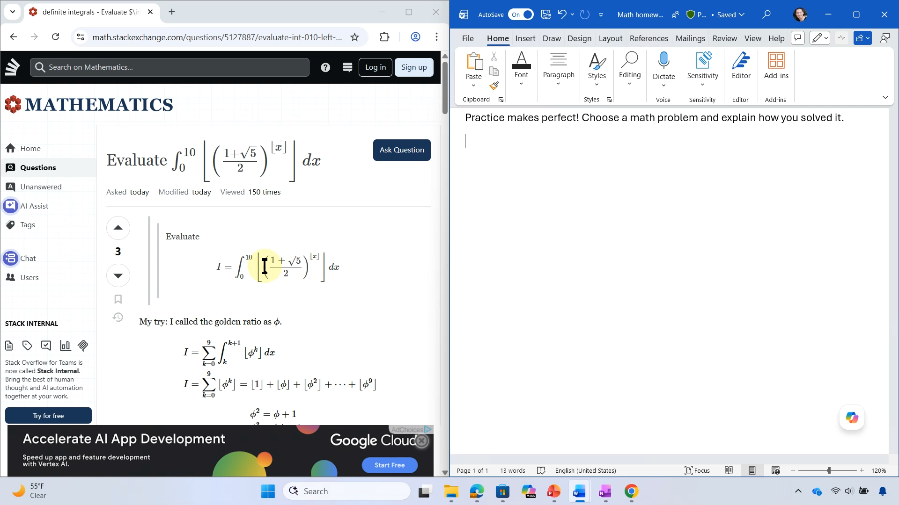
Copy math from Math Stack Exchange, one at a time using MathJax MathML window, paste into Word for Windows

Slide 28
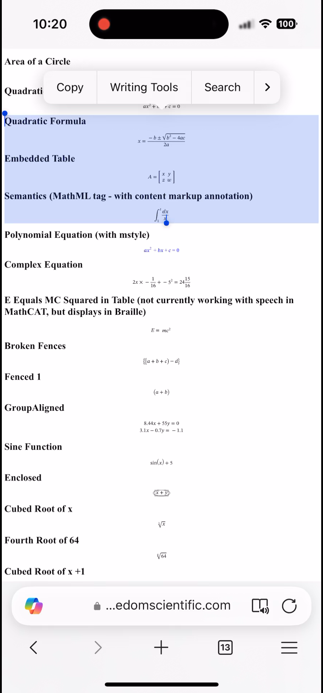
Copy MathML in HTML in Edge to PowerPoint on iOS

Slide 29
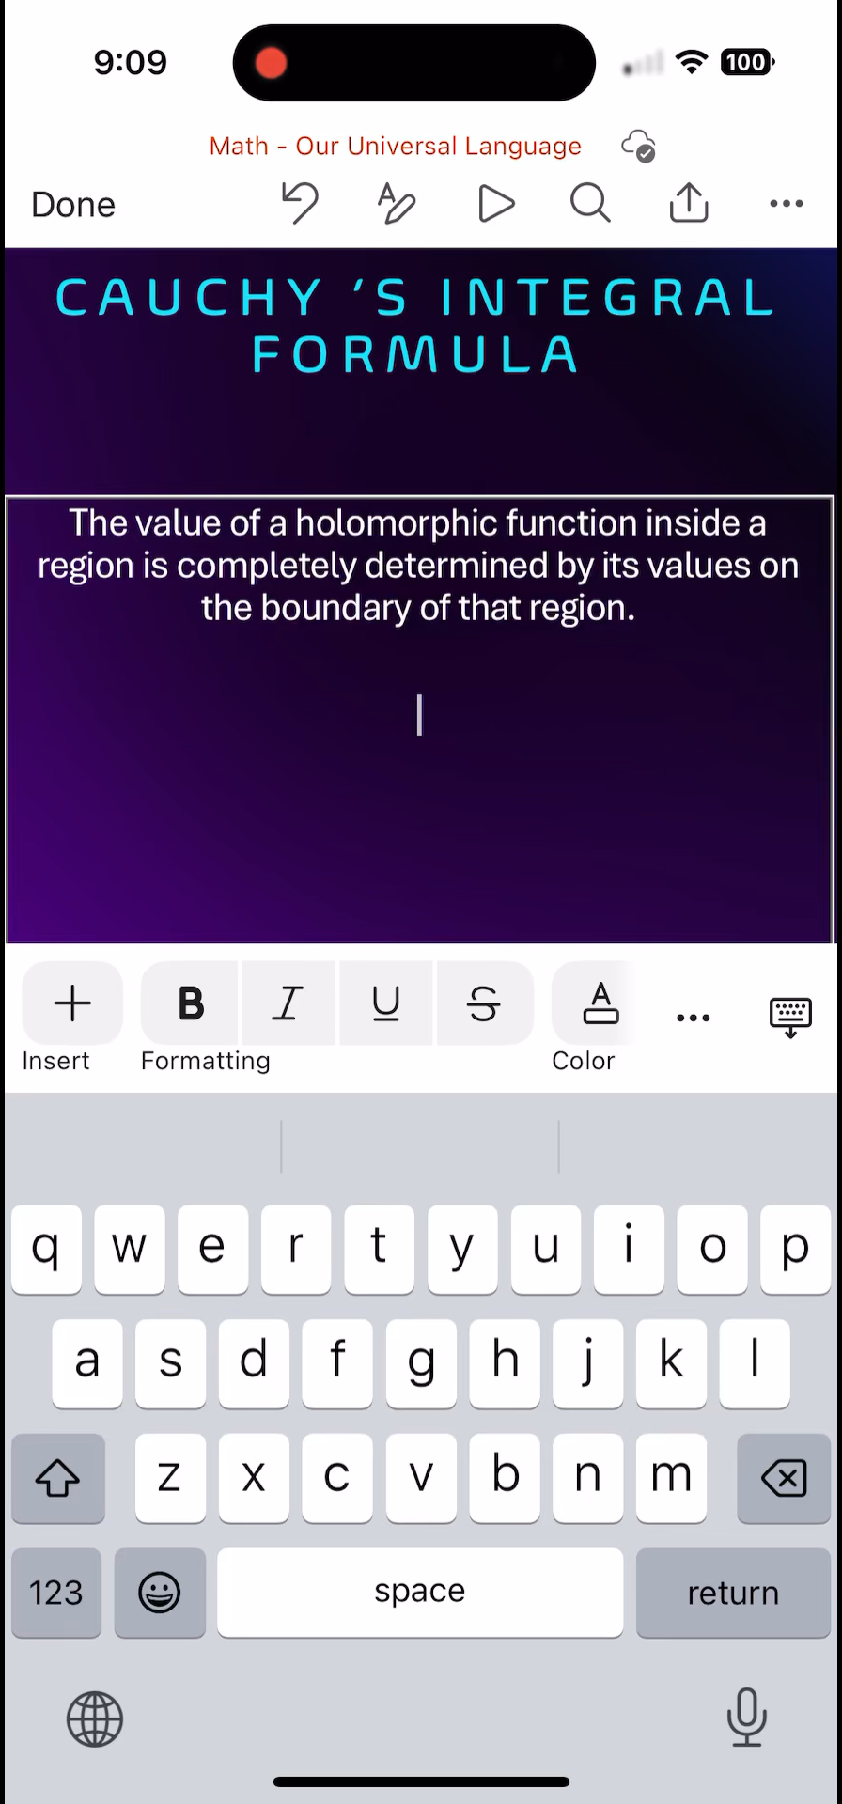
xFormula keyboard in PowerPoint for iOS

Slide 30
Impact: accessible math in Microsoft 365 from MathML
3.5M
users/month
117M
equations/month

Slide 31
Copy math and paste in other apps
Word, Excel, PowerPoint for Windows and Mac

Slide 32
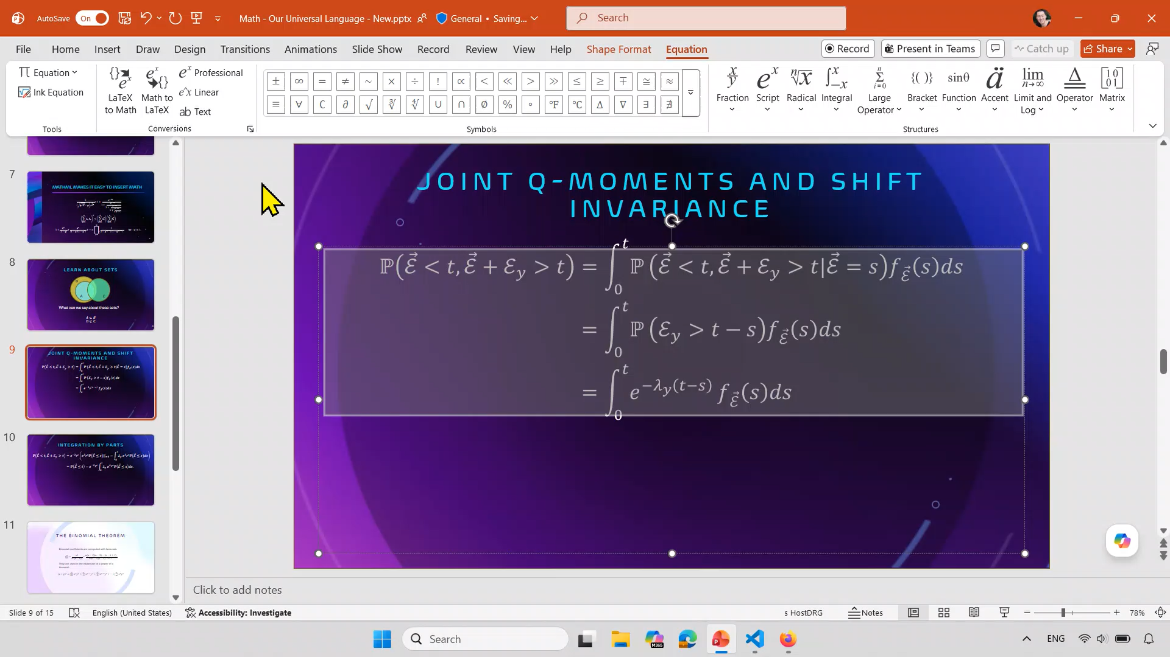
Copy as MathML in PowerPoint and Paste into HTML source of web page

Slide 33
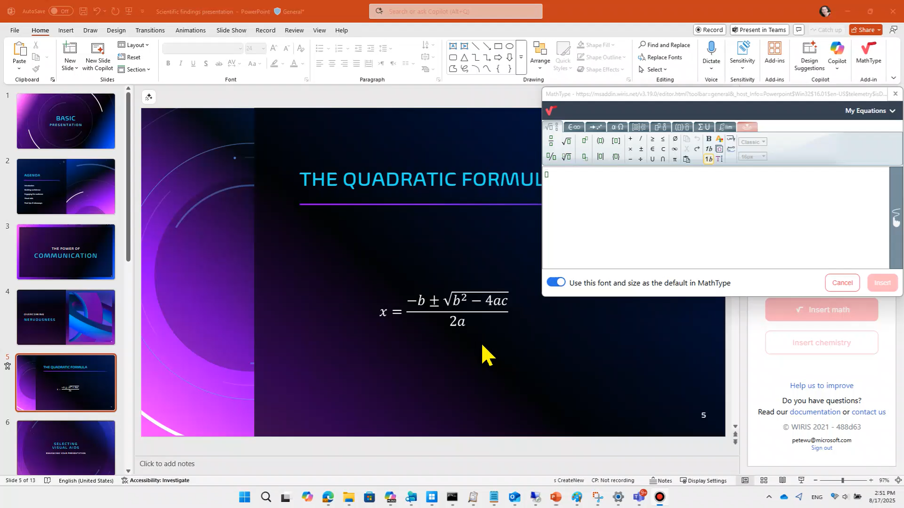
Copy MathML from PowerPoint for Windows to MathType

Slide 34
Enter and edit math in LaTeX
Word, Excel, PowerPoint for Windows and Mac

Slide 35




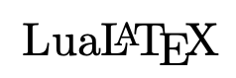

LaTeX authors created the accessible math on the web and they can accessible math in Microsoft 365 as well
AI
Web Content
Apps
MathML
MathML
MathML
Browsers
MathML
EPUB
MathML
MathML
LaTeX
TeX
Microsoft 365
LaTeX
MathML
MathML
Assistive Tech

Slide 36
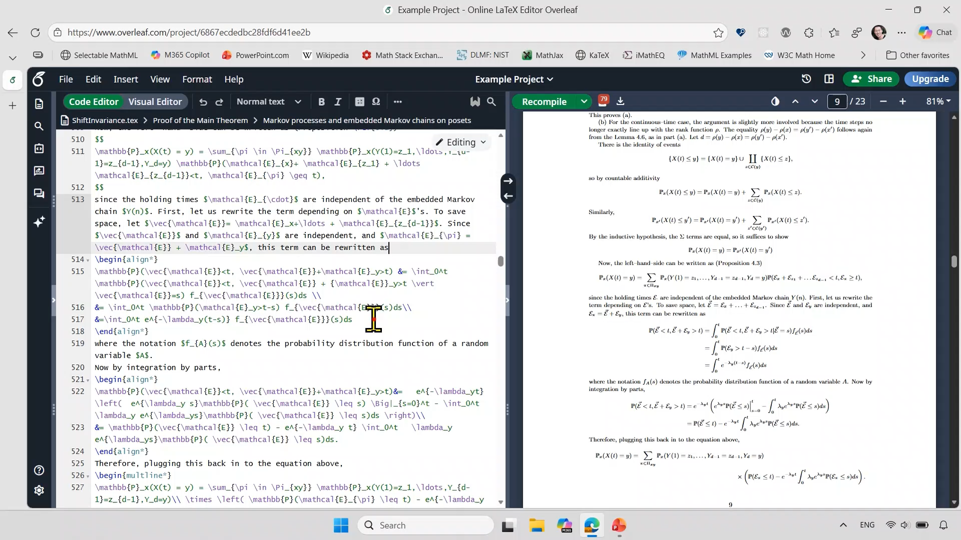
Copy/Pasting LaTeX into PowerPoint

Slide 37
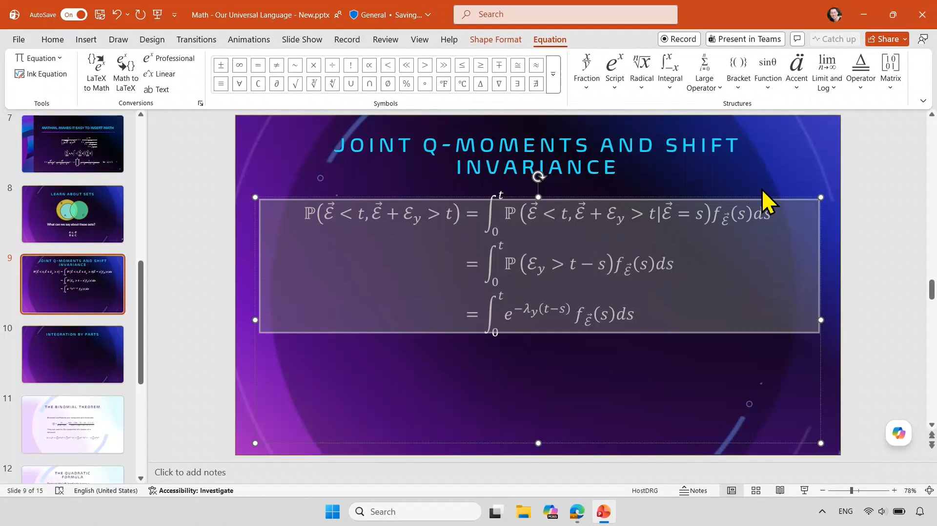
Copy/Pasting delimited LaTeX into PowerPoint

Slide 38
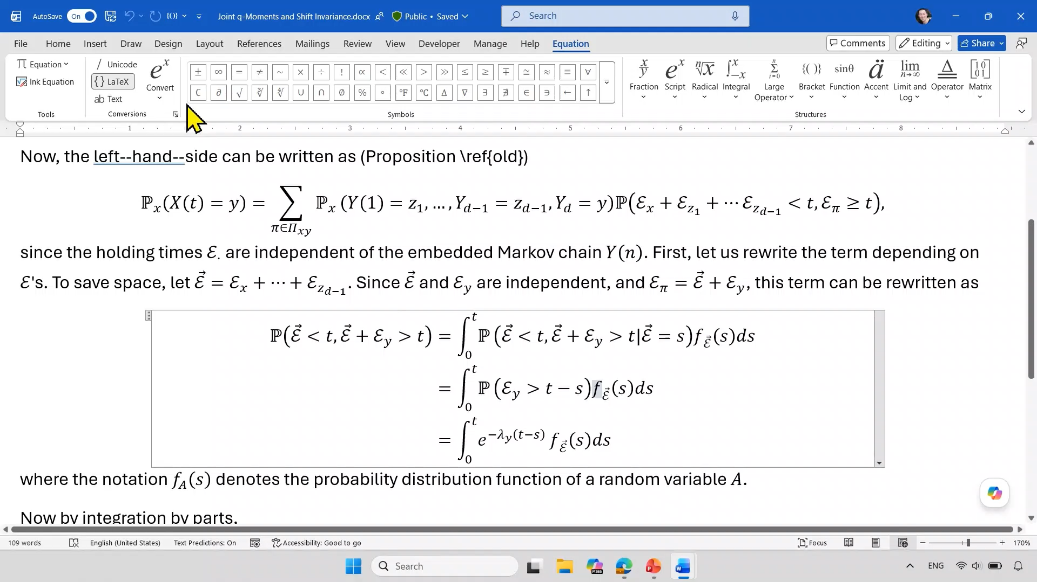
Convert Math to LaTeX and back to Math in Word

Slide 39
Math keyboard shortcuts
Word
 | Windows | Mac
Insert or toggle math | Alt+Equals | Control-Equals
LaTeX to Math | Ctrl+Alt+Equals | Command-Equals
Math to LaTeX | Ctrl+Alt+Shift+Equals | Command-Shift-Equals
PowerPoint
 | Windows | Mac
Insert or toggle math | Alt+Equals | Control-Option-Equals
LaTeX to Math | Ctrl+Alt+Equals | Command-Option-Equals
Math to LaTeX | Ctrl+Alt+Shift+Equals | Command-Option-Shift-Equals
Notes:
Keyboard shortcuts make it faster to write math in LaTeX. Especially since Office doesn’t automatically convert as you type while using LaTeX.

Slide 40
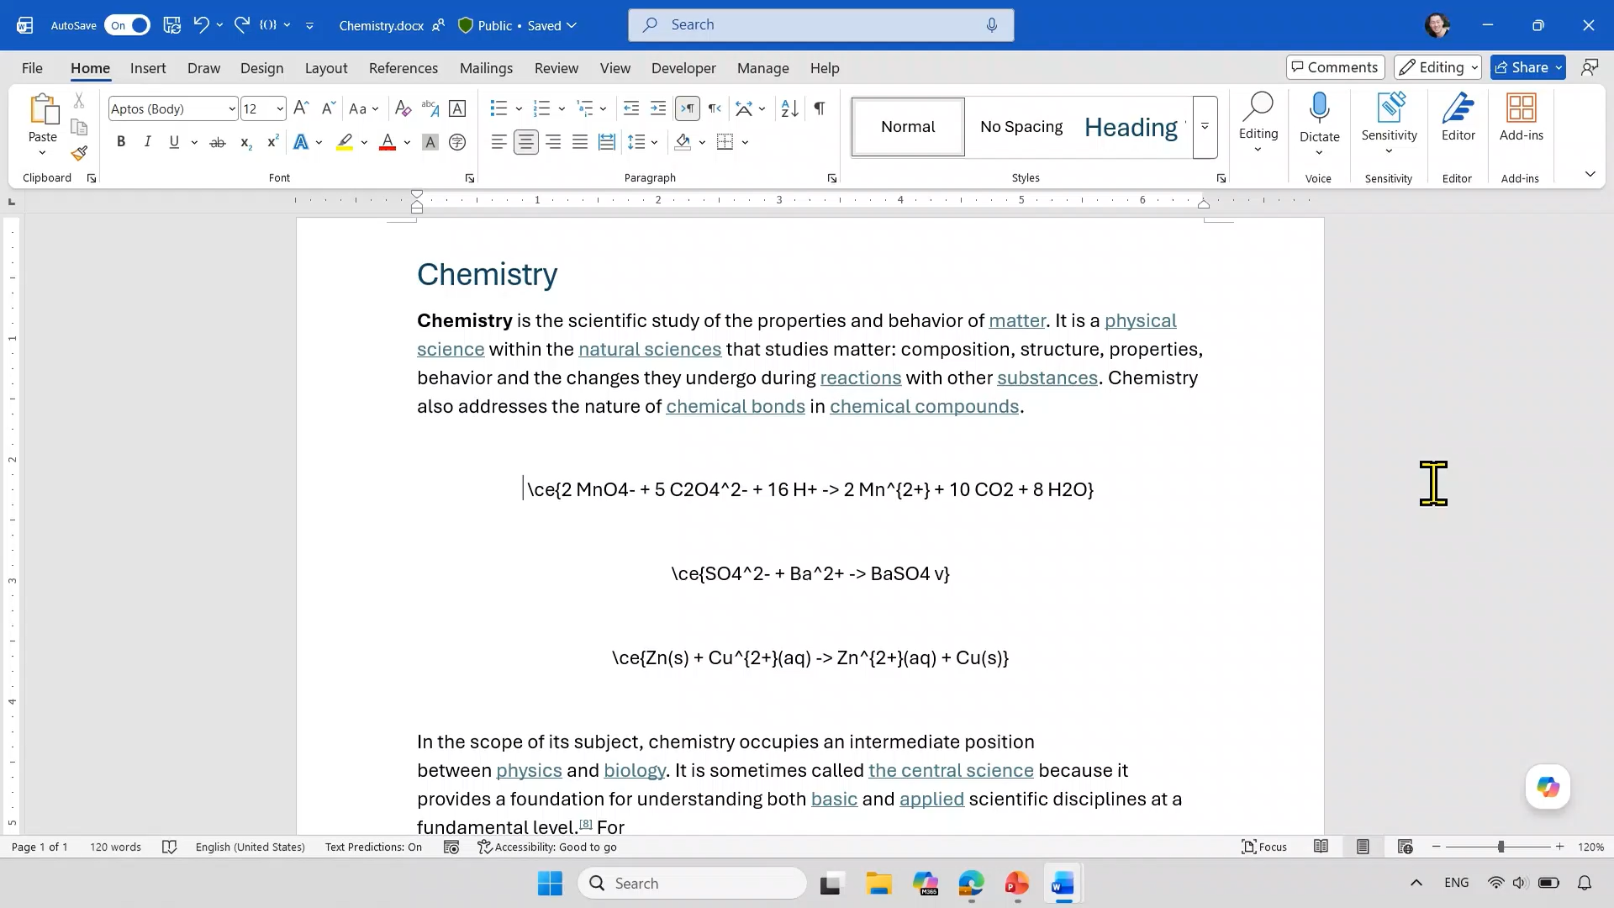
Use LaTeX for chemical formulas and equations

Slide 41
Impact: accessible math from LaTeX in Microsoft 365
377k
users/month
3.6M
equations/month

Slide 42
Export accessible math in PDF
Word and PowerPoint

Slide 43


Microsoft 365 exports PDF with accessible math using MathML
AI
Web Content
Apps
MathML
MathML
MathML
Browsers
MathML
EPUB
MathML
MathML
LaTeX
TeX
Microsoft 365
PDF
LaTeX
MathML
MathML
MathML
MathML
MathML
Assistive Tech

Slide 44
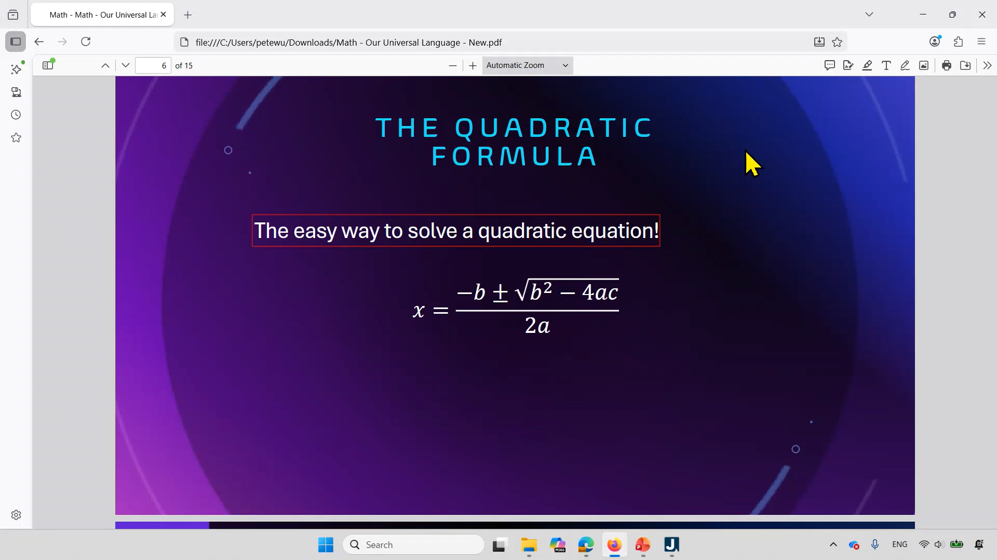
Reading math in PDF exported by PowerPoint with Firefox + JAWS Math Viewer
Notes:
Coming soon: PDFs exported by PowerPoint will contain MathML that Adobe Reader + JAWS and NVDA can read.
In this example, the JAWS Math Viewer works on the math in the PDF exported by PowerPoint and can be used to read the math part-by-part.

Slide 45
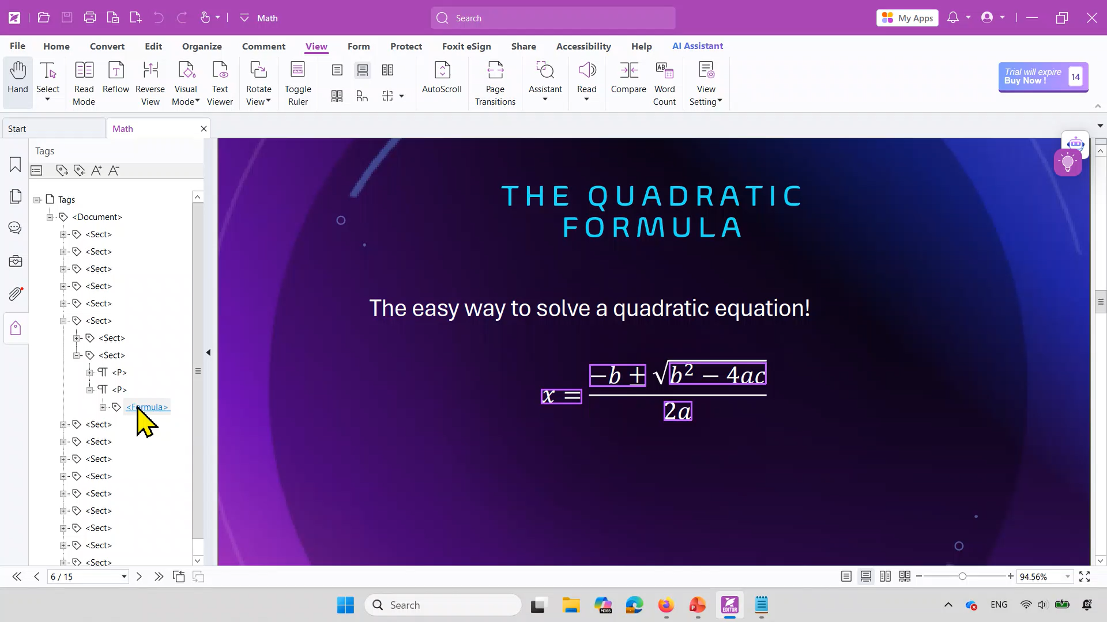
MathML in an associated file in PDF/UA
Notes:
The MSFT_MathML custom attribute on the <Formula> tag in PDF/UA is what makes this possible.

Slide 46
Impact: accessible math in PDF from Microsoft 365
2M
users/month
347M
equations/month

Slide 47
Convert Equation Editor and MathType Objects to Office Math
Word and PowerPoint for Windows and Mac

Slide 48
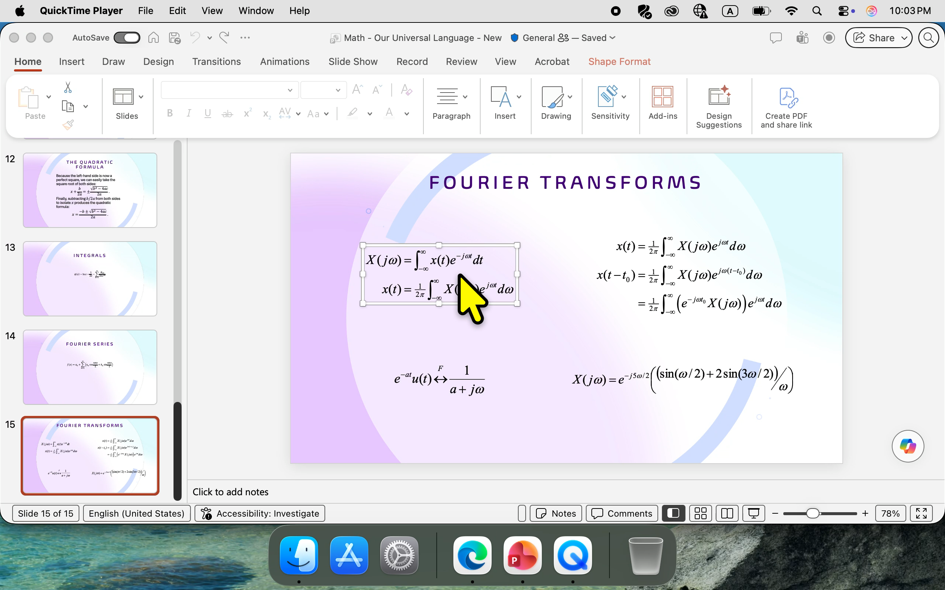
Convert to Office Math and Convert All to Office Math on the context menu in PowerPoint for Mac

Slide 49


Your Next Steps
Share your feedback
Explore session materials
aka.ms/AbilitySummit2026Survey
aka.ms/AbilitySummitResources

Slide 50
Microsoft 365 has robust support for MathML and LaTeX that make it easy to create accessible math
Microsoft 365 makes native math accessible using MathML.
Users can understand math in Microsoft 365 with JAWS, NDVA, VoiceOver, and TalkBack which use math speech and MathML provided by Microsoft 365.
It's easy to bring accessible math into Microsoft 365 using MathML.
Copy/paste MathML from math apps such as MathType. MathPix, Equatio, iMathEQ, and xFormula.
Copy/paste MathML in HTML from AI chatbots including Copilot, ChatGPT, Claude, and Grok and websites such as Wikipedia, arxiv, Math Stack Exchange, and NIST in any major browser (Edge, Chrome, Firefox, Opera, or Safari).
LaTeX authors produce the accessible math on the web and they can produce accessible math in Microsoft 365 as well.
LaTeX authors using Overleaf with Tex Live or LuaLaTeX or Canvas produce most of the accessible math on the web.
These authors can use LaTeX to produce accessible math in Microsoft 365 as well.
Microsoft 365 exports PDF with accessible math using MathML.
PDF Viewer such as Adobe Reader, Foxit, and Firefox take the MathML in PDF and expose it in the accessibility tree for assistive technologies such as JAWS, NVDA, VoiceOver, and TalkBack to use.

