Slide 1




Reading and Writing Math with a Screen Reader: 3rd edition
Friday, March 13, 2026
daisy.org/csun
daisy.org
Notes:
Witness math creation using JAWS and NVDA. Over the past year the Microsoft team made major improvements in the interface and documentation of Microsoft Word and PowerPoint. We’ll cover the current state and look at what is coming.

Slide 2




Introducing
Clint Covington
George Kerscher
Peter Wu
Richard Orme

Slide 3
Show Your Working
DAISY accessible math group
CSUN edition #1 in 2024 - baseline
  DAISY reached out to Microsoft
  Bug reports and documentation
CSUN edition #2 in 2025 - docs and hacks
  Prioritizing and validating improvements
CSUN edition #3 - inbox accessibility
  From grassroots to global

Slide 4




Heroes Who Count
DAISY math working group
Story telling and compelling video reports engaged engineering

Slide 5
Improved accessibility of reading and editing math in Microsoft 365
Writing and presenting about math is easy and inclusive with Microsoft 365 (August 2025)
Make math inclusive for everyone with Microsoft 365 (February 2026)

Slide 6
Provide Feedback with Sound
Word, Excel, PowerPoint, and OneNote for Windows

Slide 7
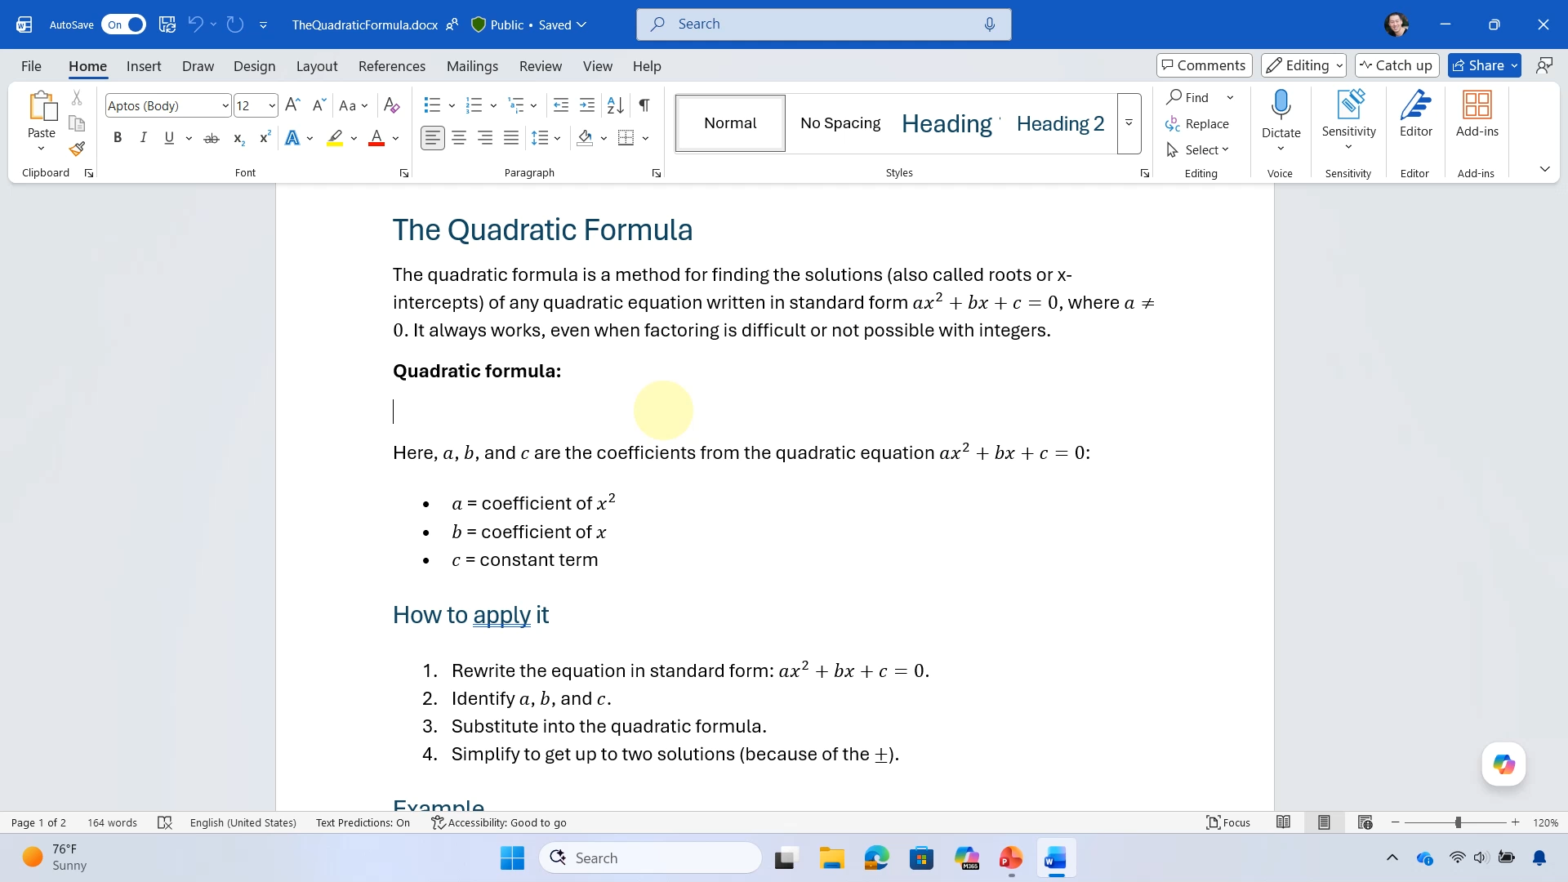
Provide Feedback with Sound in Word for Windows

Slide 8

Typing math using UnicodeMath in Word for WIndows

Slide 9
Reading math with NVDA and MathCAT
Word for Windows

Slide 10
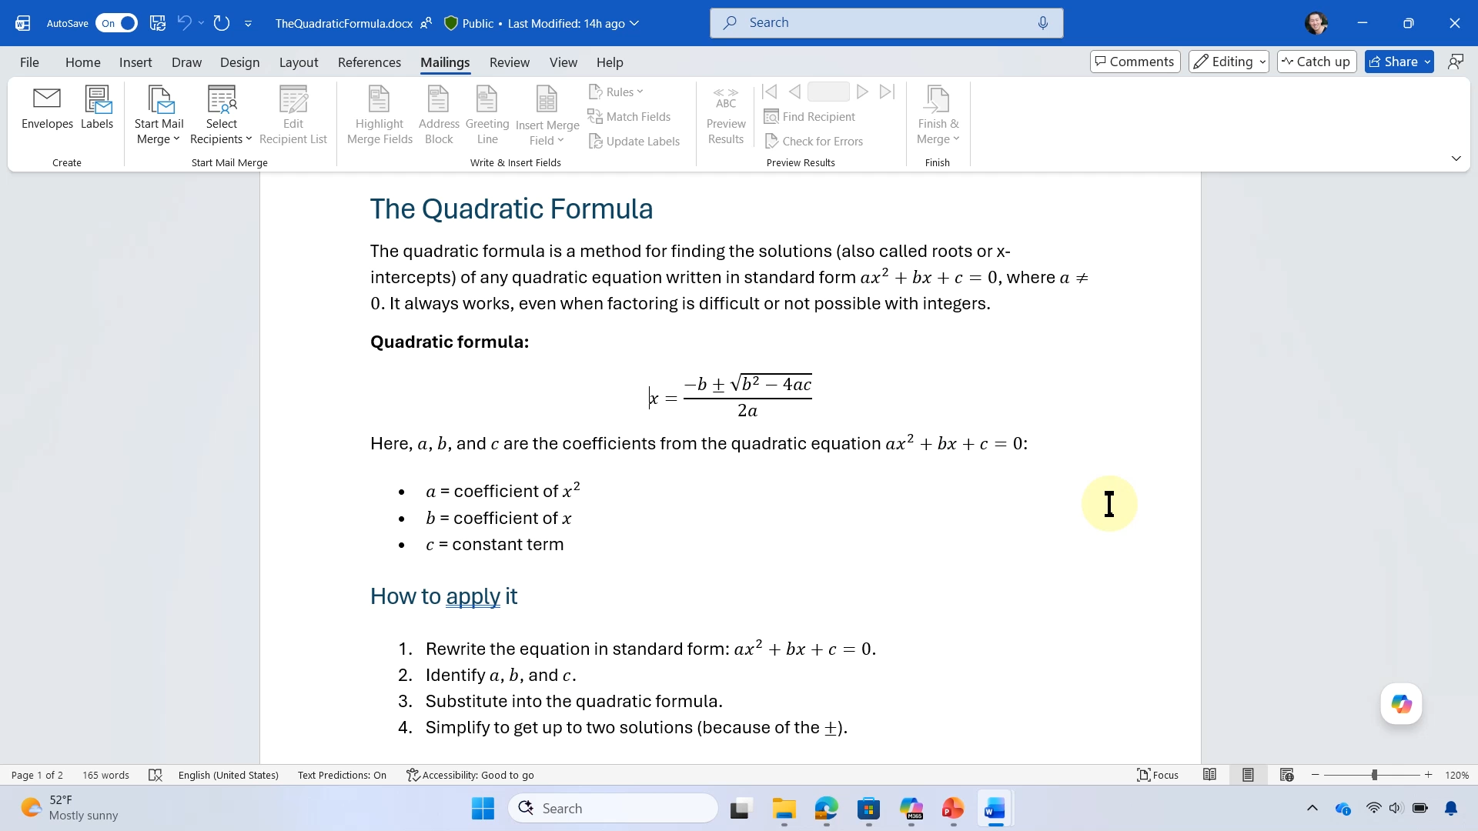
Reading math with NVDA and MathCAT in Word for Windows
⇨
⇩ (2x)
⇩
⇨
⇩
⇦
⇨
⇩
⇨ (2x)
⇨
NVDA + Alt + M
⇨

Slide 11
Additional context when editing math with a screen reader
Word, Excel, PowerPoint, and OneNote for Windows

Slide 12
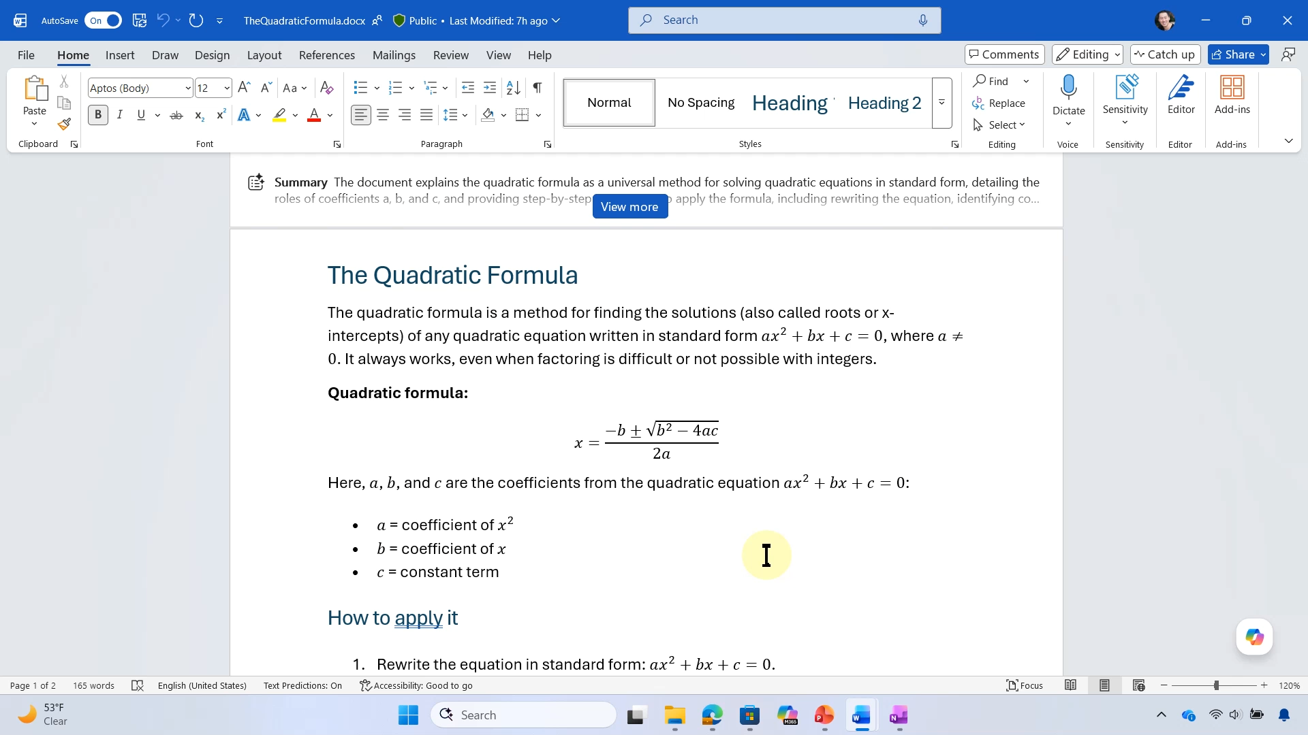
Navigate math in Word for Windows with NVDA

Slide 13
100+ additional math autocorrect codes
Word, Excel, PowerPoint, and OneNote for Windows and Mac

Slide 14
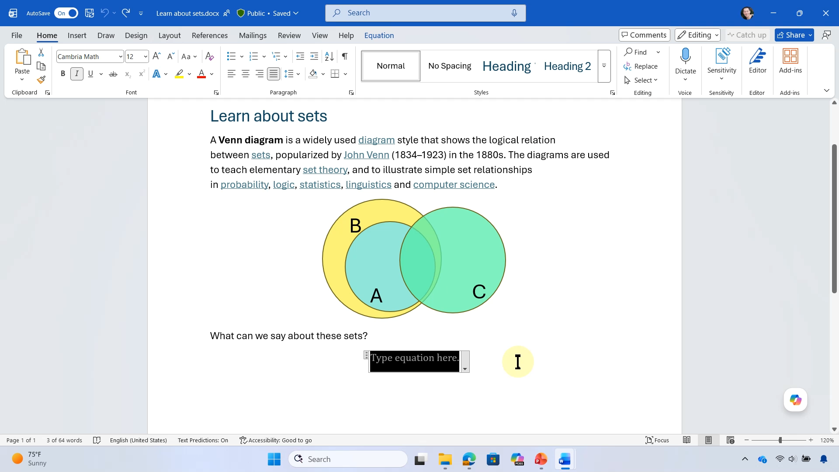
Math autocorrect

Slide 15
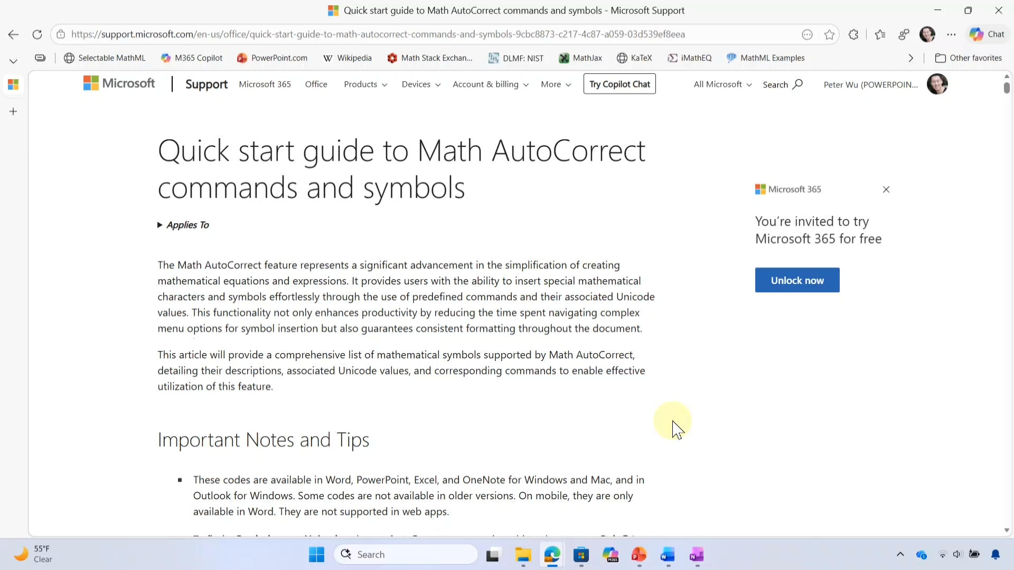
Math autocorrect

Slide 16
Improved math reading with a screen reader
Word, Excel, PowerPoint, and OneNote on all platforms
PowerPoint Live in Teams

Slide 17
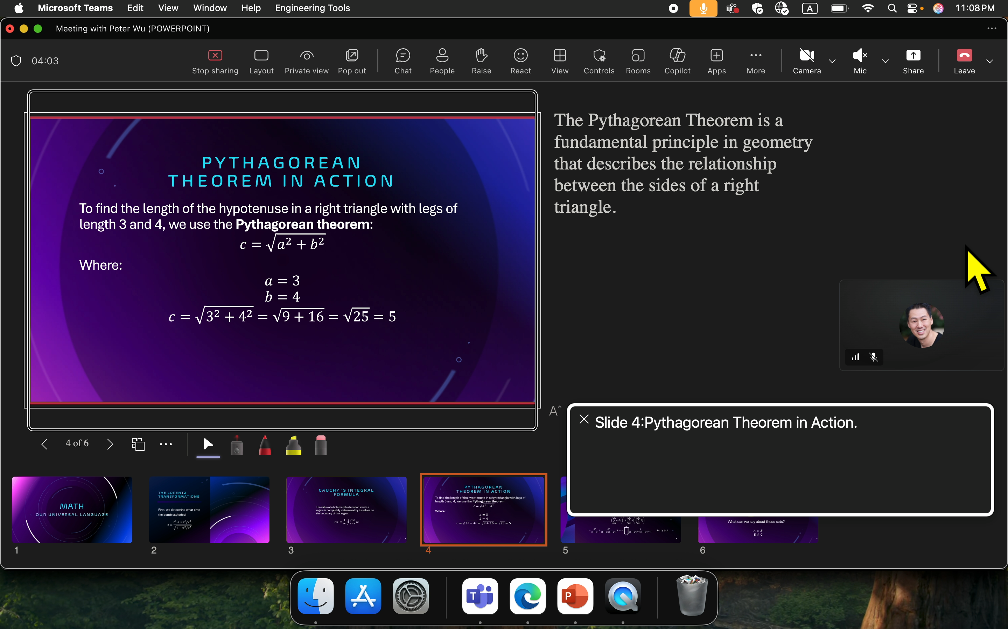
Reading math on the slide in PowerPoint Live in Teams using VoiceOver

Slide 18
Easier to create and edit native math in Microsoft 365

Slide 19
Enter and edit math in LaTeX
Word, Excel, PowerPoint for Windows and Mac

Slide 20
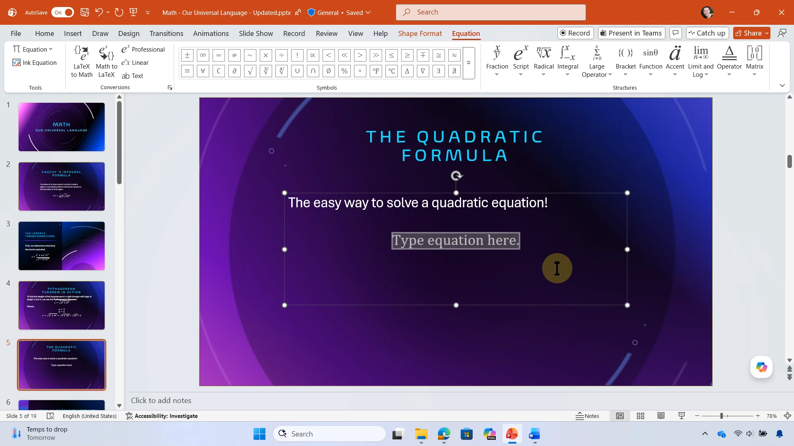
LaTeX in PowerPoint for Windows

Slide 21
Math keyboard shortcuts
Word
 | Windows | Mac
Insert or toggle math | Alt+Equals | Control-Equals
LaTeX to Math | Ctrl+Alt+Equals | Command-Equals
Math to LaTeX | Ctrl+Alt+Shift+Equals | Command-Shift-Equals
PowerPoint
 | Windows | Mac
Insert or toggle math | Alt+Equals | Control-Option-Equals
LaTeX to Math | Ctrl+Alt+Equals | Command-Option-Equals
Math to LaTeX | Ctrl+Alt+Shift+Equals | Command-Option-Shift-Equals
Notes:
Keyboard shortcuts make it faster to write math in LaTeX. Especially since Office doesn’t automatically convert as you type while using LaTeX.

Slide 22
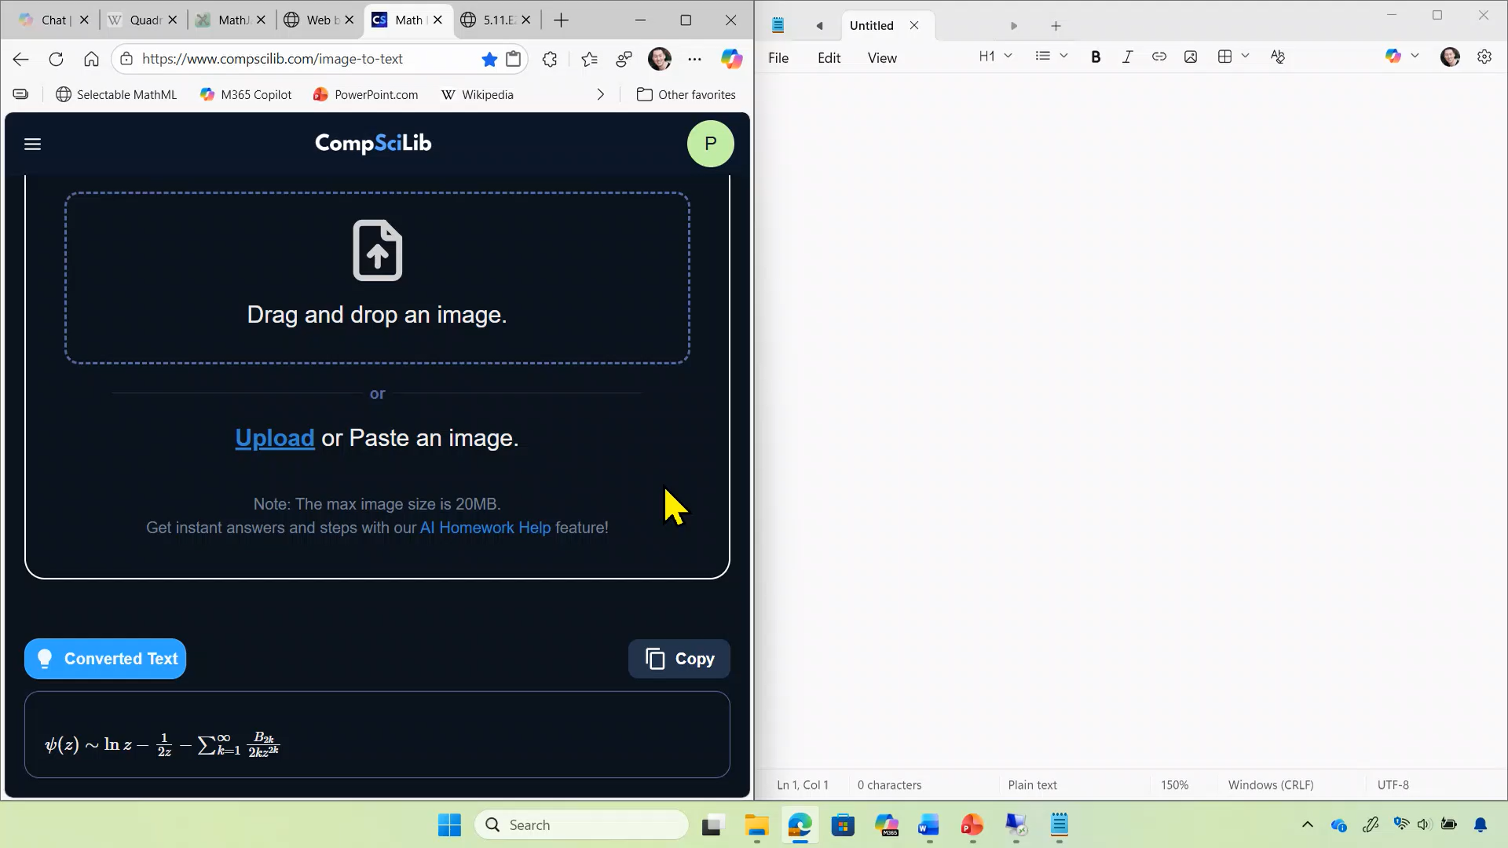
Paste text containing delimited LaTeX inserts native math in PowerPoint

Slide 23
Copy/paste math using MathML
Word, Excel, PowerPoint for Windows and Mac

Slide 24
Measuring Impact
180M
2.9M
86M
Monthly export to PDF with equations
Monthly users pasting equations
Monthly instances of new equations from HTML paste

Slide 25
Paste math from web and other apps
Word, Excel, PowerPoint for Windows and Mac

Slide 26
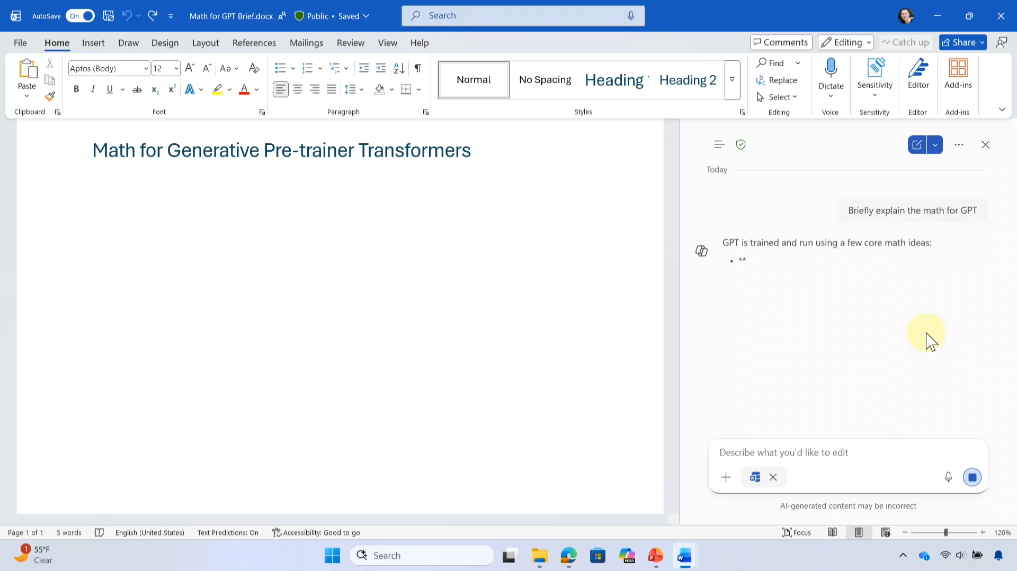
Copy math from Copilot Pane, paste into Word for Windows

Slide 27
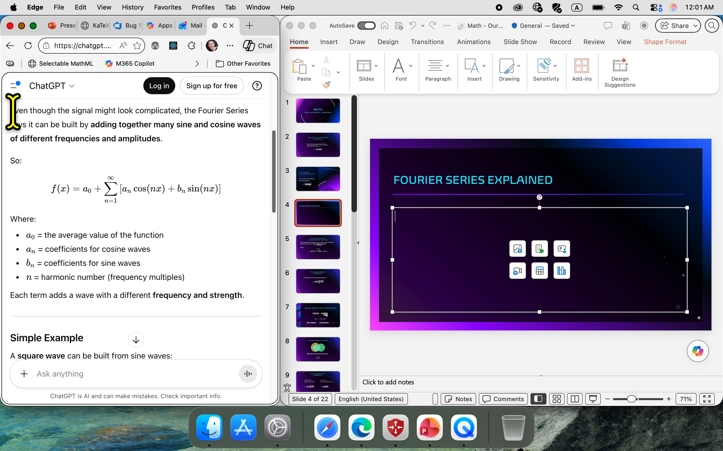
Copy math from ChatGPT in Edge; Paste into PowerPoint for Mac

Slide 28
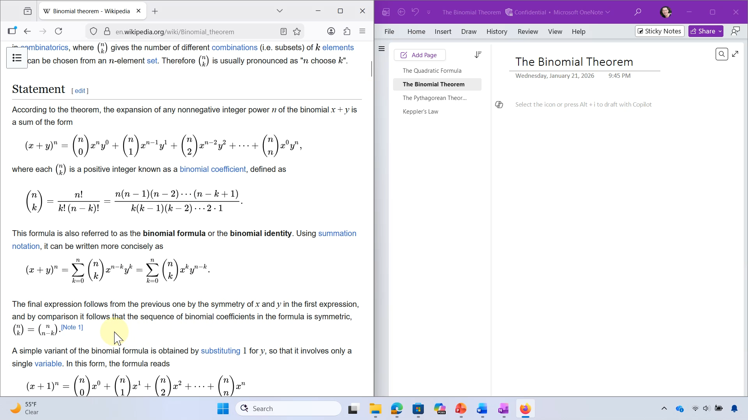
Copy math from Wikipedia in Firefox, Paste into OneNote for Windows

Slide 29
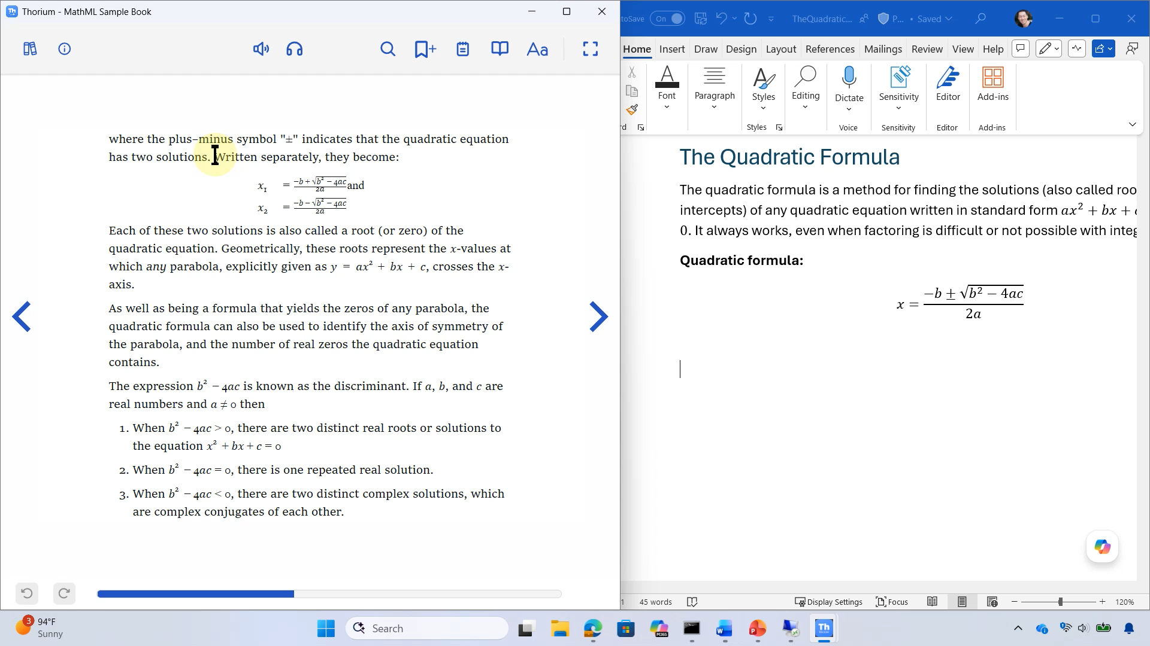
Copy math from Thorium ePub reader into Word for Windows

Slide 30
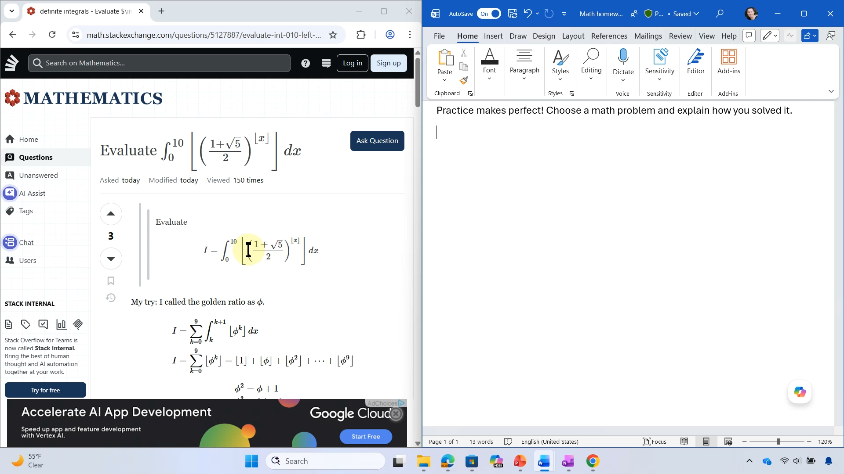
Copy math from Math Stack Exchange, one at a time using MathJax MathML window, paste into Word for Windows

Slide 31
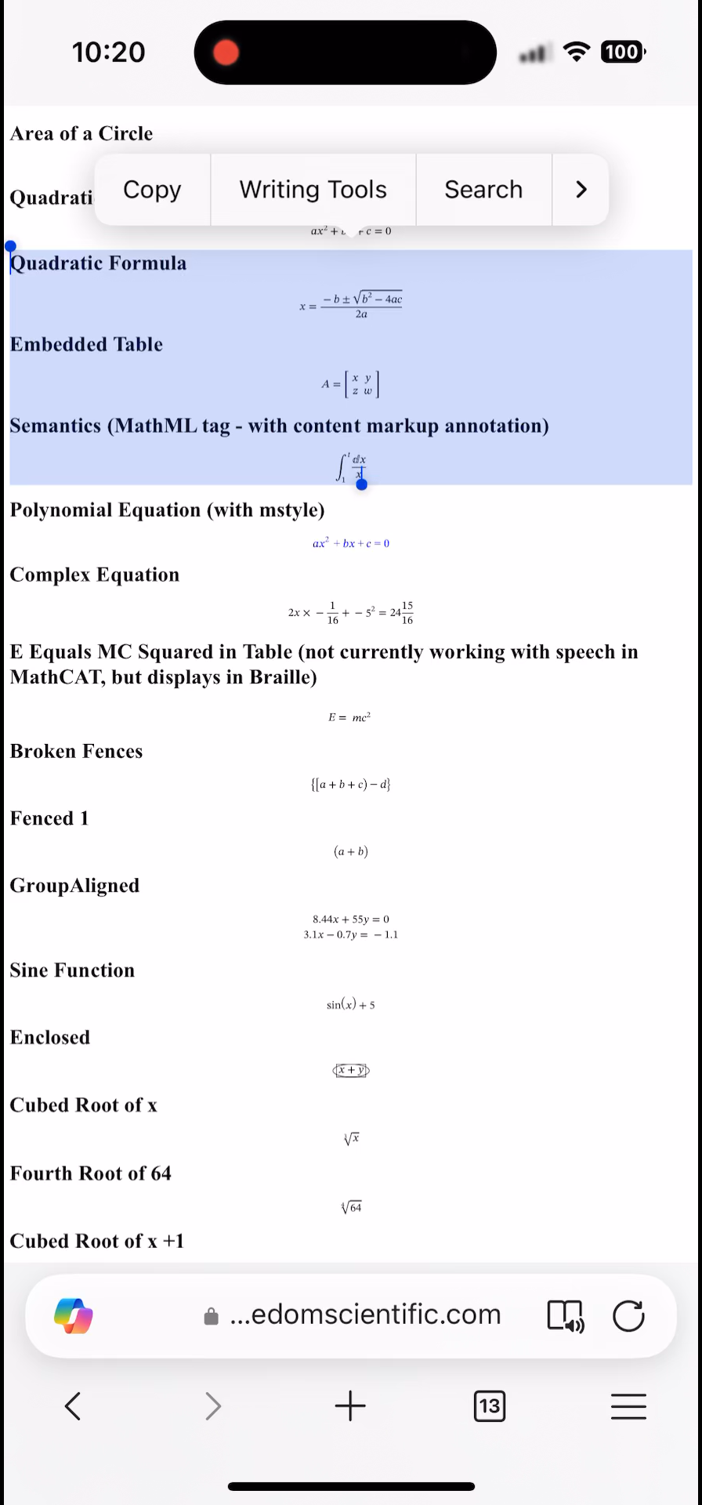
Copy MathML in HTML in Edge to PowerPoint on iOS

Slide 32
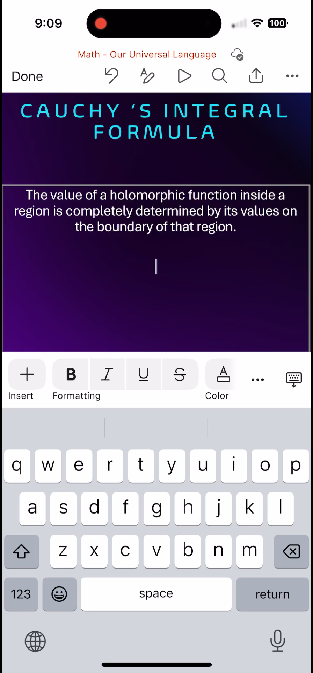
xFormula keyboard in PowerPoint for iOS

Slide 33
Copy math and paste in other apps
Word, Excel, PowerPoint for Windows and Mac

Slide 34
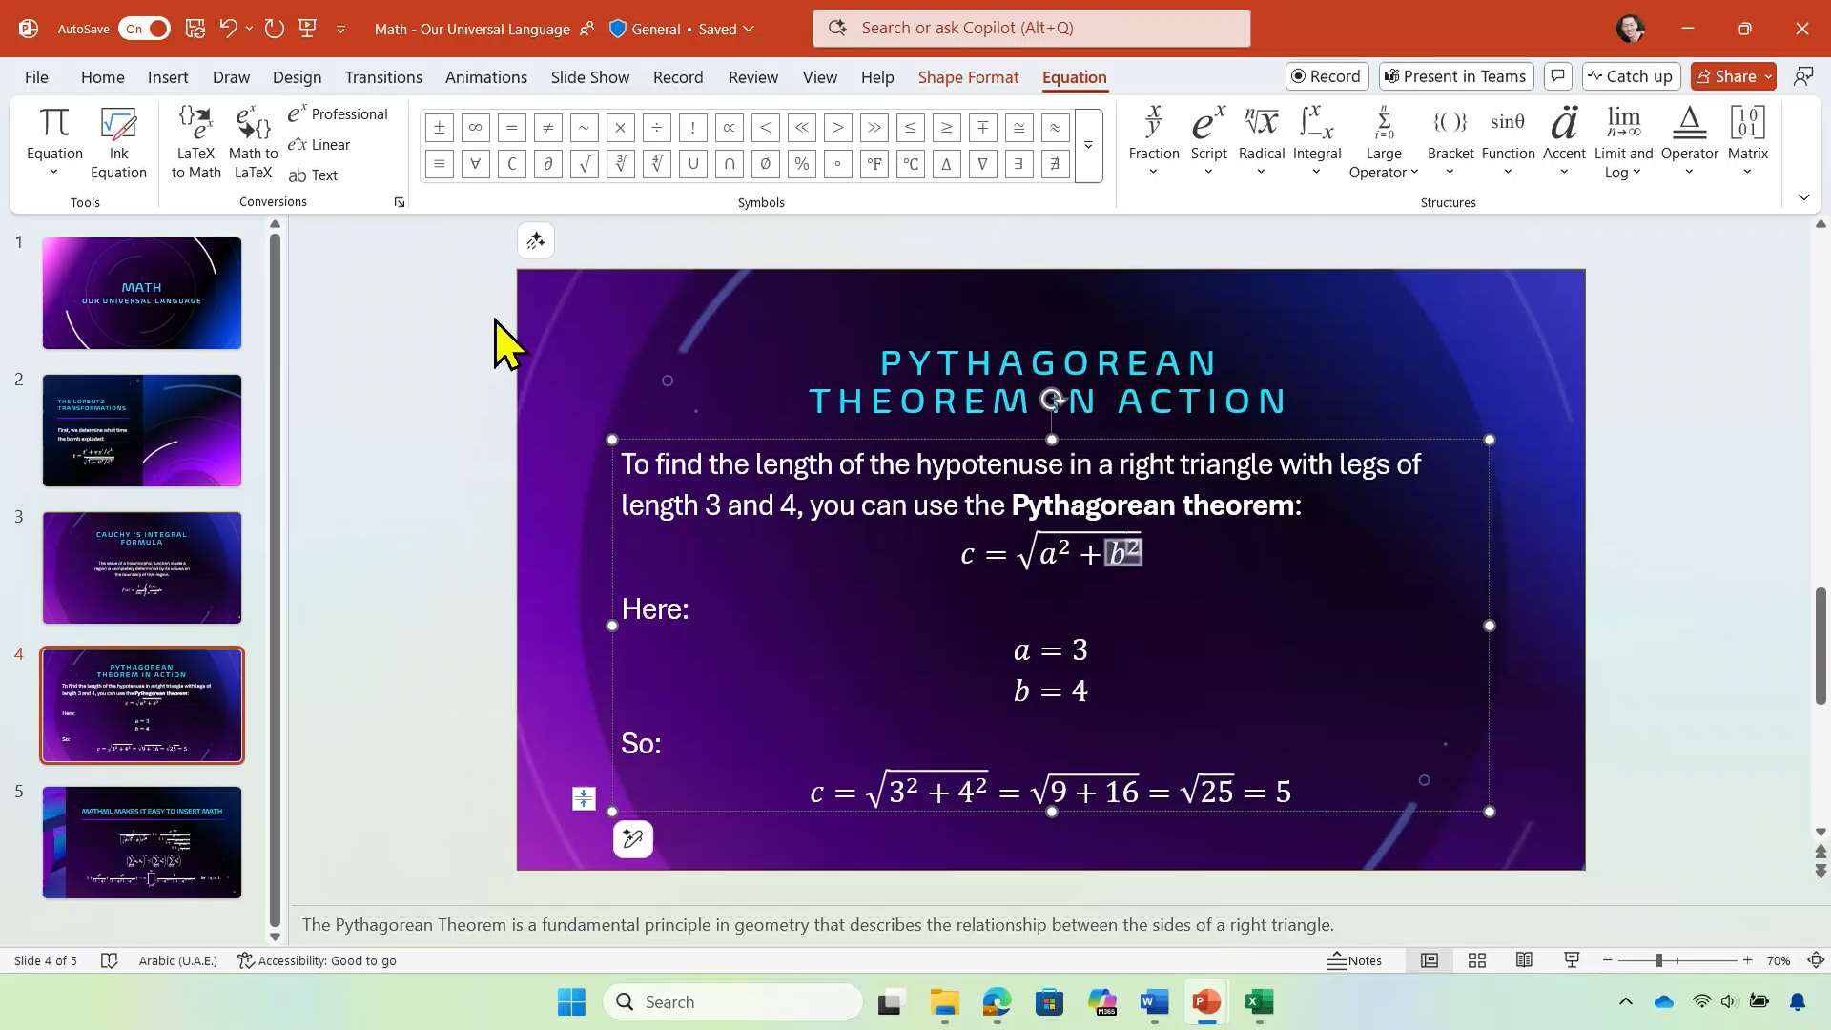
Turn on Copy as MathML in PowerPoint for Windows

Slide 35
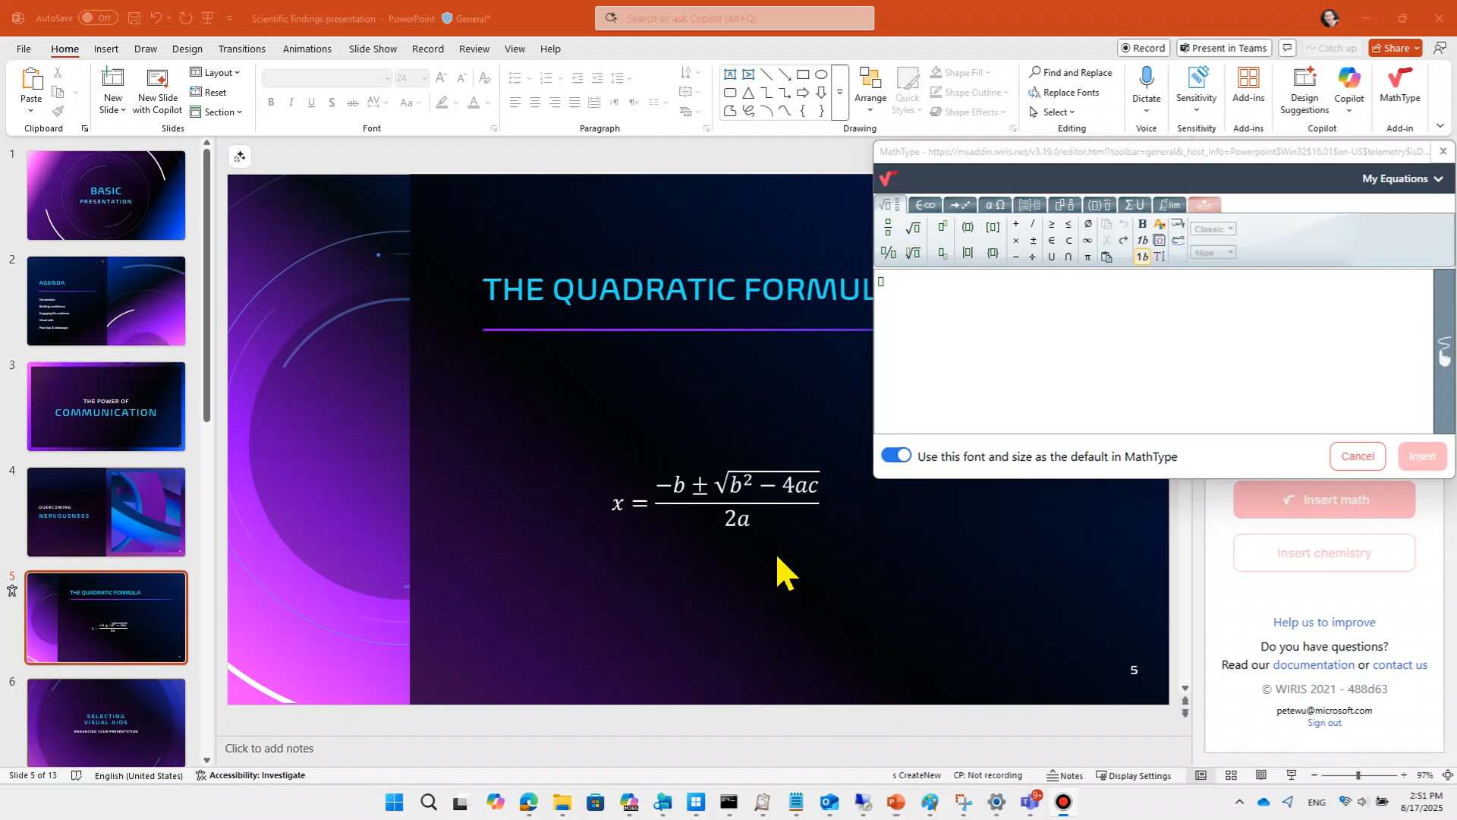
Copy MathML from PowerPoint for Windows to MathType

Slide 36
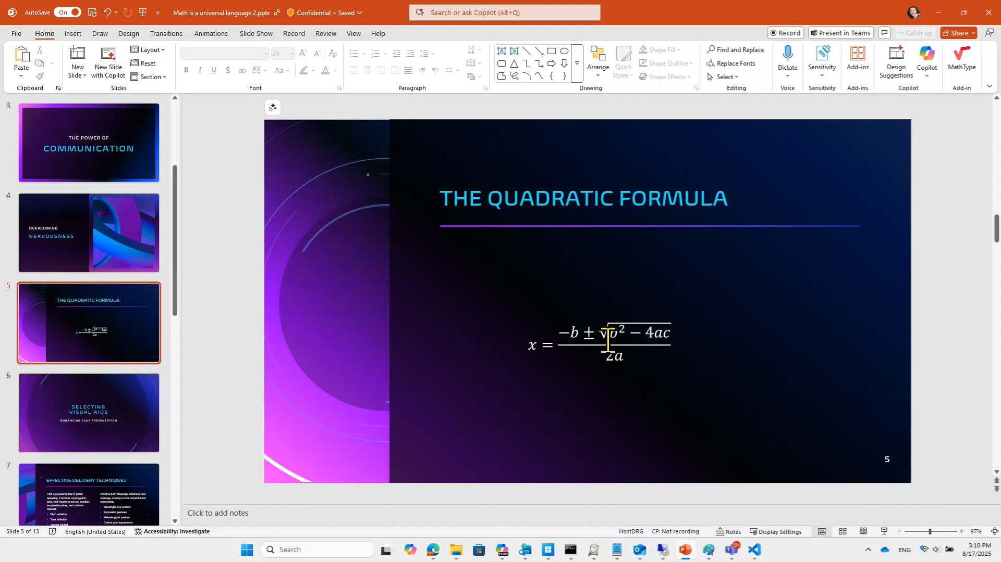
Copy MathML from PowerPoint for Windows to HTML source of webpage

Slide 37
Convert Equation Editor and MathType objects to Office Math
Word, Excel, PowerPoint for Windows and Mac

Slide 38
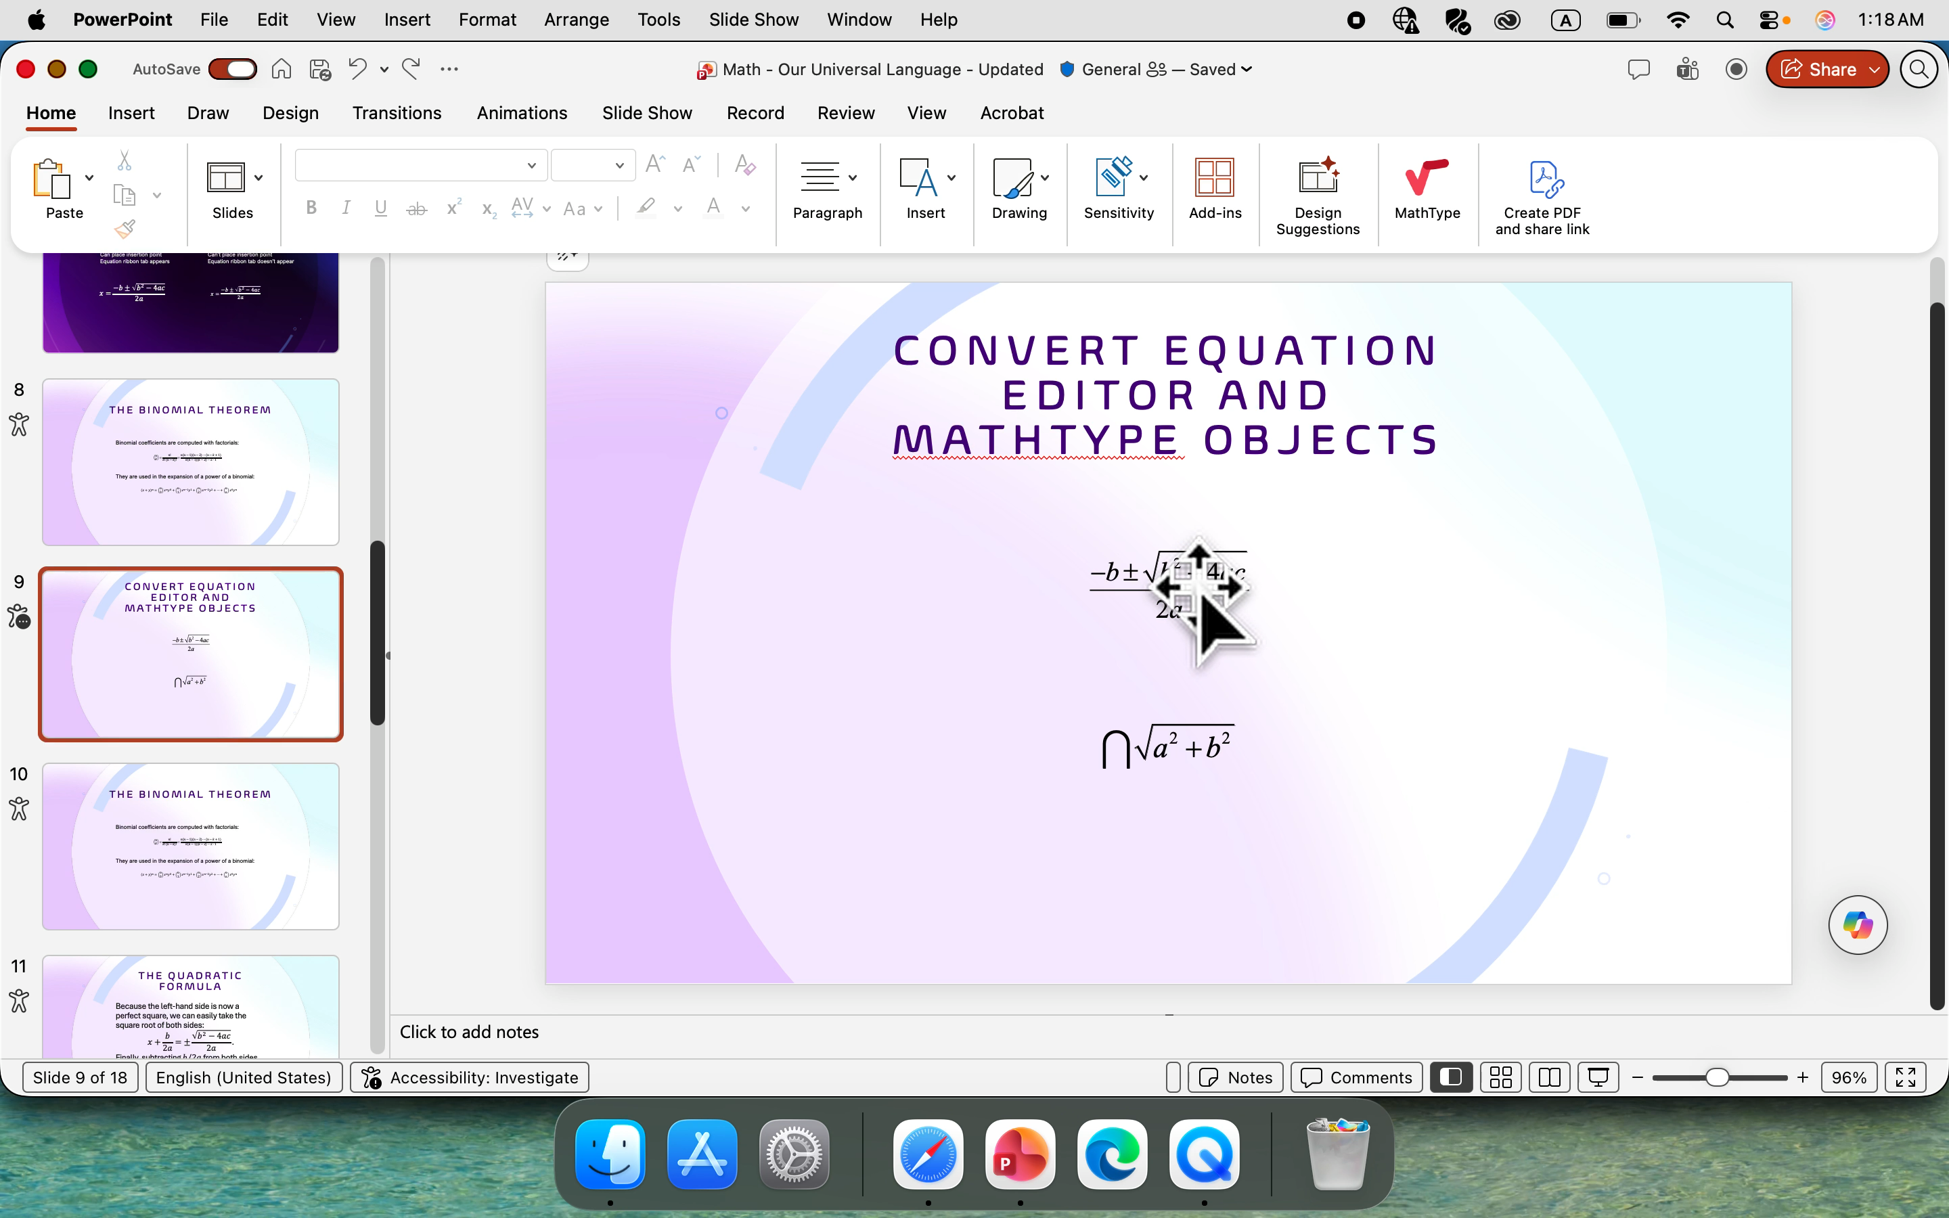
Convert to Office Math and Convert All to Office Math on the context menu in PowerPoint for Mac

Slide 39
Math reading experience for PDF with Adobe Reader + JAWS and NVDA
Word and PowerPoint

Slide 40
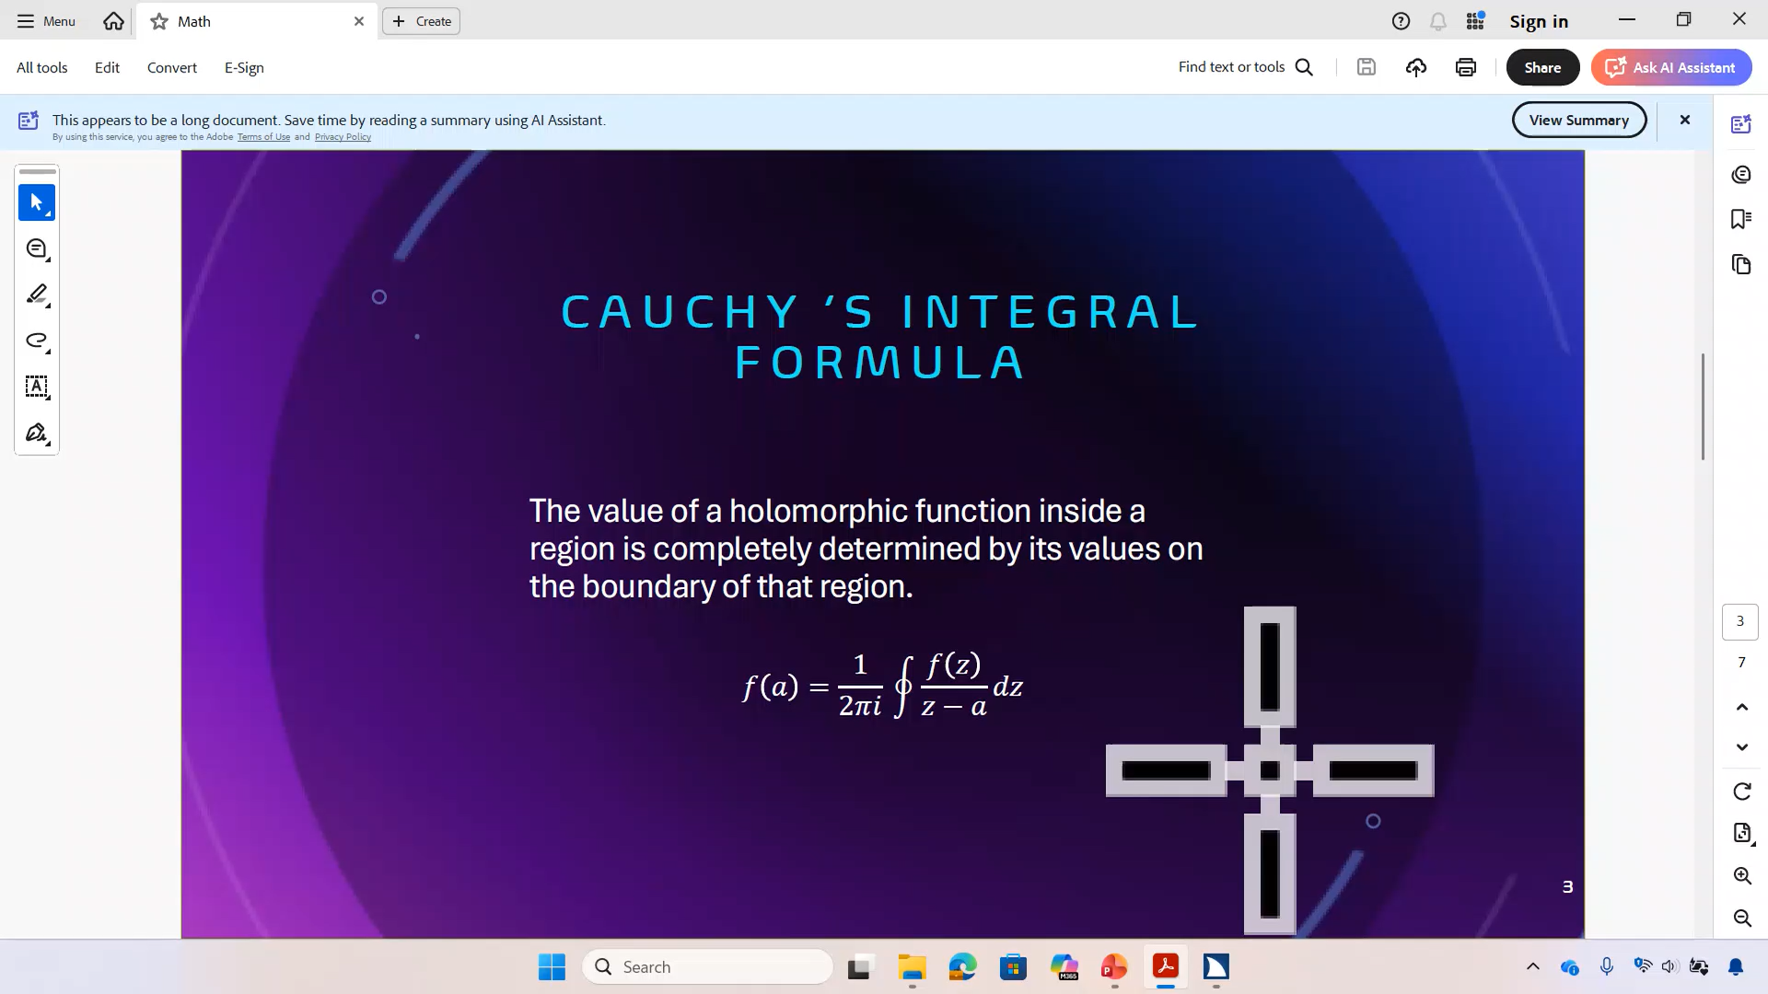
Reading math in PDF exported by PowerPoint with Adobe Reader + JAWS Math Viewer
Notes:
Coming soon: PDFs exported by PowerPoint will contain MathML that Adobe Reader + JAWS and NVDA can read.
In this example, the JAWS Math Viewer works on the math in the PDF exported by PowerPoint and can be used to read the math part-by-part.

Slide 41
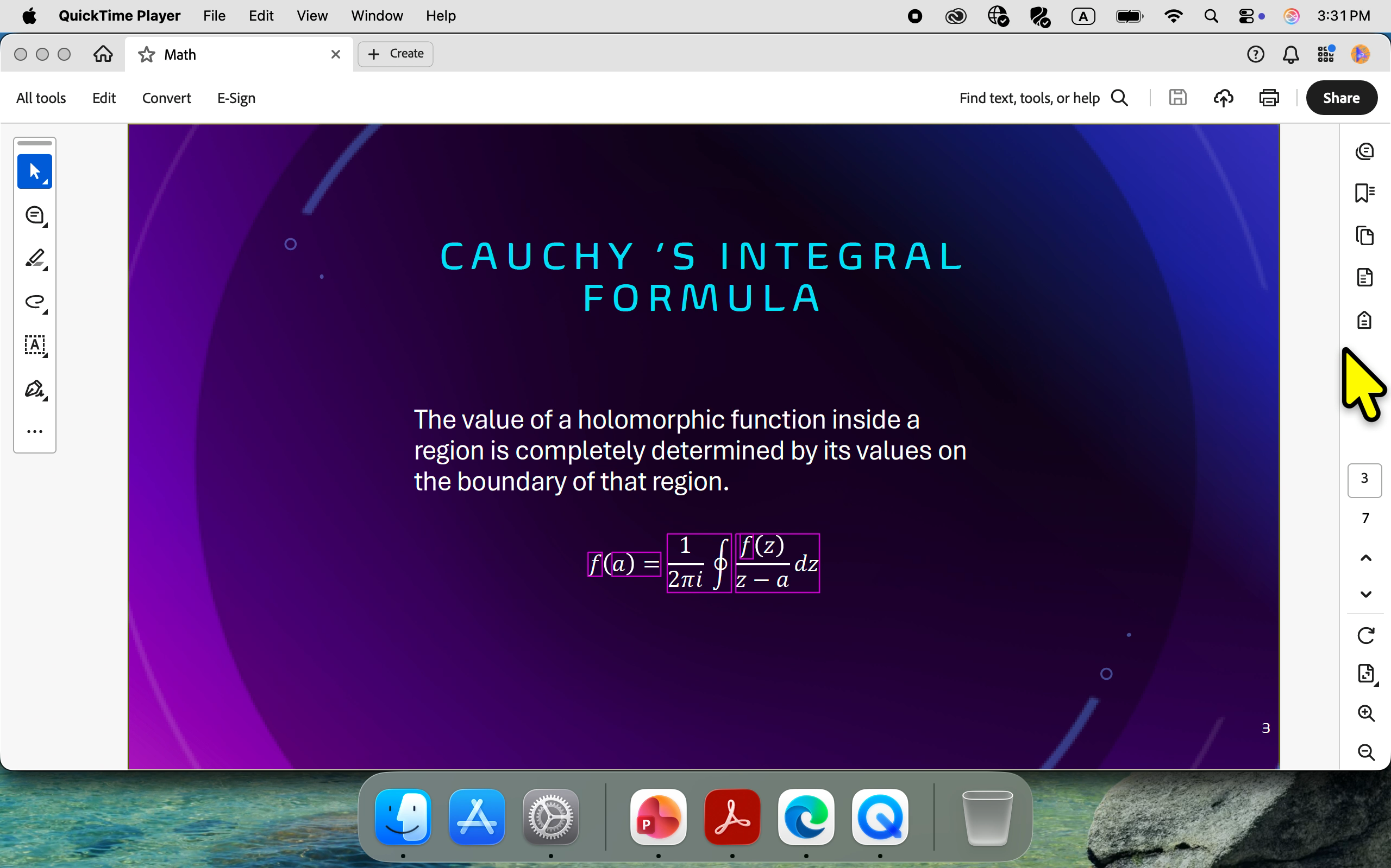
The MSFT_MathML custom attribute in PDF/UA
Notes:
The MSFT_MathML custom attribute on the <Formula> tag in PDF/UA is what makes this possible.

Slide 42

Resources
Visit daisy.org/csun to:
Connect with presenters
Download the slide deck
Links to resources
Videos from this session
daisy.org/csun

Slide 43

Thanks for coming!
daisy.org/csun

